Slide 1
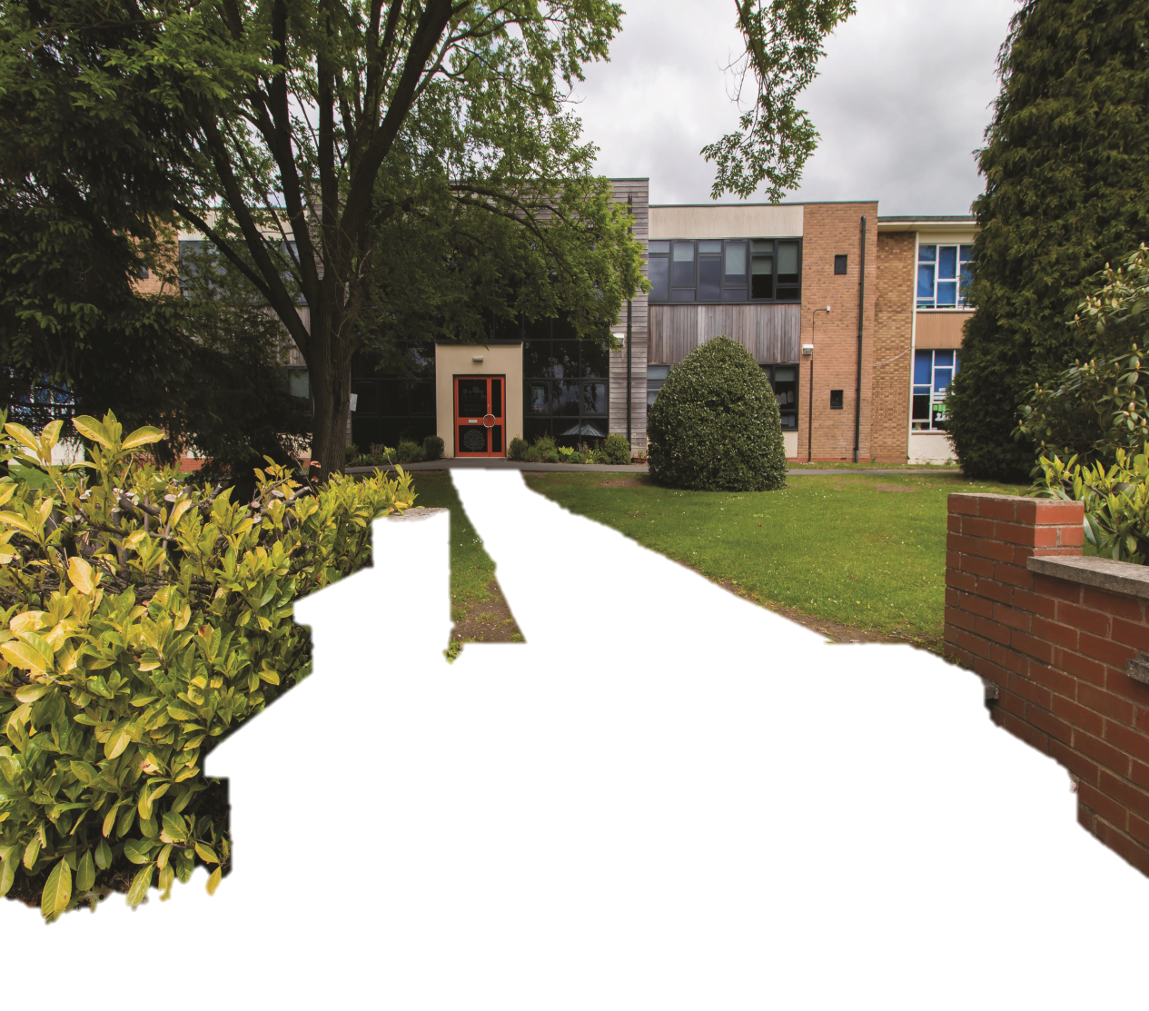

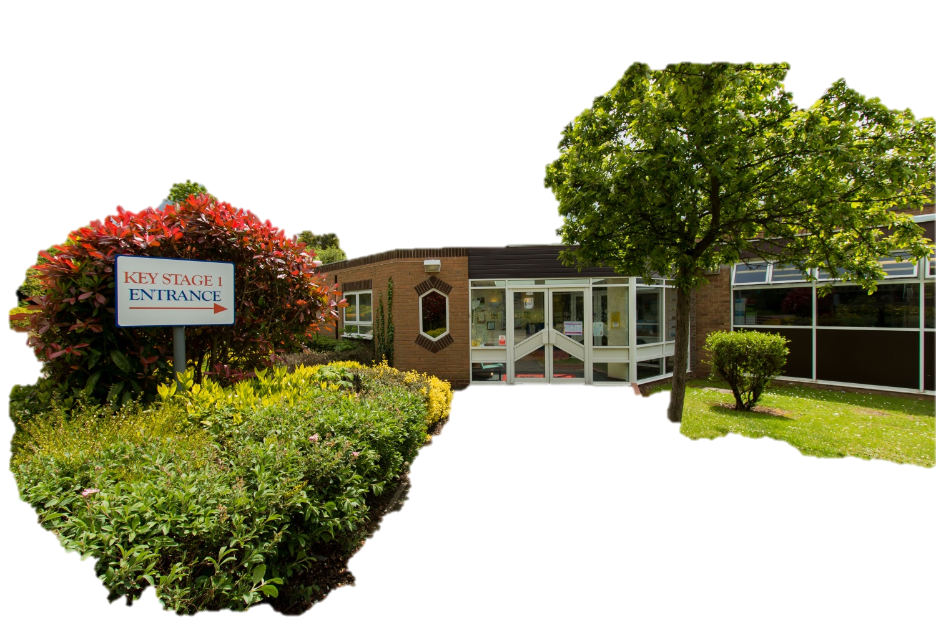

Notes:
Gemma- welcome and intro SMT. Little bit about the school (3 form entry, Nursery- year 6 mainstream school) Happy, nurturing, high achieving school.

Slide 2

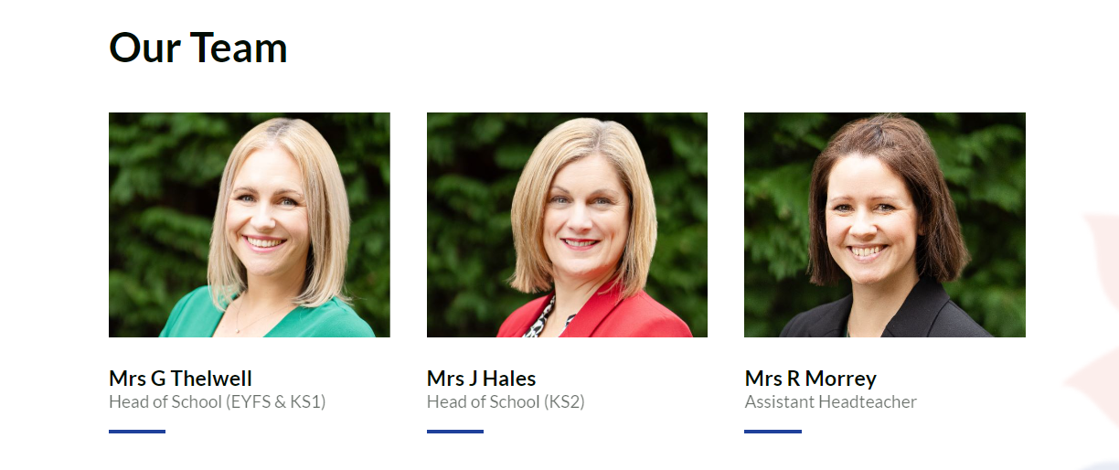
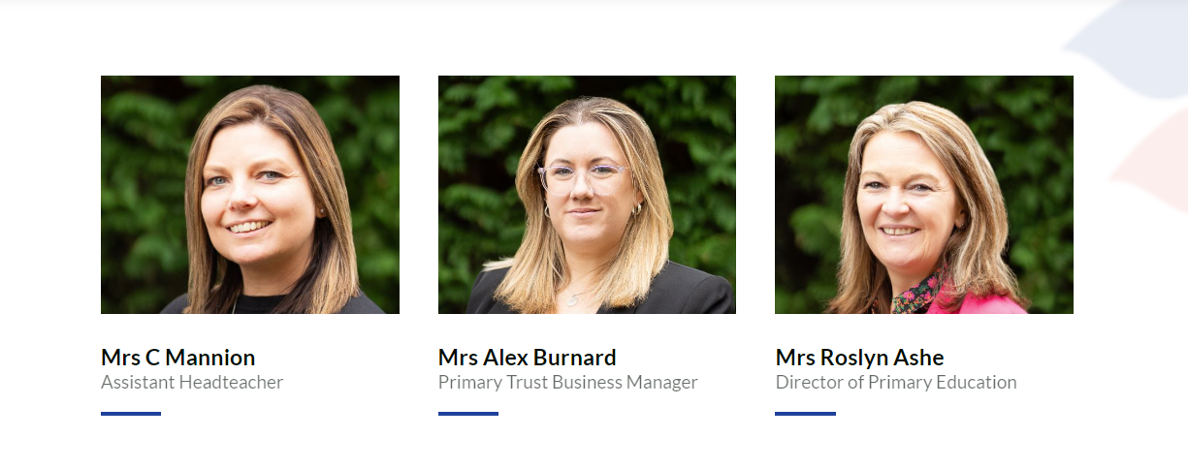
Notes:
Meet our team- open door. Friendly and approachable. You’ll see us on the gate everyday

Slide 3

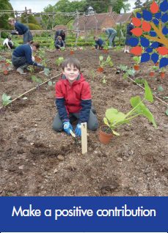


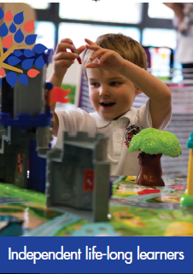
Dorridge Primary School Values
Notes:
Gemma- what these mean and why we have them as our core values

Slide 4
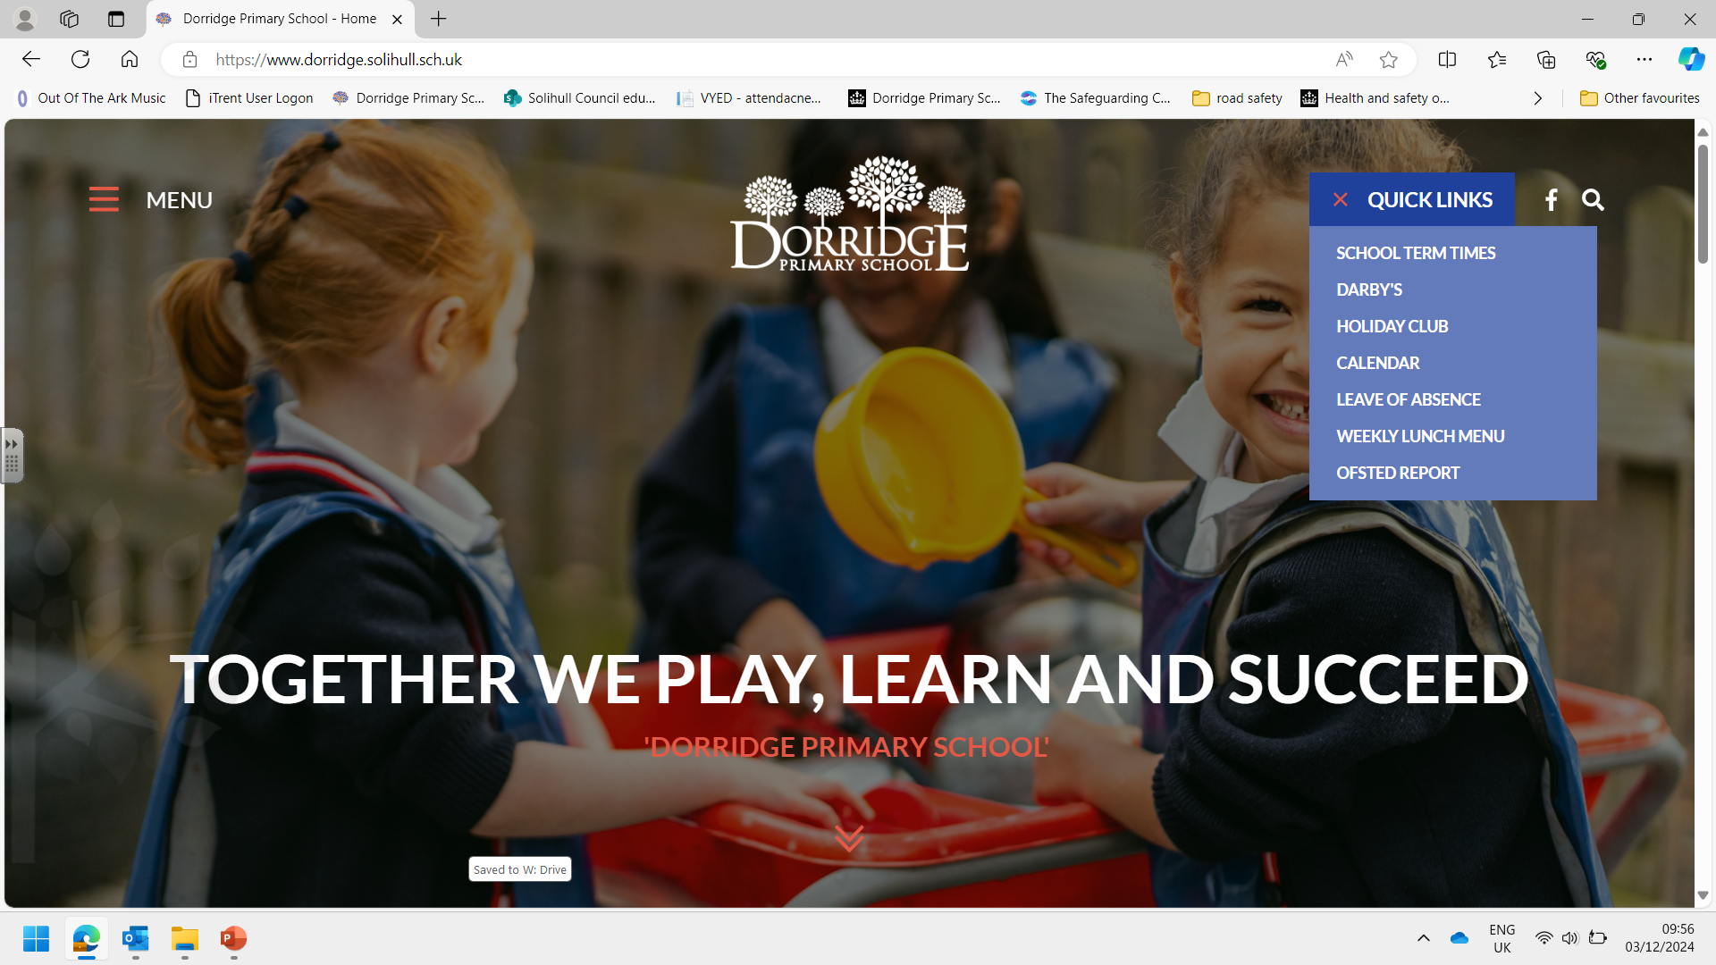
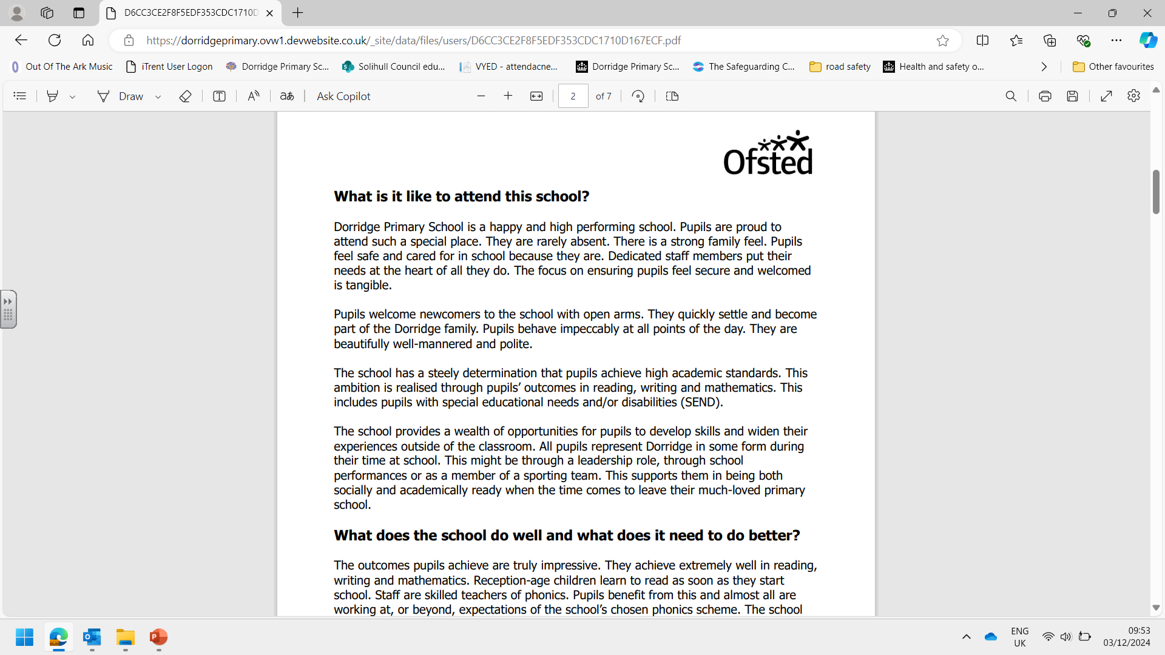
www.dorridge.solihull.sch.uk

Slide 5
Our School Improvement Priorities
2025-26
Key Priorities
Priority 1: To successfully embed the Kapow curriculum across all relevant subjects and year groups.
Priority 2: To strengthen pupils’ fluency and recall of multiplication tables across all year groups, enabling them to confidently apply number knowledge to real-life problem-solving contexts and deepen their mathematical understanding and reasoning skills.
Priority 3: To raise writing outcomes across all year groups by increasing the number of pupils achieving both the expected standard and greater depth through consistent teaching and targeted support.
Priority 4: To raise the profile of the pastoral team by providing regular, accessible early help support for families, including drop-in sessions, to strengthen home–school partnerships and improve pupil wellbeing.
Notes:
Gemma- to give a short overview of each priority

Slide 6
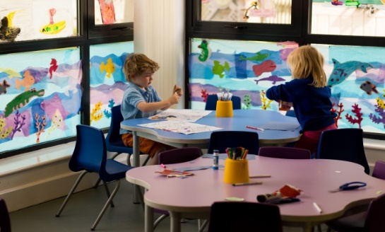

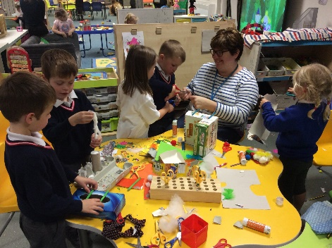

Nursery session: 5 mornings 8.30-11.30 M-F
We expect children to attend every morning – 15 hours
Extended provision:
Full time, M-F 5 full days a week
Part time – any other combination depending upon demand
Lunch: 11.30am - 12.30pm – payable
Darby's provides before and after school care on the school site all children, including Nursery and Reception.
All care is provided in our purpose built facility.
Children are escorted between Darby's and other parts of school
during change over periods by the class teacher/support staff.
The club operates between the following hours:
Breakfast session | All year groups | 7:45 am to 8:50 am
Lunch wraparound | Nursery only
Teatime session | All year groups | 3:30 pm to 6:00 pm
https://www.childcarechoices.gov.uk/
Notes:
Jodie- talk a lot about 30 hours.
We offer a fixed morning Nursery session 5 days a week, which is your child’s entitlement to 15 hours of free childcare. If you are a working parent, you may be entitled to additional free provision with the 30 hour funding.- this means your child can stay for an afternoon session too see next slide. If you don’t qualify, you may still pay for your child to attend this additional 3 hour a day session. Lunchtime care is not included within the 30 hour funding but is available to all parents at a small charge- this includes a hot meal and full supervision by our dedicated team. Currently, we provide full time care in Nursery D based in our KS1 building and NP is our part time offer which is 3 full days and 2 mornings and based in our Darby’s building. Both Nursery settings have a qualified teacher in post and your child will also have a TLSA key worker. Both Nursery’s offer the same learning opportunities and experiences. We are particularly delighted with our new play area at NP which you’ll see on our tour later.

Slide 7
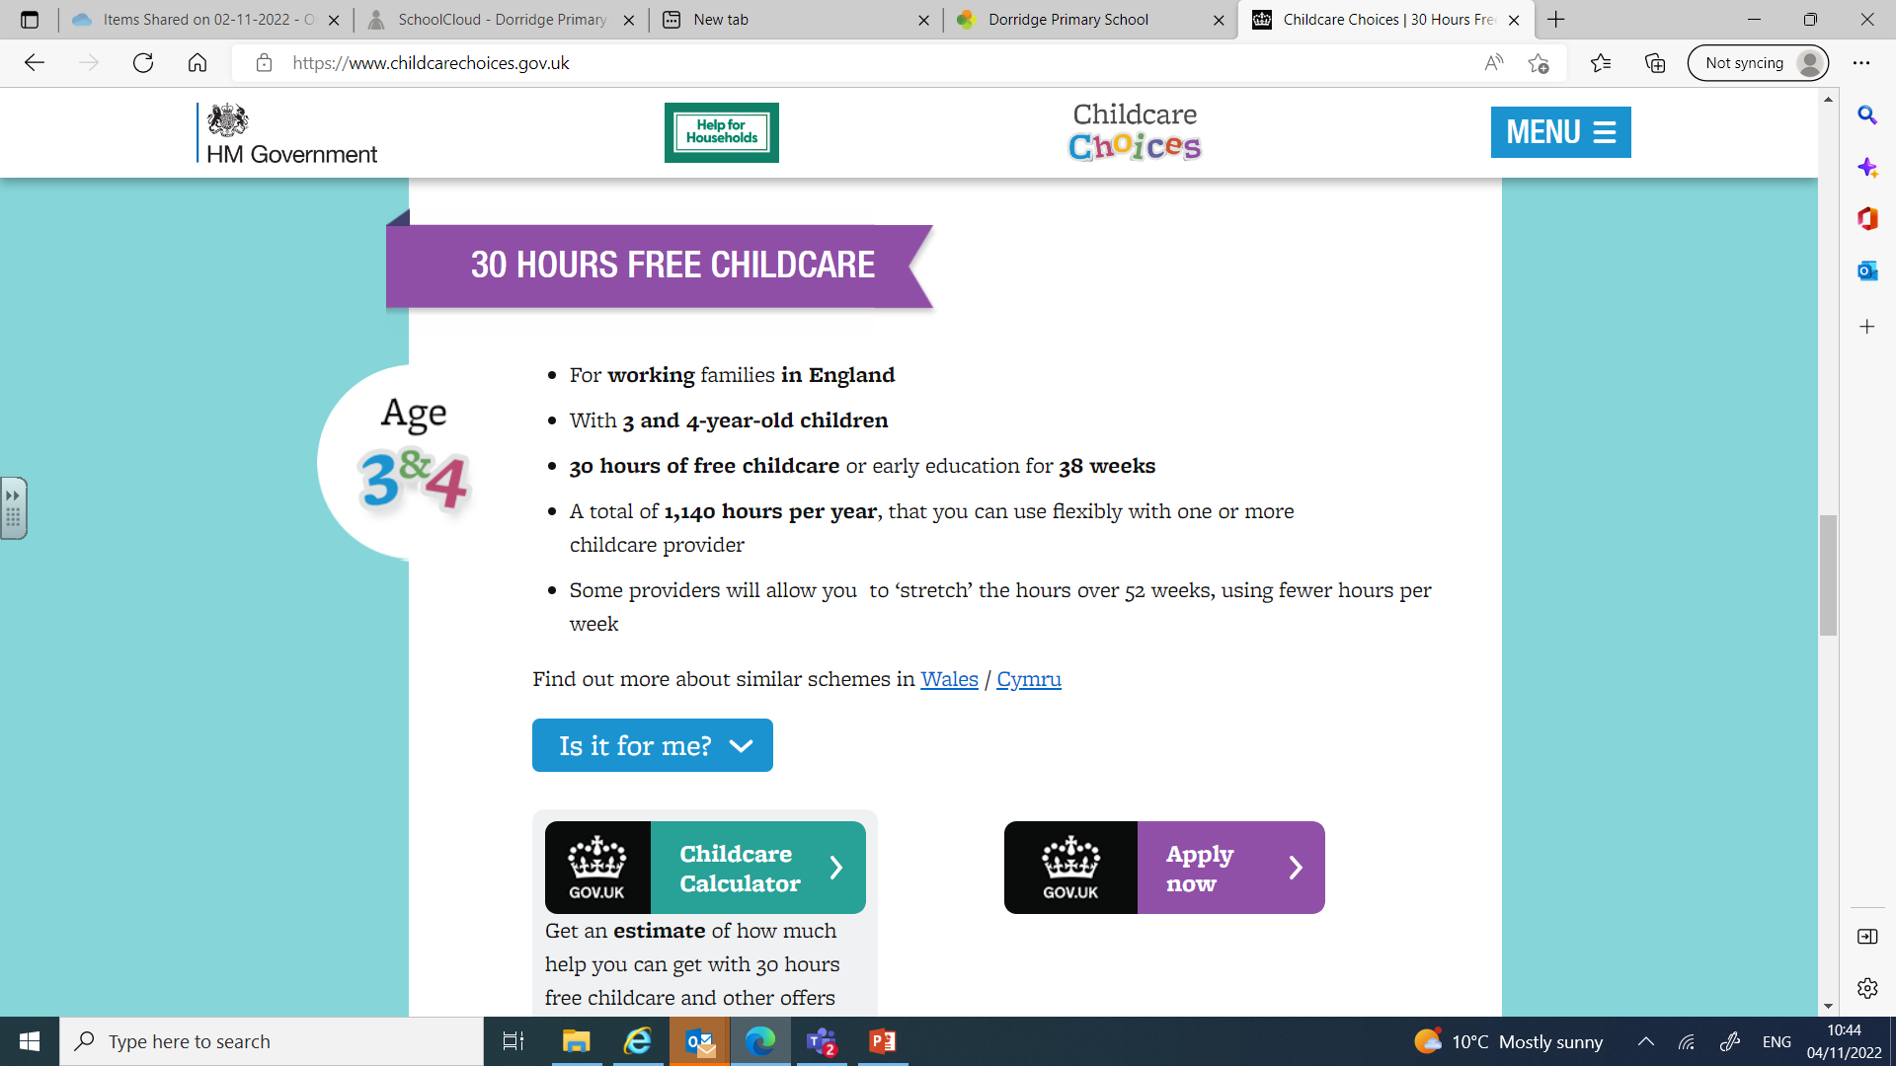
https://www.childcarechoices.gov.uk/
Notes:
Jodie- to see whether you are eligible for the 30 funding, visit the government website above. We also provide a link on our own school website if you have difficulty finding it.

Slide 8
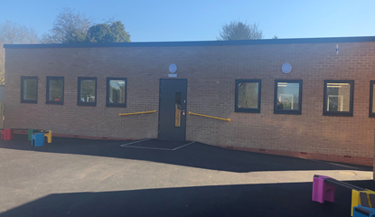
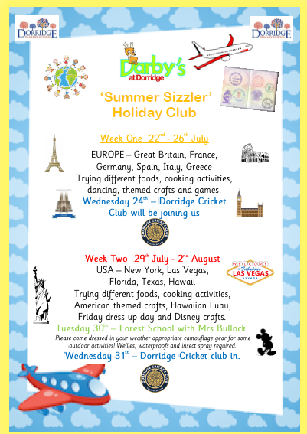
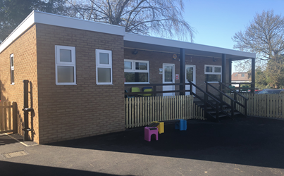

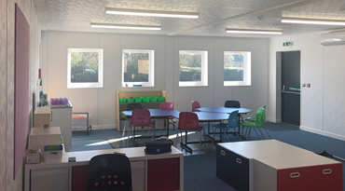

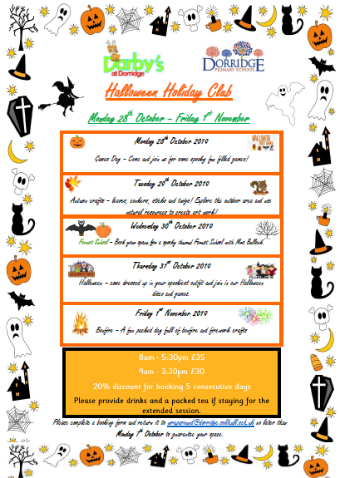
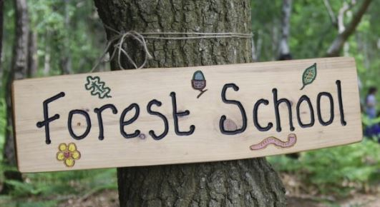
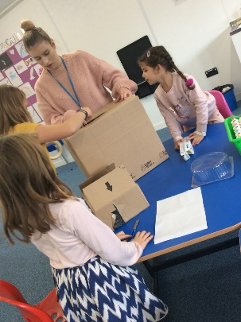
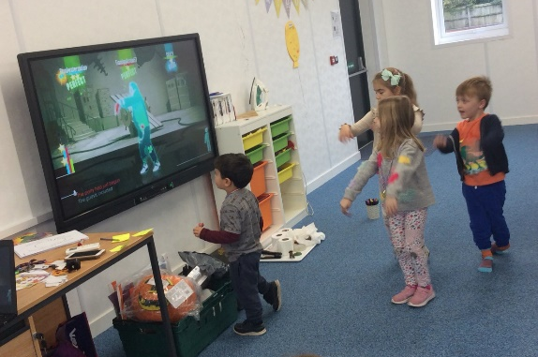

Holiday Club
Notes:
Jodie- Holiday club is available to all children who attend Dorridge, Nursery to Year 6.

Slide 9


Creative Arts Week
Science Week
Andy Root Coaching – PE and after school clubs
Healthy Lifestyles Week
Notes:
Jodie

Slide 10

What is the Early Years Foundation Stage?
The Early Years Foundation Stage (E.Y.F.S.) is the stage of education for children from birth to the end of the Reception year
All schools and Ofsted-registered early years providers must follow the EYFS, including childminders, preschools, nurseries and school reception classes
It is based on the recognition that children learn best through play and active learning.
Notes:
Robyn/Claire

Slide 11
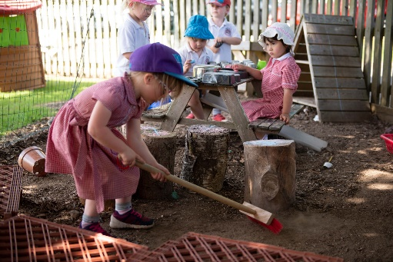
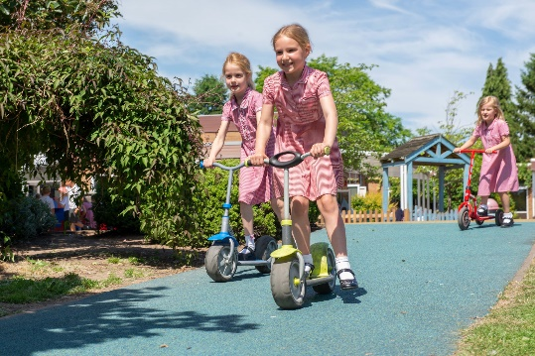
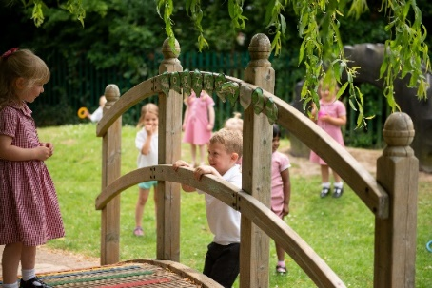
Benefits of a School Based Nursery
Qualified teacher plans, teaches and assesses.
Ease of transition to Reception- excellent education starting points
Familiarity with school setting and staff
Establish and continuing friendships through EYFS and main school
Flexible wrap around care – from 7:45 – 6:00pm each day and holiday provision with school staff
At Dorridge, we currently offer morning Nursery places ONLY.
30 Hour funding for 3 and 4 years olds (if eligible)
At Dorridge, there is access and opportunities to whole school facilities including Forest School, large outside areas in school grounds, gardens, running track, resources, IT equipment, large play areas.
Being part of the whole school community including special assemblies, visitors, events (benefits for children and parents)
Parents will receive a half termly email observation of their child in nursery, so you can keep tabs of what they’ve been up to.
Notes:
Robyn/ Claire

Slide 12
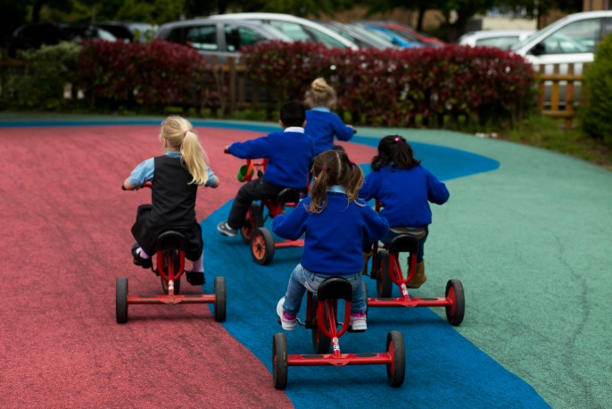
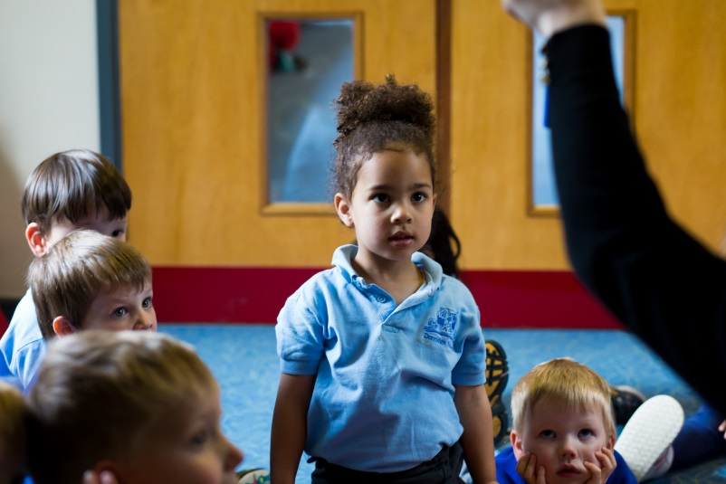
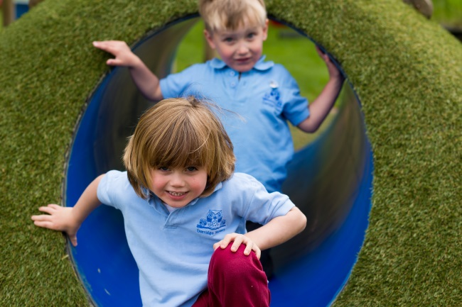
A typical day in Nursery…
Come in and find name before register
Interest Session
Dough Gym & Funky Fingers
Virtual Base- Literacy
Continuous Provision
Virtual Base- Numeracy
Continuous Provision
Story/singing/circle time
Lunch/ home time
Notes:
Claire

Slide 13
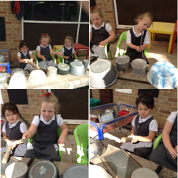
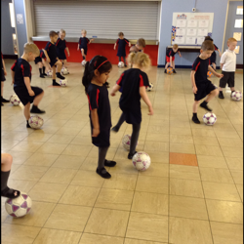
A typical day in Reception…
Come in and self-register
Busy books
Phonics
Continuous Provision
Assembly
Dough Gym & Funky Fingers
Literacy
Lunch
Register
Maths
Continuous Provision
Story/ collect bag etc.
Notes:
Claire

Slide 14
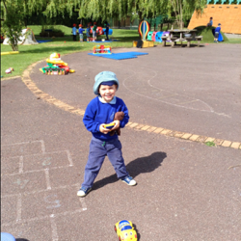
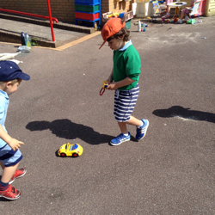
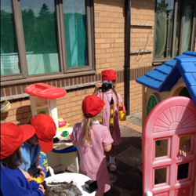
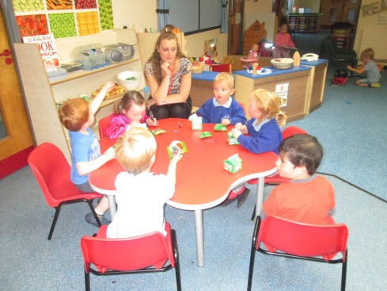
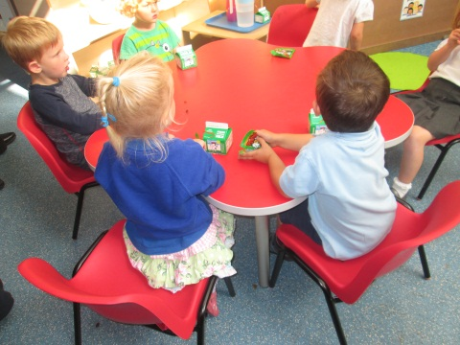
Other matters…
Children will have free flow to outside!!
Snack is available throughout the session
Notes:
Claire

Slide 15
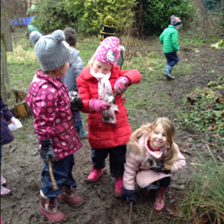
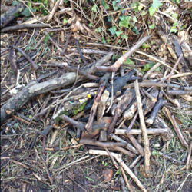
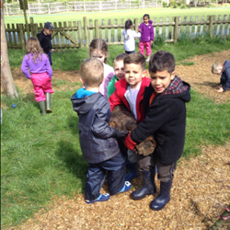
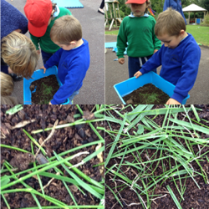
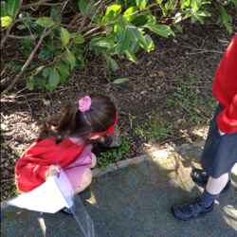
Forest School
‘Forest School is an innovative educational approach to outdoor play and learning.’
Notes:
Gemma- at end of slide, mention PTA events and lisa. Very supportive PTA who have helped to raise thousands of pounds for our children over the years. Things such as new canopies, play equipment, mental health hub, Forest School and environmental garden to name but a few.
Our Christmas Fair is always a popular event for the community. Please come and join us on Saturday 2nd December from 11am in the KS2 building.
Hand back to Ros

Slide 16
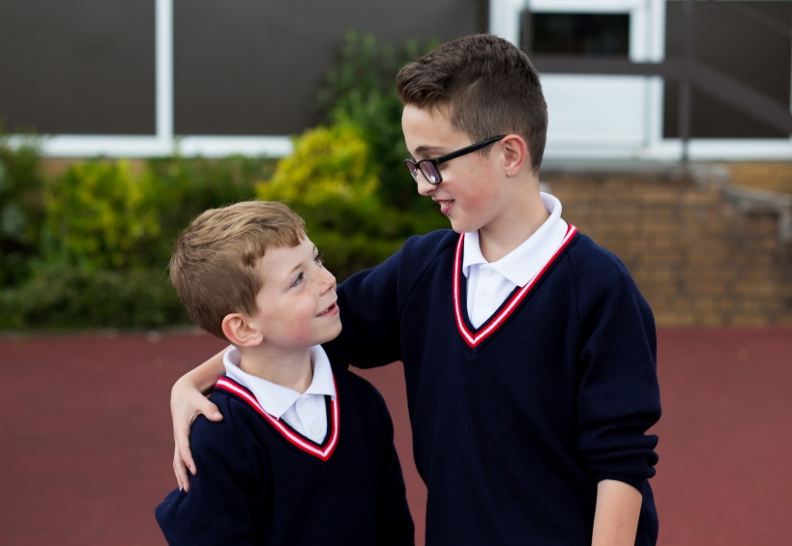
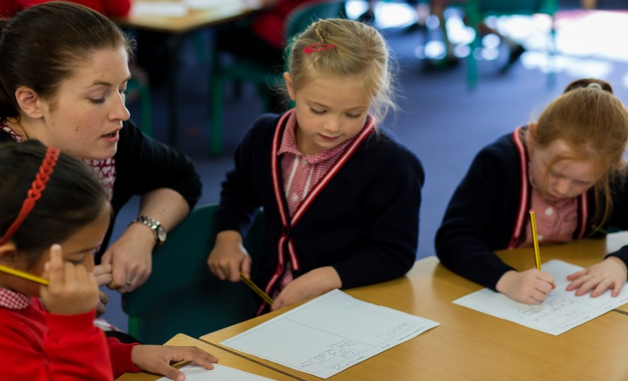
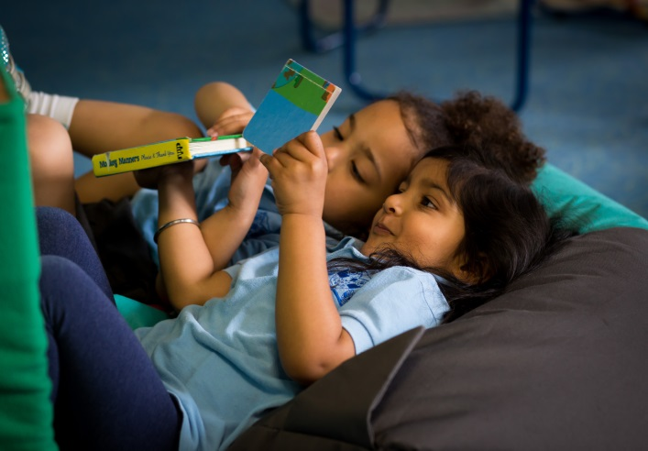

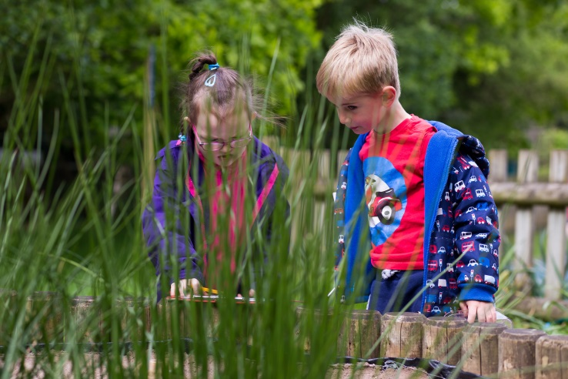
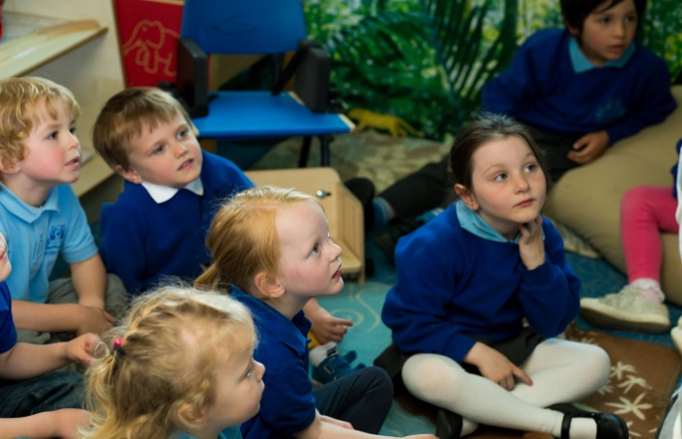
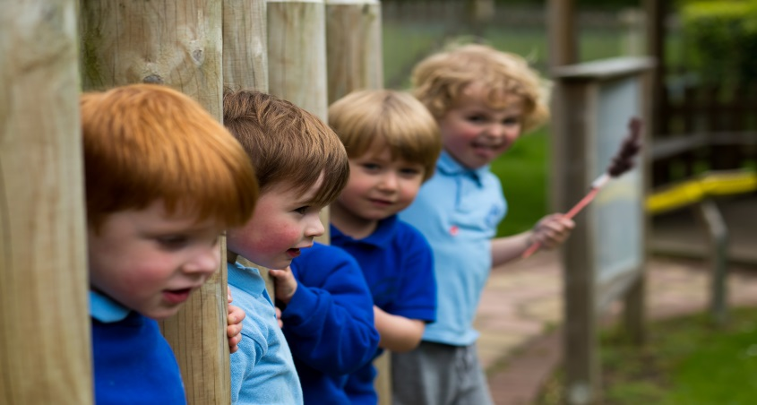
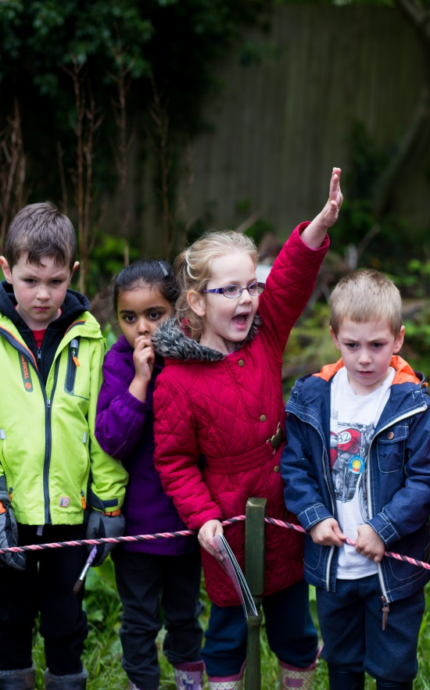
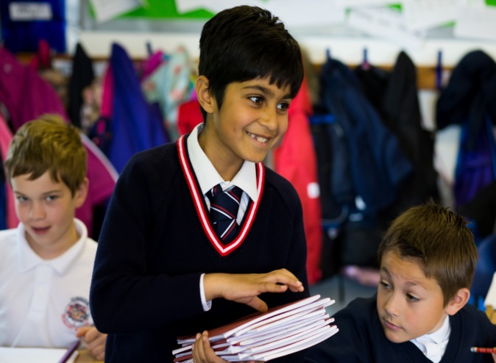
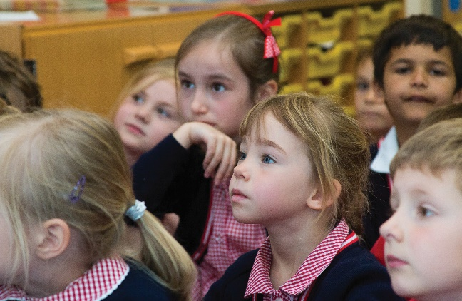
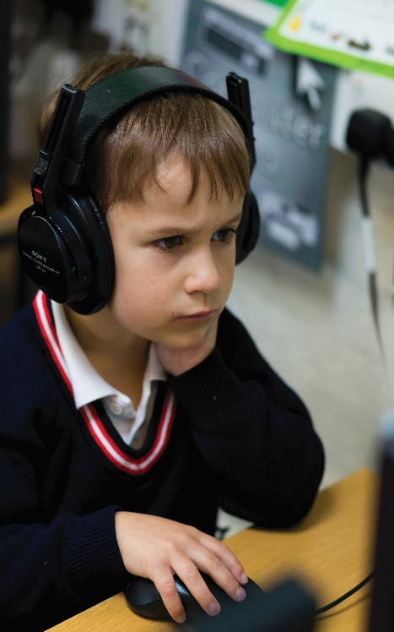
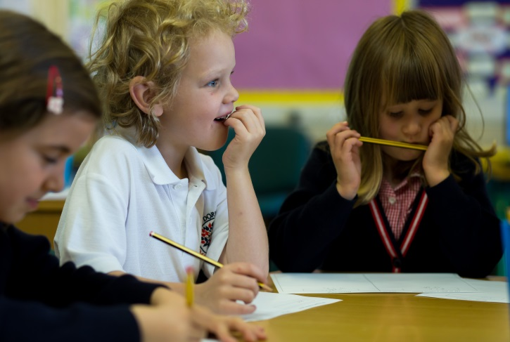

Notes:
Gemma- thank you for attending. We’d like to give you an opportunity to have a tour of our provision and who better to conduct it than our wonderful Year 6 House Representatives. My team and I will available in the hall should you have any questions after the tour. Take a look at our school website (address at top of the slide) to find out more abut the school.
Before you leave today, don’t forget to pick up an application for Nursery, a Next Steps Leaflet and the 30 Hour entitlement flyer.
Thank you for coming. We very much hope that Dorridge will be your first choice and we look forward to welcoming you and your child in September 2023.

