Slide 1

Notes:
Emma P

Slide 2

Teachers | Mrs Biddlecombe (3D) – Year Lead (Mrs Dudek and Mrs Faulkner (3D) Autumn 1) Mrs Perkins and Mrs Keogh (3P) Mrs Nankivell (3S)
Teaching Assistants | Mrs Harden
Other Staff | Mrs Mason Mrs Holtom (Forest School) Sports Coaches
Notes:
Emma P

Slide 3
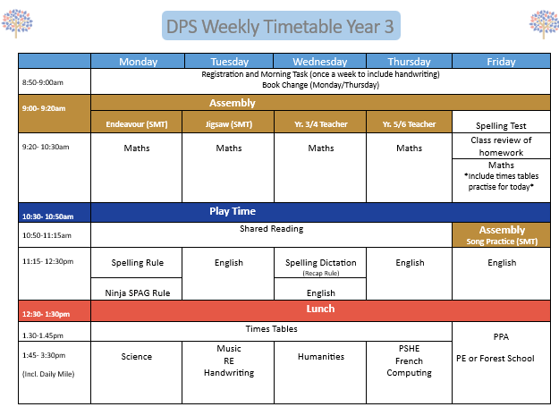
Notes:
Emma P

Slide 4



Units
Each half term, we study a different theme:
This half-term: Fractured Stories (fairy tales)
Next half-term: Non-Fiction (theme to be decided as we get to know the children)
Later on in Yr. 3 includes:
Poetry unit (Nature), Roald Dahl author focus, leaflets & a little Michael Morpurgo
SPAG
Grammar, spelling and writing skills are taught through the theme.
The school use Alan Peat sentence types for lots of this (they are in the HSO)
as well as Ninja SPAG.
In addition, children learn a new spelling rule each week. The weekly spelling test will test the children’s understanding of that week’s spelling rule together with the Year 3 common exception words (as noted in the HSO).
We use Essential Spelling which teaches the children rules to help them to become better spellers. Spellers for life, not just for the test!
Notes:
Sarah N

Slide 5


Reading
Every child will read to an adult at least once a half term – However, many will be heard more regularly during the Autumn term. With this in mind, children should make sure that their reading scheme books and HSO are in school every day.
In Yr.3, once your child is a fluent reader, the key focus moves from decoding to comprehension (their understanding of what is being read). You can support your child by encouraging lots of book discussion into reading time at home. Build their confidence in answering retrieval, inference and prediction questions as well as making sure that they understand the meaning of words.
Weekly stickers in the HSO will provide information about the shared reading text and class discussion. We will often include a focus for discussion at home.
From Yr. 3, children change their books independently on Mondays and Thursdays. We will also have an allocated class time weekly for the library (TBC) as well as one allocated lunchtime each week. Once confirmed, please ensure that if your child wants to change their library book, they bring it into school on these days.
We do of course also encourage them to read books of their own from home, so if they’re hooked on a good, high-quality chapter book, they can bring that into school to continue during reading time instead.
Notes:
Sarah N

Slide 6

Notes:
Sarah N

Slide 7
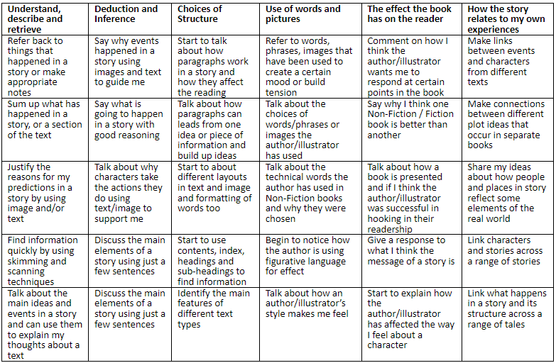

Notes:
Sarah N

Slide 8

As a school, maths is taught using the White Rose maths mastery scheme. The scheme breaks the learning down into small manageable units and aims to show all children that everyone can do maths, whilst building mastery through a focus on problem solving and explaining.
TT Rockstars and Mathletics are used for homework. Your child can also continue to consolidate their learning through a number of fantastic online tools :
TT Rockstars (which can be used on free play)
White Rose 1-minute maths app
Daily 10
Hit the Button
Visnos clock
Don’t forget to use any opportunities for them to read the time for you and to
mentally calculate the total spend in a shop and/or the change required.
Regularly practising their times tables will also be a great help as they work
towards the Yr. 4 multiplication tables check.
Notes:
Lauren

Slide 9

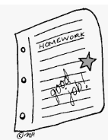

Children should read for 20 minutes a night.
Please note the book or page numbers read in the HSO and sign to confirm that they have read. Any additional comments about discussions and understanding of the text are always helpful to see.
Monday: English homework and spellings are handed out
Tuesday: Mathletics or TT Rockstars set online
Thursday: English homework is due back
Friday: Maths homework to have been completed
Friday: Weekly spelling test
Homework is compulsory in KS2 and we appreciate your support with this. Tasks set shall link to learning within the classroom (and generally seek to consolidate their learning).
Spelling support at home: Please encourage your child to explain the spelling rule and to practise the spellings throughout the week. Little and often helps to embed their learning. As we may add a few surprise words that use the same spelling rule to the weekly test, you may want to do the same at home too.
Homework support: We do ask that children try to complete their homework independently. They should be encouraged to use their neatest handwriting and to challenge themselves to try their very best (just like they do in the classroom). If support has been needed, a little note in their homework book is really helpful information for the class teacher. Once completed, please support their learning journey by checking and discussing their completed homework with them before it is handed in.
Notes:
Lauren

Slide 10



During the school day, the children are immersed in a rich and varied curriculum.
In Yr. 3, each class shall take part in Forest School (two half-terms over the year to experience two different seasons) and will begin to learn French.
Some of the topics in other subjects include:
Would you prefer to live in the Stone Age, Bronze Age or Iron Age?
Ancient Egypt
Vanishing Rainforests
Friction and Magnets
Rocks
Plants
Light
Notes:
Emma D

Slide 11

Events and trips …
Autumn
Pantomime (whole school trip) (“Oh yes we are!”)
Spring
TBC
Summer
Swimming Week
Our curriculum is changing this year, and we are looking at many possible exciting ways of enhancing the children’s learning over the coming year: to bring their learning to life.
More details for all trips shall be sent out over the year.
Can you help?
Your expertise could enhance their learning journey.
Notes:
Sarah N

Slide 12

PE - Friday
The children should come to school wearing their PE kit. Please refer to the PE kit uniform policy and we do ask that the children are dressed for the weather, i.e. rugby shirt and joggers in winter
Long hair should be tied back and earrings should be removed (or if recently pierced, covered with plasters).
Alternatively, for two half-terms per class, Friday afternoon will be Forest School:
  Please refer to the HSO to consent and to find out more
    3D: Autumn 1 and Spring 2
    3P: Autumn 2 and Summer 1
    3S: Spring 1 and Summer 2
Notes:
Emma D

Slide 13

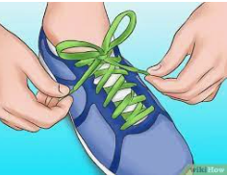
Daily mile
Children can keep trainers in school (in a named carrier bag which is kept on their peg). ***This really isn’t essential though in Year 3***
The Daily Mile is completed every day except Friday (PE day). It takes place in all weathers except ice and severe rain, so please do make sure that they have a coat in school for wet days
We do ask that children are able to quickly and independently tie their own laces if their trainers are not velcro.
Notes:
Emma D

Slide 14
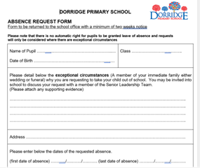
Attendance
Good attendance is vitally important to your child’s education
We monitor all children’s attendance on a half termly basis – we will write to you if your child’s attendance drops below 90%
Central Schools Attendance and Welfare Service support schools and families in maintaining good attendance
This request needs to be completed at least 4 weeks in advance
Notes:
Jodie / Emma P

Slide 15
Fines
Your local council can give each parent a fine of £80, rising to £160 if you do not pay within 21 days.
From the 2024 to 2025 school year, each parent will only get up to 2 fines for the same child in a 3-year period.
If you get a second fine in 3 years it will be £160. If you do not pay the fine in 28 days you may be taken to court for keeping your child out of school.
If your child is off school 3 or more times within the 3 years you will not be fined but may be taken to court
If you’re taken to court You could get a fine of up to £2,500, a community order or a jail sentence up to 3 months. The court could also give you a Parenting Order
Each half day in school is known as a session.
After 10 sessions (5 days) of unauthorised absences (over a 10 week rolling programme) you will be fined
Both parents are fined for each child who has missed 10 sessions of school recorded as unauthorised
FINES ARE ONLY GIVEN FOR UNAUTHORISED ABSENCE – SICKNESS ABSENCE IS AUTHORISED
Notes:
Jodie / Emma P

Slide 16


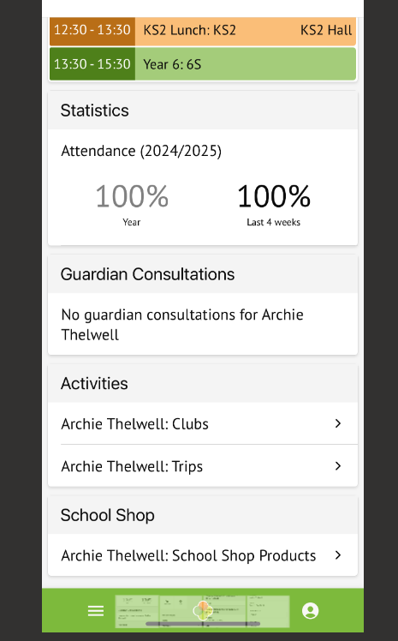
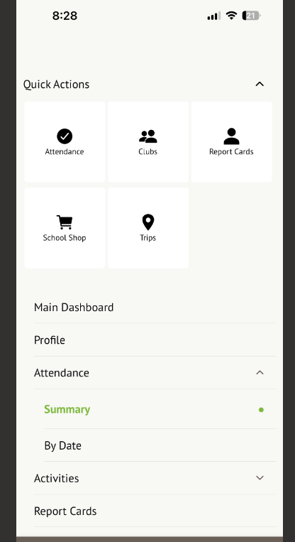
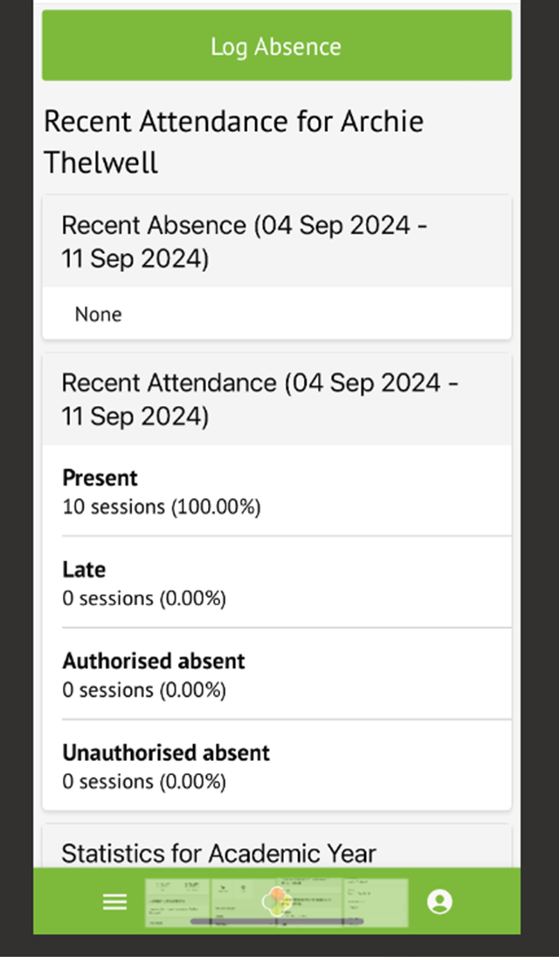

After the successful launch last year ...
Illness Actions: If you child is ill, please report it via your Arbor app.
2. Click here
1. Click here
Notes:
Emma D

Slide 17
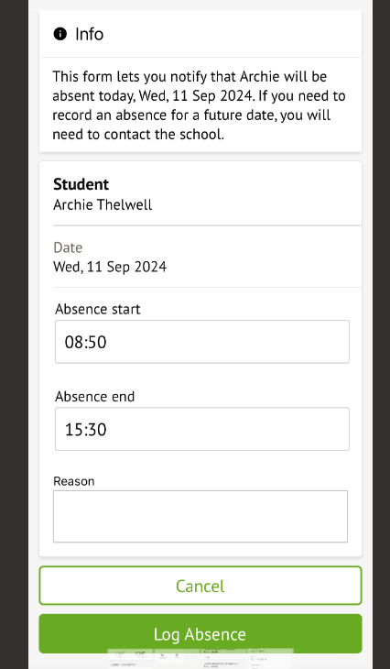

For sickness and diarrhoea, we ask the children are kept away from school for 48 hours to avoid infecting other children.
All children get coughs and colds; this should not stop them coming to school unless they are feeling really poorly.
Please be aware we will send a child home if we think they are too poorly.
Further advice on other medical conditions can be found on our website.
Try to make all medical appointments outside of school hours. If this is not possible then you will be asked to provide evidence to our admin team for the appointment.
Once you’ve completed the form, click here to send to the office. This replaces the need to ring .
Notes:
Emma D

Slide 18

Uniform
Please refer to the website for the Uniform Policy, but in essence:
We encourage children to be smart and take pride!
Highlights
Please ensure that all items are named (it really does help when items are misplaced!).
Nail varnish and make up is not allowed.
Trainers cannot be worn to school (except on PE days) without a note from yourselves explaining why this is necessary.
Long hair must be tied back using uniform compliant hair accessories only.
Only a simple, small stud is permitted (and none should be worn on PE days)
PE Kit must also be uniform compliant (only plain navy blue or black hoodies and tracksuits/legging are permitted if you do not own the school rugby top.)
Notes:
Lauren

Slide 19

Equipment in school
Please could children be equipped with these items:
30cm rigid transparent ruler
Large glue stick (a non coloured version please)(check regularly!)
Pencils
Red & Green Pencil Crayon
Sharpener
Pencil crayons
(Felt tips are optional)
Scissors (optional)
Purple Biro (Editing Pen) (optional)
Water bottle
These items should ideally all be named please.
Children’s belongings have to fit in a small drawer underneath their desk.
Notes:
Lauren

Slide 20
Home School Organiser (HSO)
The HSO remains an essential tool for communication with your class teacher.
The children are encouraged to become more independent in Yr. 3. They should bring their HSO home each night and back to school the following day.
Please check and sign to show their reading at home. Again, the children can write in what they have read and ask you to sign it (to increase their levels of responsibility).
Checking of HSOs is carried out once a week by the class teacher or TAs (usually on a Monday). If you write a note for the class teacher in the HSO that requires a more urgent response, please make sure that your child is aware, so that they can show their HSO when they arrive in school.
Do take the time to look through them, there is plenty within them to support ongoing learning at home.
Notes:
Sarah N

Slide 21

Rewards and Sanctions
Rewards
Class Dojo Points – Dojo points are awarded for behaviour and work. For every 25 Dojos, your child will win a reward (e.g. homework pass, bring your teddy in for the day and take the class register)
Postcard home (by the Year Lead or SMT)
Weekly Endeavour Certificate. In KS2, the Endeavour Assembly takes place on a Monday. If your child earns an award in an extra curricular club they can bring these into school to show during the assembly.
Sanctions
Thinking Time– reflecting on the incident.
  Verbal warning
  2 minutes
  5 minutes
  10 minutes with the Year Lead and a letter is sent home
Thinking time can also be used as an opportunity for children to reflect on any incidents at lunchtime.
Notes:
Emma P

Slide 22


Purpose:
Share updates on pupils and classroom activities
Communicate important school announcements
Encourage positive student behaviour
Parent Expectations:
Use ClassDojo for school-related updates & inquiries
Message during appropriate hours (no late evenings/weekends/holidays)
Communicate politely & respectfully
Avoid public discussion of sensitive/confidential matters
Allow time for teacher responses
Messaging Guidelines:
Keep inquiries brief & relevant
Urgent matters → follow the school’s official communication channels arrange (phone/email or arrange an in-person meeting)
Do not discuss other pupils/families, report absences, or make public complaints
Notes:
Emma P

Slide 23

Food and drink
Snacks
In Yr. 3, the children bring in their own break time healthy snack from home or (with your agreement) they can access a snack from the tuck shop (Please talk about this with your child, so that they know whether they are allowed to use the school tuck shop).
ParentPay accounts should be credited for the tuck shop purchases in advance.
Please do ensure that all snacks sent in from home are nut free as there are many children in the school who have severe allergies.
If you order milk for your child, they collect this in the KS2 hall every break time.
Water
All children are encouraged to regularly drink water throughout the day. We ask that all children bring a named water bottle into school on a daily basis.
Notes:
Sarah N

Slide 24

The next couple of slides explain how you can access the
Safer Schools app
which gives you important safeguarding information.
Copyright 2019 © INEQE Group Ltd.
Notes:
Sarah N

Slide 25

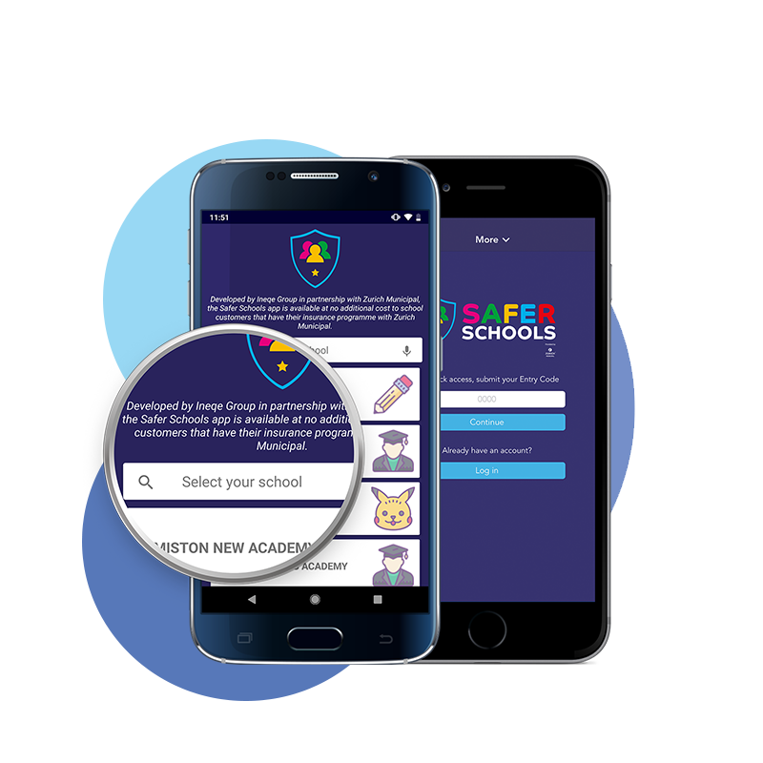
To open the app
Download the app for free from the Google Play Store or App Store.
Enter the name of our school here.
Then tap ‘Continue’
Copyright © INEQE Group Ltd.
Notes:
Sarah N

Slide 26
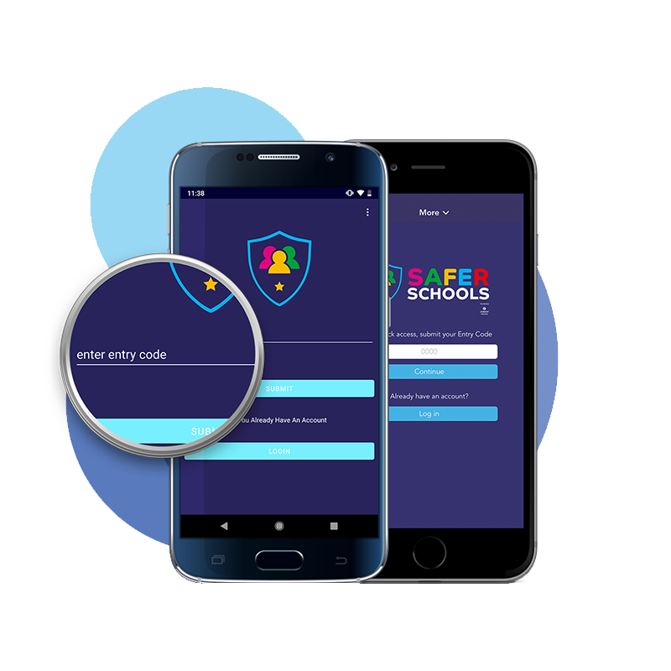
ENTER YOUR CODE
This is where you enter your ‘Entry Code’ Our school code is 6903
6903
This will then give you access to the content within the app.
Copyright © INEQE Group Ltd.
Notes:
Sarah N

Slide 27
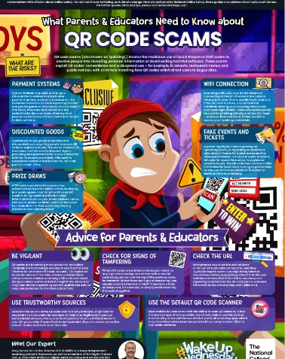
#Wakeupwednesday
Keeping parents updated on new trends, apps and keeping children safe in an online world.
Look out for weekly Wednesday updates on Class Dojo.
Notes:
Sarah N

Slide 28


SMILE
A whole school initiative that we use to help improve our pupils mental health and well being.
Socialise
Move
Interest
Learn
Engage
Notes:
Lauren

Slide 29


Join the PTA Facebook group
Dorridge Primary PTA
PTA working together to raise money for our school thus helping improve the learning environment for all pupils attending Dorridge Primary
Notes:
Sarah N

Slide 30

Notes:
Sarah N

Slide 31



