Slide 1

Parents’ Information Evening
Key Stage 1
2024-25
Notes:
Mel

Slide 2
Key Stage 1 Team
Heads of School: Mrs Thelwell and Mrs Hales
Assistant Heads: Mrs Mannion and Mrs Morrey
Year Leaders: Miss Farrington Year 1
Miss Thornton Year 2
Year 1 Team:
Mrs Kitchen, Mrs Keogh (Mrs Dudek), Mrs Richardson
Miss Bamber, Mrs Hunt, Miss Edwards, Mrs Hunt, Mrs Arnold
Year 2 Team:
Miss Pitt, Mrs Melville, Mrs Barker
Mrs Taylor, Mrs Morris, Mrs Mason
Mrs Barr: Family Support Worker
Notes:
Claire/Robyn

Slide 3
Morning and Hometime
Gates open at 8:30am – please be prompt. If you need to see your child’s teacher, please make an appointment. Any messages should be written in the Home School Organiser or sent on ClassDojo.
Hometime is 3:20pm. 2D and 2P come out of the door by the hall. 2S and Year 1 come out of their own classroom doors.
Notes:
Claire/Robyn

Slide 4
Children’s Mental Health and Wellbeing
Notes:
Claire/Robyn

Slide 5





The 5 main aims of the SMILE approach are:
Notes:
Claire/Robyn

Slide 6
The 5 steps to wellbeing
Socialise – Talking with others and staying connected with friends and family.
Move – The importance of exercise and being active.
Interest – Taking an interest and being mindful of our own feelings.
Learn – Learning new skills and finding their passions.
Engage – Showing kindness to others.
at Dorridge Primary School
Notes:
Claire/Robyn

Slide 7
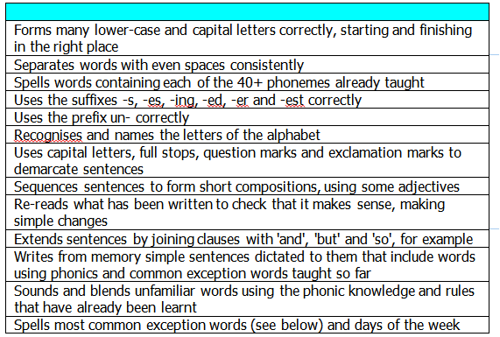
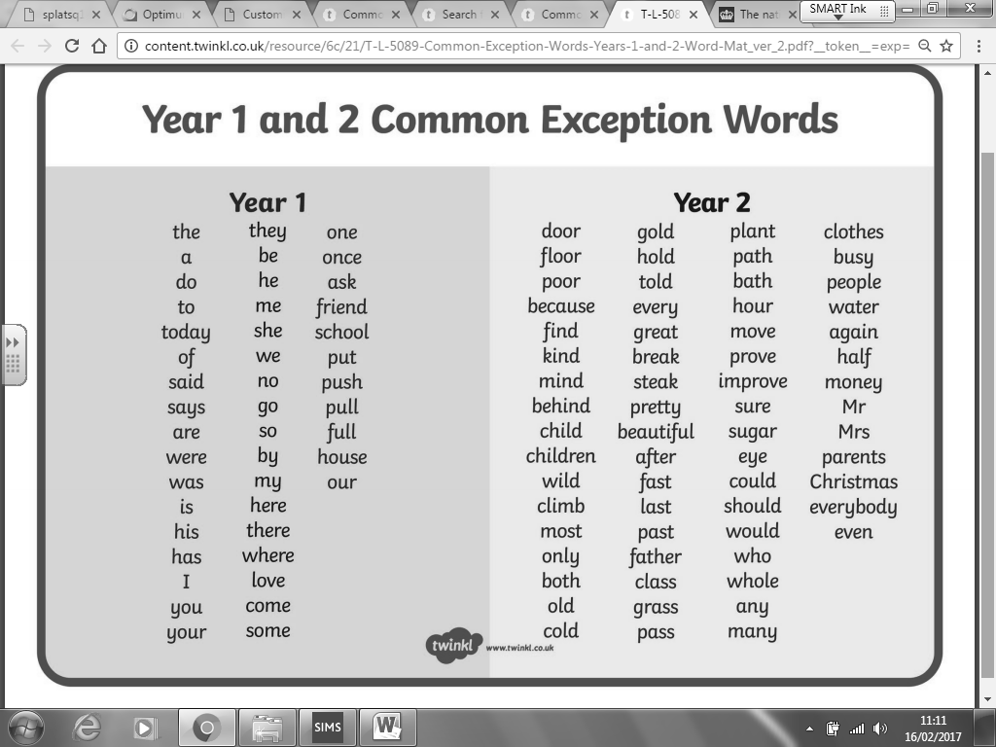
Year 1 Writing
On pg110 of the Home School Organiser.
To be ‘secure’ at the end of Year One a pupil must be able to demonstrate most of the above statements with competence and across a range of contexts.
A letter formation information sheet can be found in the Home School Organiser on pg111.
Notes:
Alana

Slide 8
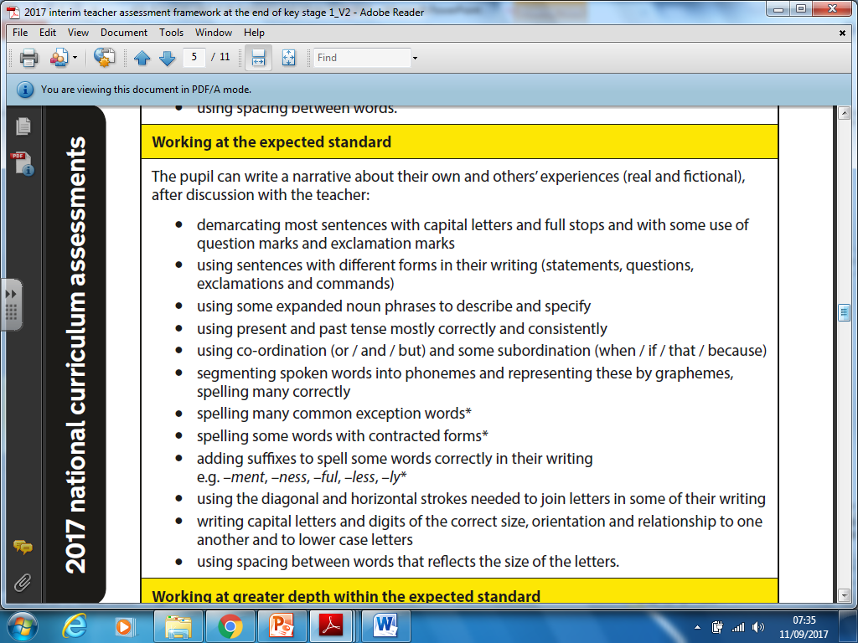
Year 2 Writing
80% of the time
60% of them
Notes:
Kiera

Slide 9
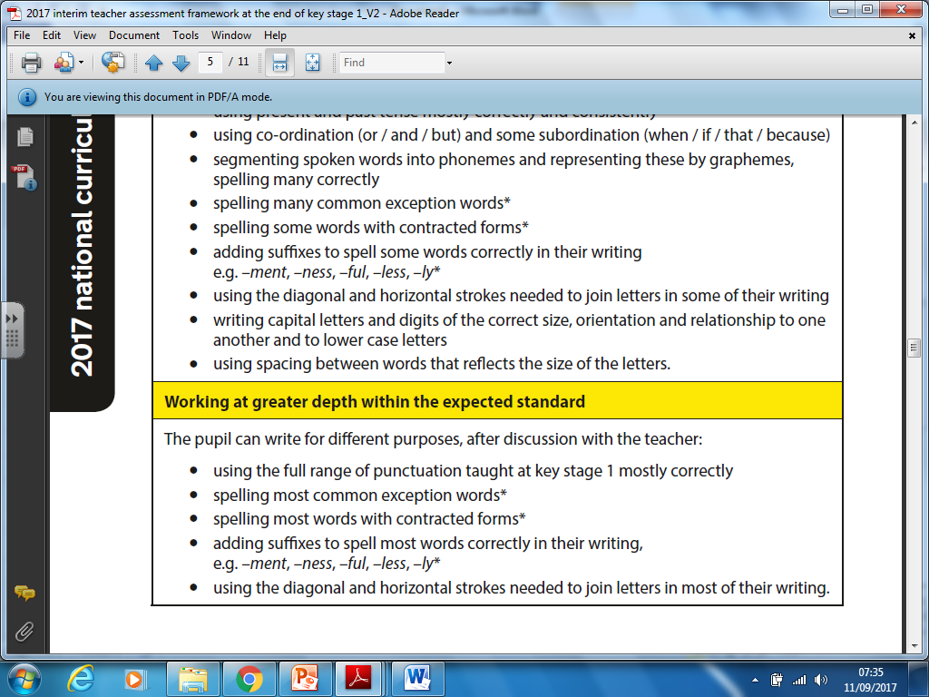
Year 2 Writing
80% of them
Notes:
Kiera

Slide 10
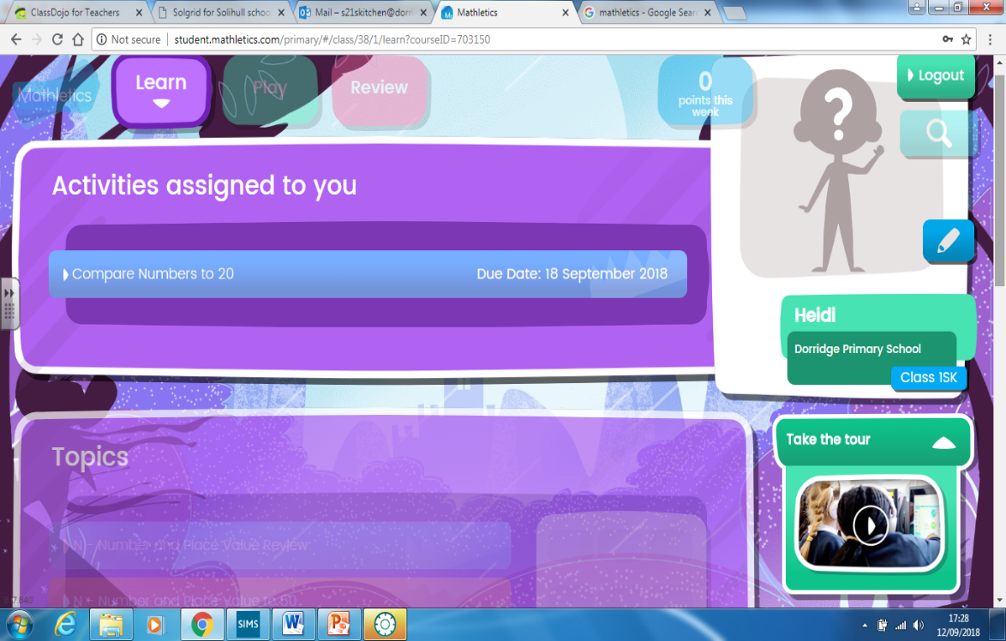

Homework
Monday – English (Spellings and reading/writing task)
A spelling sheet will be set every Monday – return on Thursday please.
Year 1 will be set 5 spellings and no weekly spelling test.
Year 2 have a weekly spelling test each Friday. Spelling books are sent home on Monday for you to check your child’s score. Please ensure that the spelling book is returned by Thursday.
Tuesday – Maths (Mathletics)
Every day – Reading
              Books are changed in school on a Monday.
              A school adult will listen to your child read once per week.
Notes:
Kirsten

Slide 11
Reading Raffle
In order to boost the children’s enjoyment for reading, each term we have a reading raffle where 1 child from each class will win a £5 voucher to buy a book.
To earn a raffle ticket, the children need to read 5 x per week, and have this signed in their diary. The class teacher will check this and give them their raffle tickets accordingly.
On top of this the children will earn dojos for home reading:
- 1 dojo = Reading 3 x in a week
- 2 dojos = Reading 5 x in a week
Notes:
Becci

Slide 12



Behaviour
Rewards: Class Dojo points
Stickers
Endeavour certificates
Postcards home
Sanctions:
Warning
2 minutes thinking time
5 minutes thinking time
10 minutes thinking time with LMT / SMT and letter home
Notes:
Nina

Slide 13

Safer Schools is an app school are able to provide to families of Dorridge Primary School. It gives you the most up to date online safety information to ensure the best safeguarding for our pupils.
Copyright 2019 © INEQE Group Ltd.

Slide 14
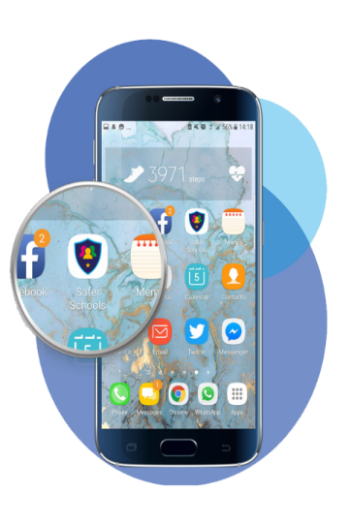
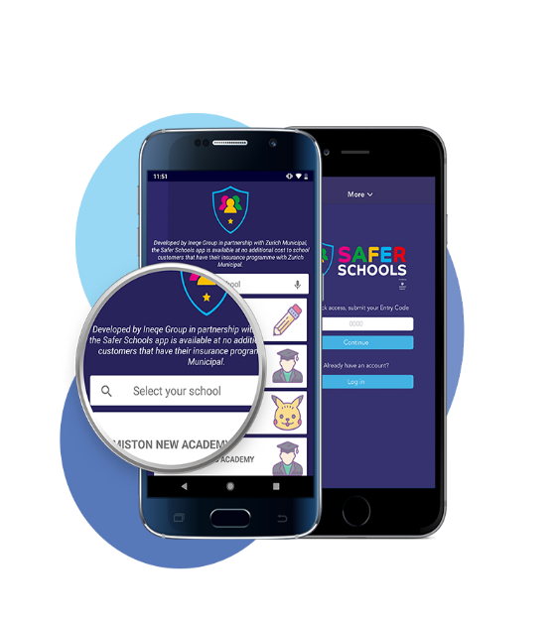
To open the app
Download the app for free from the Google Play Store or App Store.
Enter the name of our school here.
Then tap ‘Continue’
Copyright © INEQE Group Ltd.

Slide 15
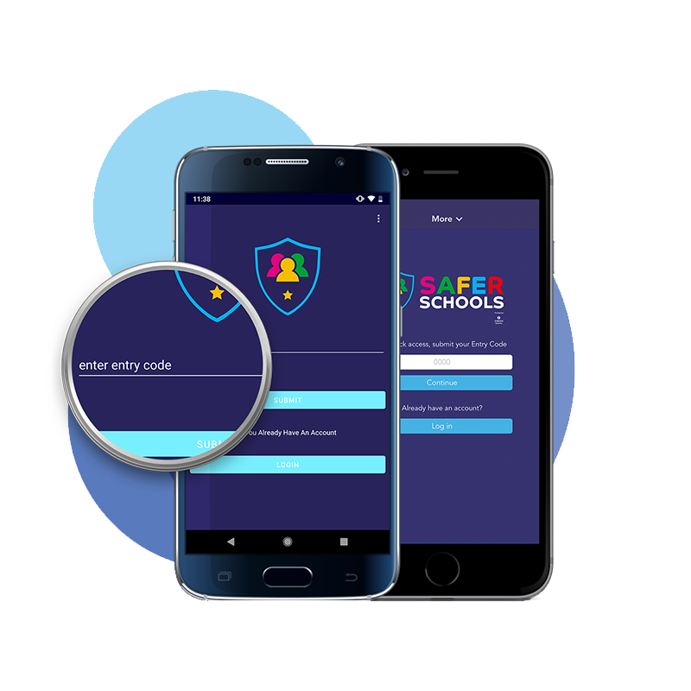
ENTER YOUR CODE
This is where you enter your ‘Entry Code’ Our school code is
6903
This will then give you access to the content within the app.
Copyright © INEQE Group Ltd.

Slide 16
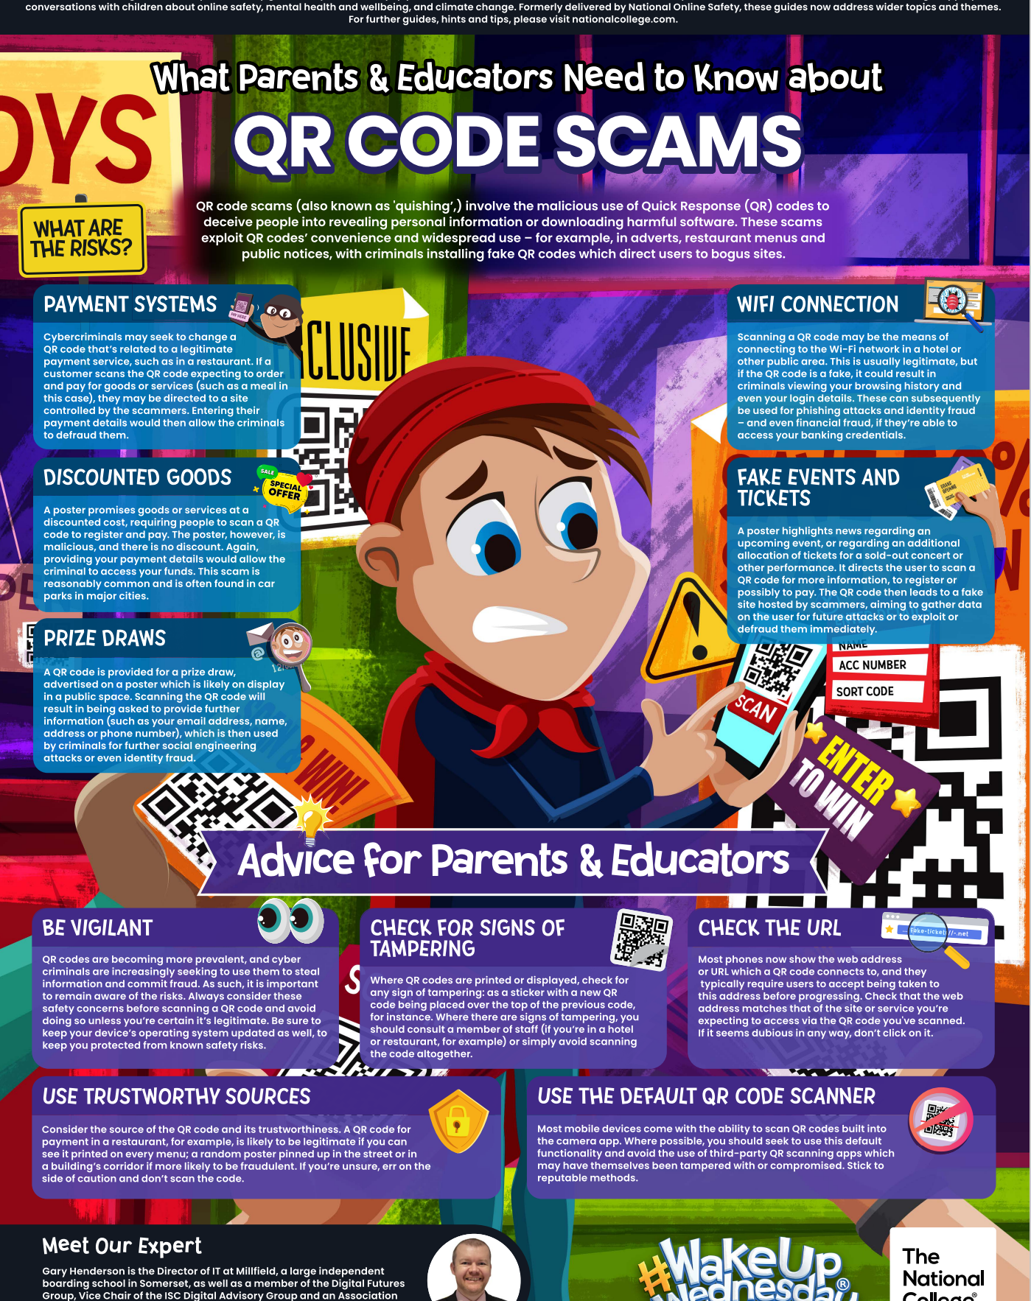
#Wakeupwednesday
Keeping parents updated on new trends; apps and keeping children safe in an online world.
Look out for weekly Wednesday updates on Class Dojo.
Notes:
Claire/Robyn

Slide 17
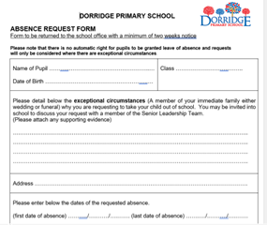
Attendance
Good attendance is vitally important to your child’s education
We monitor all children’s attendance on an half termly basis – we will write to you if your child’s attendance drops below 90%
Central Schools Attendance and Welfare Service support schools and families in maintaining good attendance
This request needs to be completed at least 2 weeks in advance

Slide 18
Fines
Each half day in school is known as a session.
After 10 sessions (5 days) of unauthorised absences (over a 10 week rolling programme) you will be fined
Both parents are fined for each child who has missed 10 sessions of school recorded as unauthorised
FINES ARE ONLY GIVEN FOR UNAUTHORISED ABSENCE – SICKNESS ABSENCE IS AUTHORISED
Your local council can give each parent a fine of £80, rising to £160 if you do not pay within 21 days.
From the 2024 to 2025 school year, each parent will only get up to 2 fines for the same child in a 3-year period.
If you get a second fine in 3 years it will be £160. If you do not pay the fine in 28 days you may be taken to court for keeping your child out of school.
If your child is off school 3 or more times within the 3 years you will not be fined but may be taken to court
If you’re taken to court
You could get a fine of up to £2,500, a community order or a jail sentence up to 3 months. The court could also give you a Parenting Order

Slide 19
Illness
All children get coughs and colds; this should not stop them coming to school unless they are feeling really poorly.
Please be aware we will send a child home if we think they are too poorly.
Try to make all medical appointments outside of school hours. If this is not possible then you will be asked to provide evidence to our admin team for the appointment.
If you child is ill, please ring the school office on
01564 772836 – option 1 to report it including your child’s name and class.
For sickness and diarrhoea, we ask the children are kept away from school for 48 hours to avoid infecting other children
Further advice on other medical conditions can be found on our website
Notes:
Claire/Robyn

Slide 20


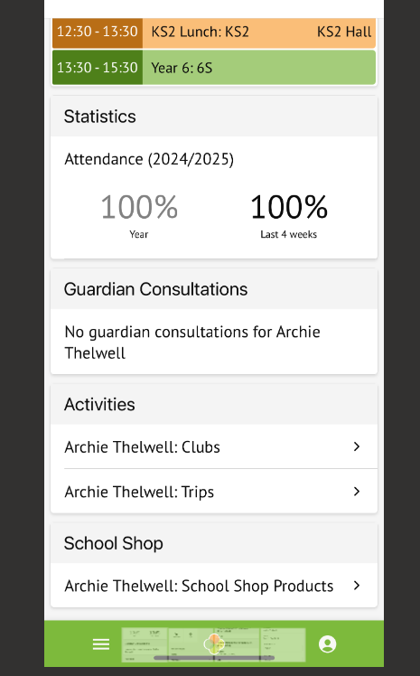
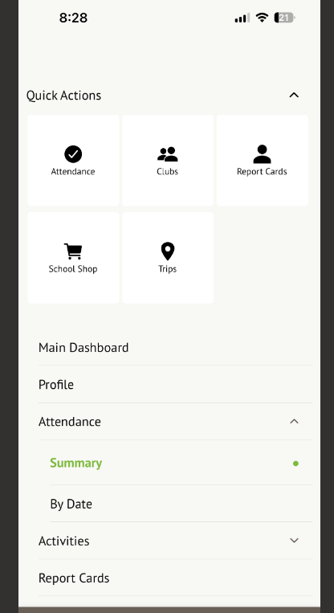
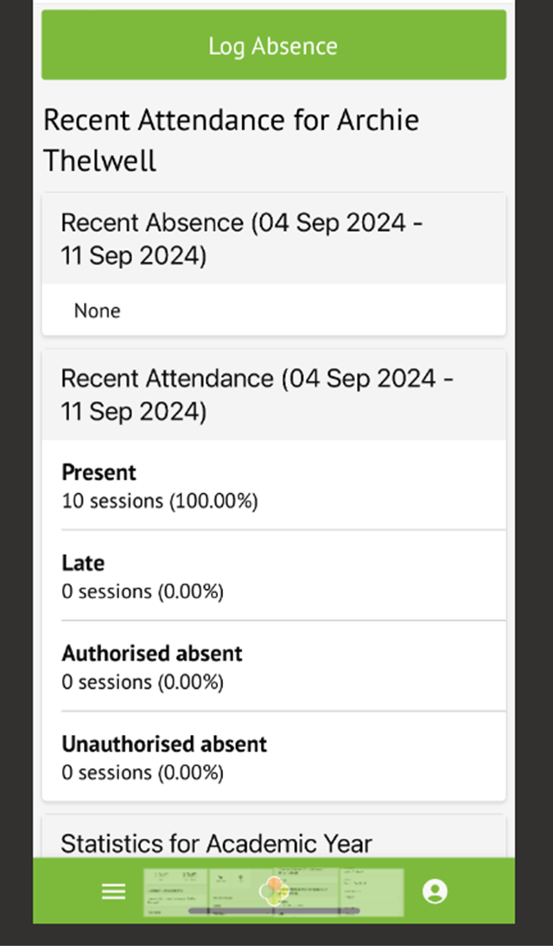

NEW FOR 2024!
Illness Actions: If you child is ill, please report it via your Arbor app.
2. Click here
1. Click here

Slide 21
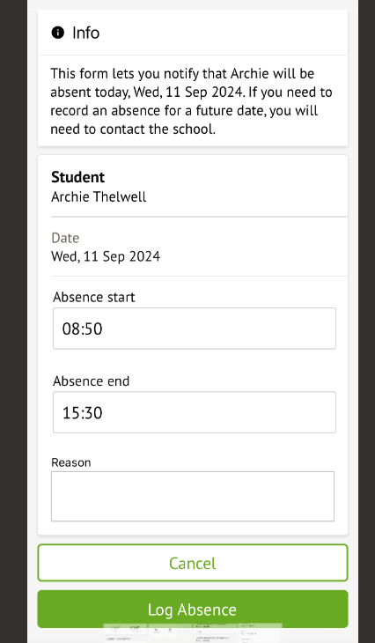

For sickness and diarrhoea, we ask the children are kept away from school for 48 hours to avoid infecting other children.
All children get coughs and colds; this should not stop them coming to school unless they are feeling really poorly.
Please be aware we will send a child home if we think they are too poorly.
Further advice on other medical conditions can be found on our website.
Try to make all medical appointments outside of school hours. If this is not possible then you will be asked to provide evidence to our admin team for the appointment.
Once you’ve completed the form, click here to send to the office. This replaces the need to ring .

Slide 22
Dorridge Primary Curriculum
(DPC)
Please see curriculum overviews
Year 1 – Autumn Term
Buildings
This unit focuses on the different structures we see in towns and cities around the world, as well as how building styles have changed over time.
Time Travellers
We will be exploring events such as the first moon landing and the Great Fire of London, as well looking at our school’s own history.
Notes:
Sophie

Slide 23
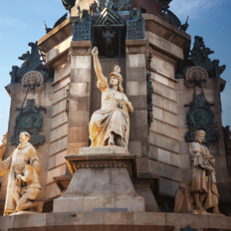

Dorridge Primary Curriculum
(DPC)
Please see curriculum overviews
Year 2 – Autumn Term
Brainwaves
The new term begins with an exciting 2 week unit of work called 'Brainwaves' where the children will learn about how their brains work, how they learn and what they can do to keep their brains healthy.
Media Magic
This involves learning about a range of technology and media. We will be focusing on the development of new technologies, as well as how communication methods have developed throughout history, learning about
We are all looking forward to an exciting term ahead!
Notes:
Georgie

Slide 24


Endeavour Assembly
FRIDAY
Notes:
Claire/Robyn

Slide 25
Assemblies
Christmas Play: Year 2 only
Thursday 12th December (morning 9:30am and afternoon 2pm)
Please attend ONE performance so all parents have the opportunity to see their child(ren) perform.
Notes:
Kiera

Slide 26
Parent/Grandparent Helpers
In school – this will be in a different year group to your child
Trips
Reading with children
We need your expertise! Science week, creative arts week, mathematicians, musicians etc.
Resources – Keep your eyes peeled for notices on the ‘Weekly News’ and the website/ClassDojo
Notes:
Claire/Robyn

