Slide 1

Parents’ Information Evening
Key Stage 1
2025-26

Slide 2
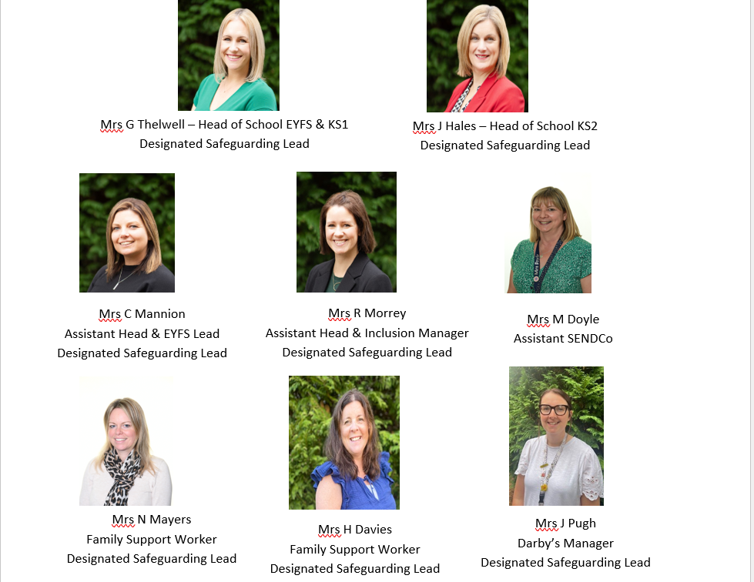
Who’s who?

Slide 3
Key Stage 1 Team
Year Leaders: Miss Farrington Year 1
Miss Thornton Year 2
Year 1 Team:
Mrs Johnson, Mrs Richardson
Miss Bamber, Mrs Hunt
Year 2 Team:
Mrs Scott, Mrs Stajka, Mrs Barker
Mrs Taylor, Mrs Morris, Miss Edwards, Mrs Cotteril
Notes:
SMT

Slide 4
Morning and Hometime
Gates open at 8:40am – please be prompt. If you need to see your child’s teacher, please make an appointment. Any messages should be written in the Home School Organiser or sent on ClassDojo.
Hometime is 3:20pm. 2D and 2P come out of the door by the hall. 2S and Year 1 come out of their own classroom doors.
Notes:
SMT

Slide 5
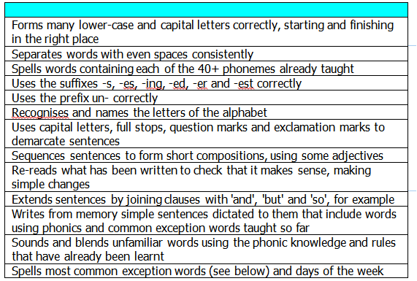
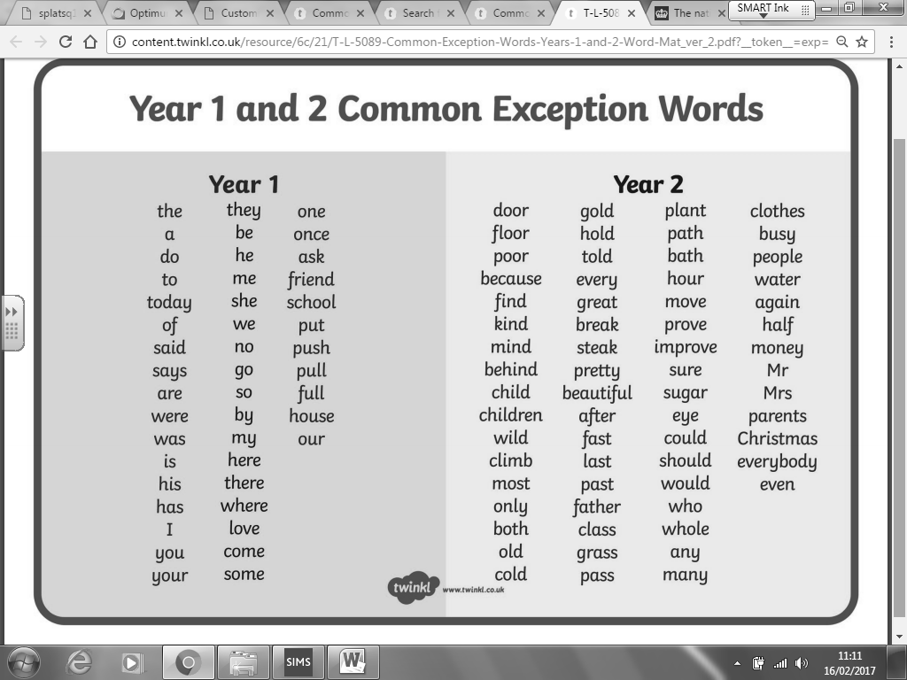
Year 1 Writing
Found in the Home School Organiser.
To be ‘secure’ at the end of Year One a pupil must be able to demonstrate most of the above statements with competence and across a range of contexts.
A letter formation information sheet can be found in the Home School Organiser.
Notes:
Alana

Slide 6
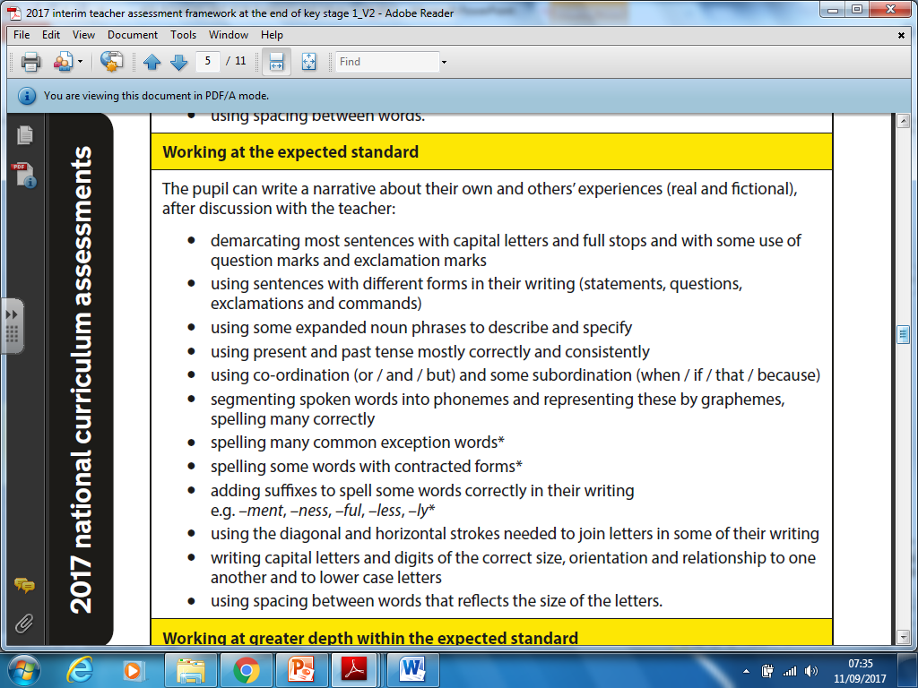
Year 2 Writing
80% of the time
60% of them
Notes:
Kiera

Slide 7
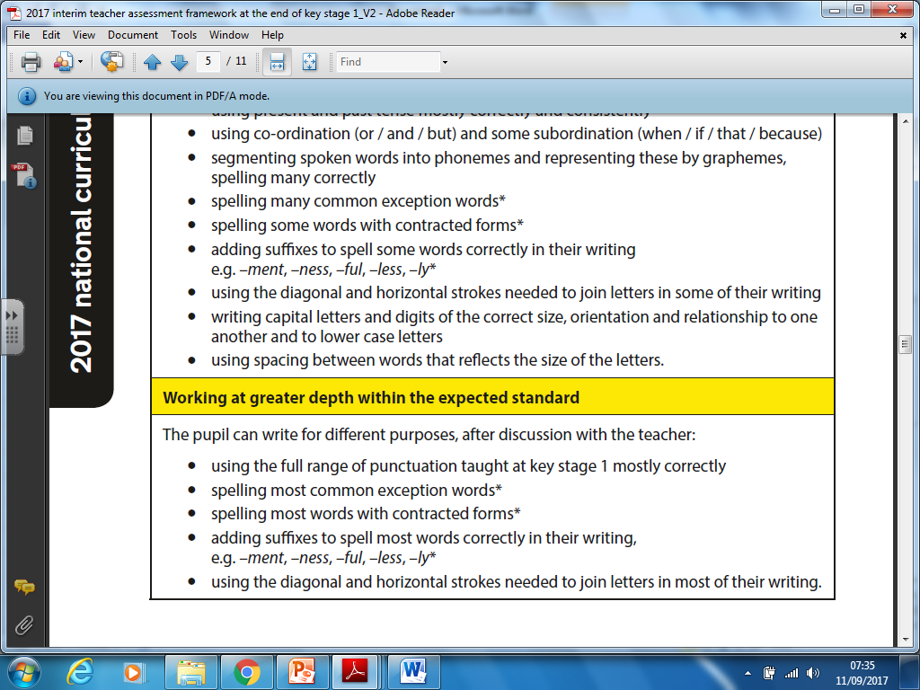
Year 2 Writing
80% of them
Notes:
Kiera

Slide 8
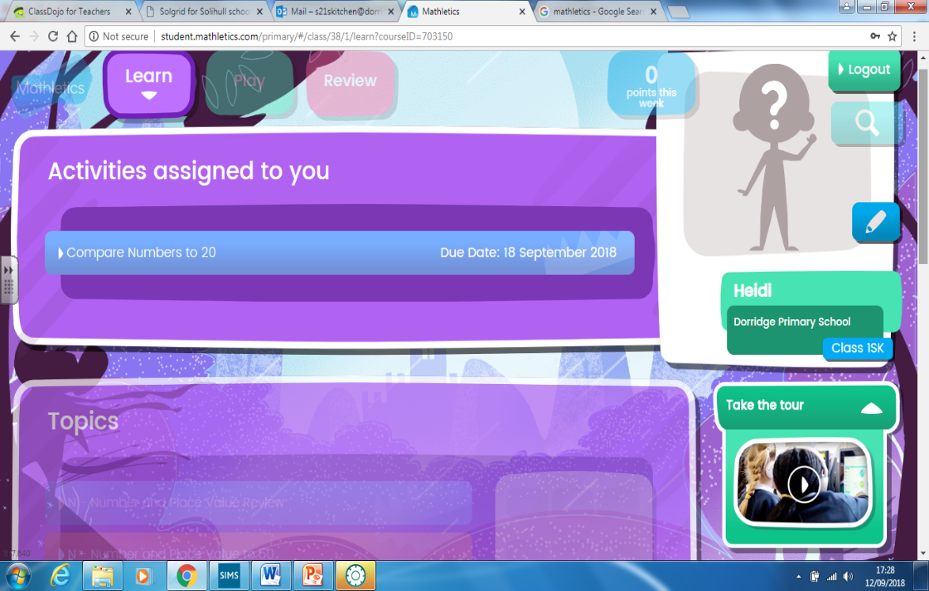

Homework
Monday – English (Spellings and reading/writing task)
A spelling sheet will be set every Monday – return on Thursday please.
Year 1 will be set 5 spellings and no weekly spelling test.
Year 2 have a weekly spelling test each Friday. Spelling books are sent home on Monday for you to check your child’s score. Please ensure that the spelling book is returned by Thursday.
Tuesday – Maths (Mathletics)
Every day – Reading
In Year 2 – The children have
access to TTRS where we will
be holding weekly competitions
between the 3 classes.
              Books are changed in school on a Monday.
              A school adult will listen to your child read once per week.
Notes:
Kirsten

Slide 9
Reading Raffle
In order to boost the children’s enjoyment for reading, each term we have a reading raffle where 1 child from each class will win.
To earn a raffle ticket, the children need to read 5 x per week, and have this signed in their diary. The class teacher will check this and give them their raffle tickets accordingly.
On top of this the children will earn dojos for home reading:
- 1 dojo = Reading 3 x in a week
- 2 dojos = Reading 5 x in a week
Notes:
Kiera

Slide 10



Behaviour
Rewards: Class Dojo points
Stickers
Endeavour certificates
Postcards home
Sanctions:
Warning
2 minutes thinking time
5 minutes thinking time
10 minutes thinking time with LMT / SMT and letter home
Notes:
Nina

Slide 11

Safer Schools is an app school are able to provide to families of Dorridge Primary School. It gives you the most up to date online safety information to ensure the best safeguarding for our pupils.
Copyright 2019 © INEQE Group Ltd.
Notes:
SMT

Slide 12
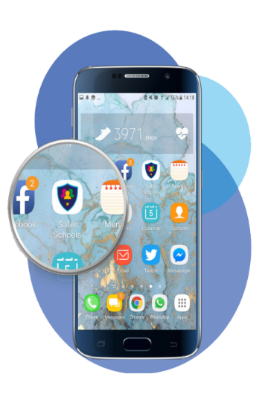
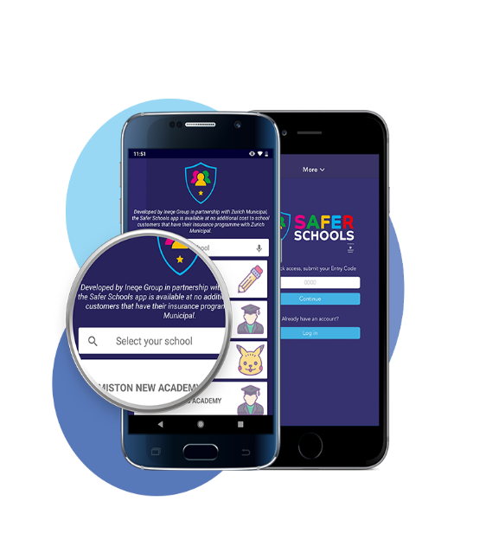
To open the app
Download the app for free from the Google Play Store or App Store.
Enter the name of our school here.
Then tap ‘Continue’
Copyright © INEQE Group Ltd.
Notes:
SMT

Slide 13
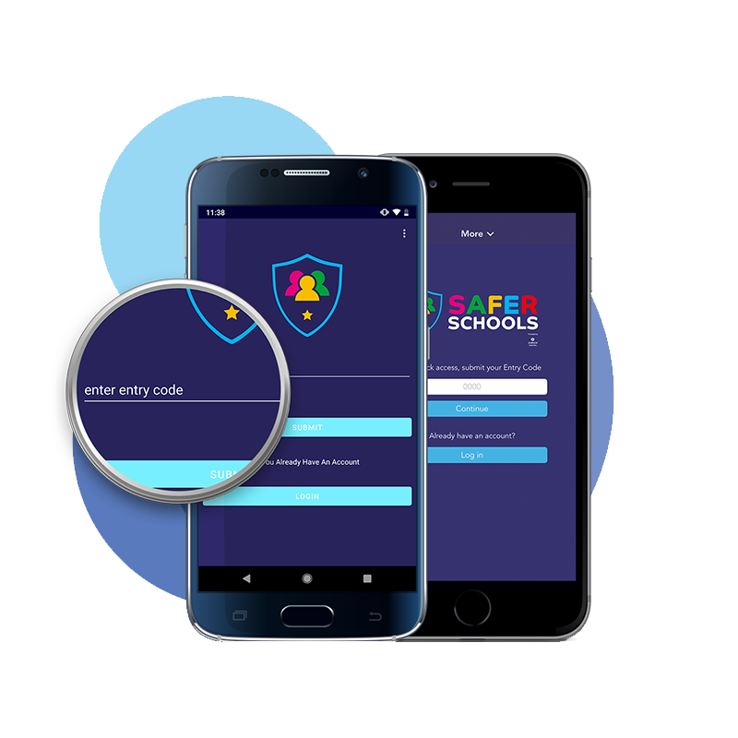
ENTER YOUR CODE
This is where you enter your ‘Entry Code’ Our school code is
6903
This will then give you access to the content within the app.
Copyright © INEQE Group Ltd.
Notes:
SMT

Slide 14
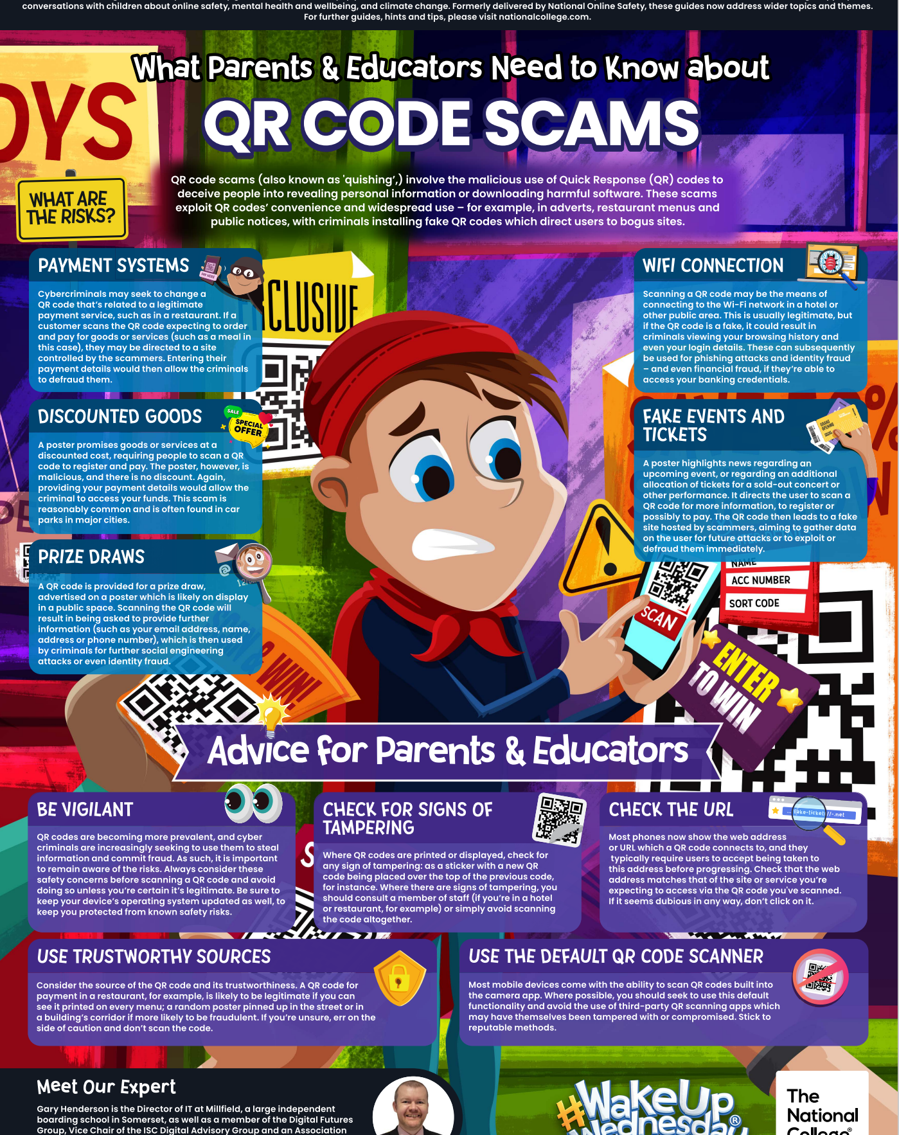
#Wakeupwednesday
Keeping parents updated on new trends; apps and keeping children safe in an online world.
Look out for weekly Wednesday updates on Class Dojo.
Notes:
SMT

Slide 15
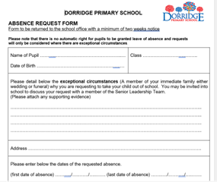
Attendance
Good attendance is vitally important to your child’s education
We monitor all children’s attendance on a half termly basis – we will write to you if your child’s attendance drops below 90%
Central Schools Attendance and Welfare Service support schools and families in maintaining good attendance
This request needs to be completed at least 4 weeks in advance
Notes:
SMT

Slide 16
Fines
Each half day in school is known as a session.
After 10 sessions (5 days) of unauthorised absences (over a 10 week rolling programme) you will be fined
Both parents are fined for each child who has missed 10 sessions of school recorded as unauthorised.
It’s the LA who fine, not school. We must follow Government legislation
FINES ARE ONLY GIVEN FOR UNAUTHORISED ABSENCE – SICKNESS ABSENCE IS AUTHORISED
Notes:
SMT

Slide 17


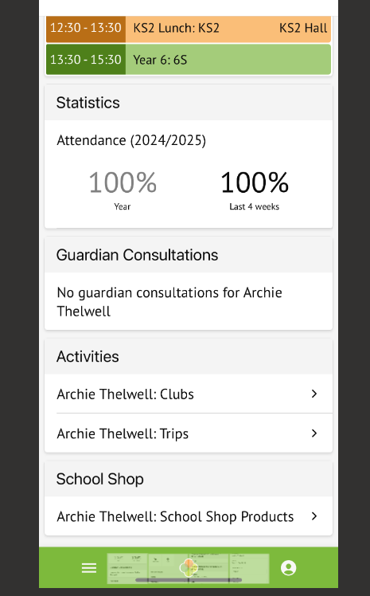
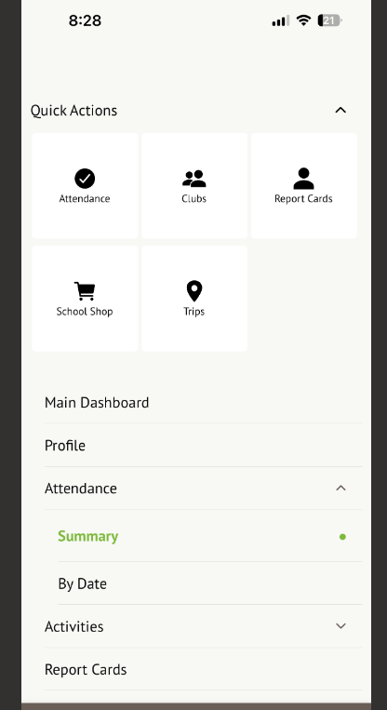
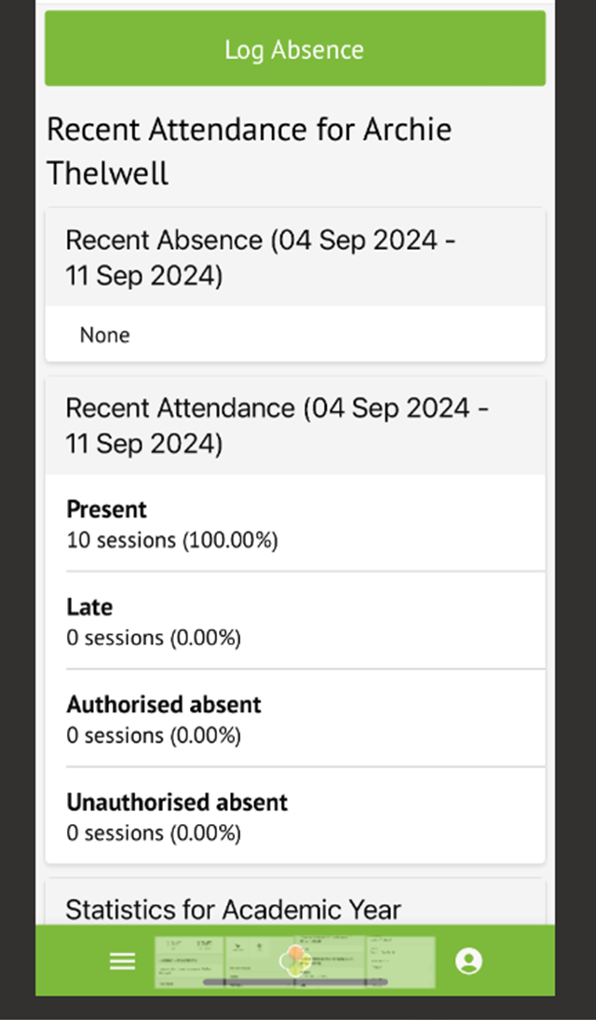

Reporting your child’s absence
2. Click here
1. Click here
Notes:
SMT

Slide 18
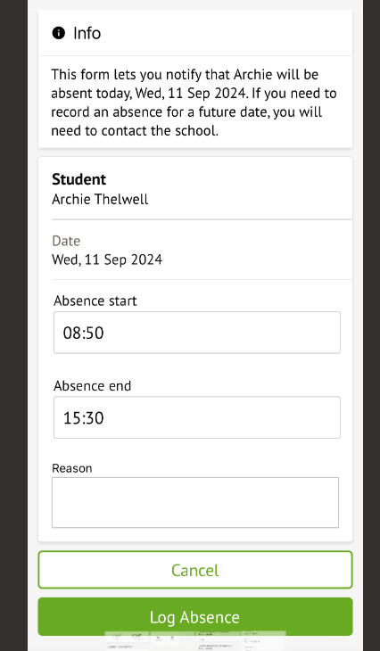

For sickness and diarrhoea, we ask the children are kept away from school for 48 hours to avoid infecting other children.
All children get coughs and colds; this should not stop them coming to school unless they are feeling really poorly.
Please be aware we will send a child home if we think they are too poorly.
Further advice on other medical conditions can be found on our website.
Try to make all medical appointments outside of school hours. If this is not possible, then you will be asked to provide evidence to our admin team for the appointment.
Once you’ve completed the form, click here to send to the office. This replaces the need to ring .
Notes:
SMT

Slide 19
Dorridge Primary Curriculum
(DPC)
New scheme for 25-26 - Kapow
Year 1 – Autumn Term
Geography – What is it like here?
Our first unit for geography is looking at where we are in the world with a key focus on our immediate environment. We will look at maps and aerial photographs to identify physical and human features. We will develop our directional language and draw our own maps of the school grounds.
History – How am I making history?
In history we are looking at our own personal history and how we fit in. We will compare our parents and grandparents lives to our own and explore special events. We will learn that ‘the past’ is events that have already happened and that people change as they get older. We will be ordering events chronologically by creating simple timelines. Later in the term we will be asking for photographs to support the children’s learning. This will be communicated via Dojo and on the Weekly News.
Notes:
Anna?

Slide 20
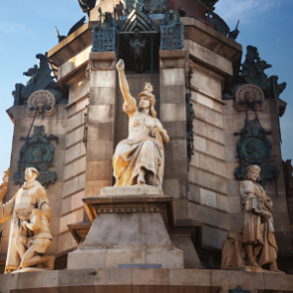

Dorridge Primary Curriculum
(DPC)
New scheme for 25-26 - Kapow
Year 2 – Autumn Term
History - How was school different in the past?
Our first History unit this year will be ‘How was school different in the past’. Through this, the children will look at what school was like in the past, and how it has changed to the way the children experience school life today. They will learn to correctly order and date events on a timeline, make comparisons between schools in the past and present, identify features of a classroom now and a classroom 100 years ago, identifying some similarities and differences and decide whether they would have preferred to go to school in the past or not and explain why.
Geography – Would you prefer to live in a hot or cold place? Our first geography unit ‘Would you prefer to live in a hot or cold place’. This involves learning about our world and the different climates different countries experience. The children will learn to name and locate the seven continents on a world map, as well as the North and the South Poles and the Equator, describe some similarities and differences between the UK and Kenya, investigate the weather, writing about it using key vocabulary and explaining whether they live in a hot or cold place.
We always love hearing about parents who work in or have experiences related to our topics, therefore if you feel this applies to you and would feel comfortable coming to talk to the children, please contact your child’s class teacher or Miss Thornton!
Notes:
Georgie

Slide 21
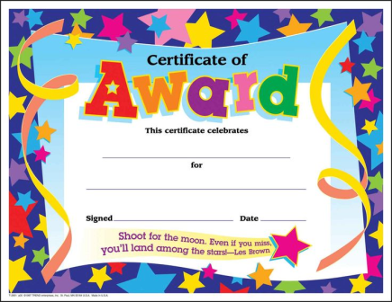

Endeavour Assembly
FRIDAY
Notes:
SMT

Slide 22
Assemblies
Christmas Play: Year 2 only
Thursday 11th December (morning 9:30am and afternoon 2pm)
Please attend ONE performance so all parents have the opportunity to see their child(ren) perform.
Two tickets per child.
Notes:
Sophie S

