Slide 1



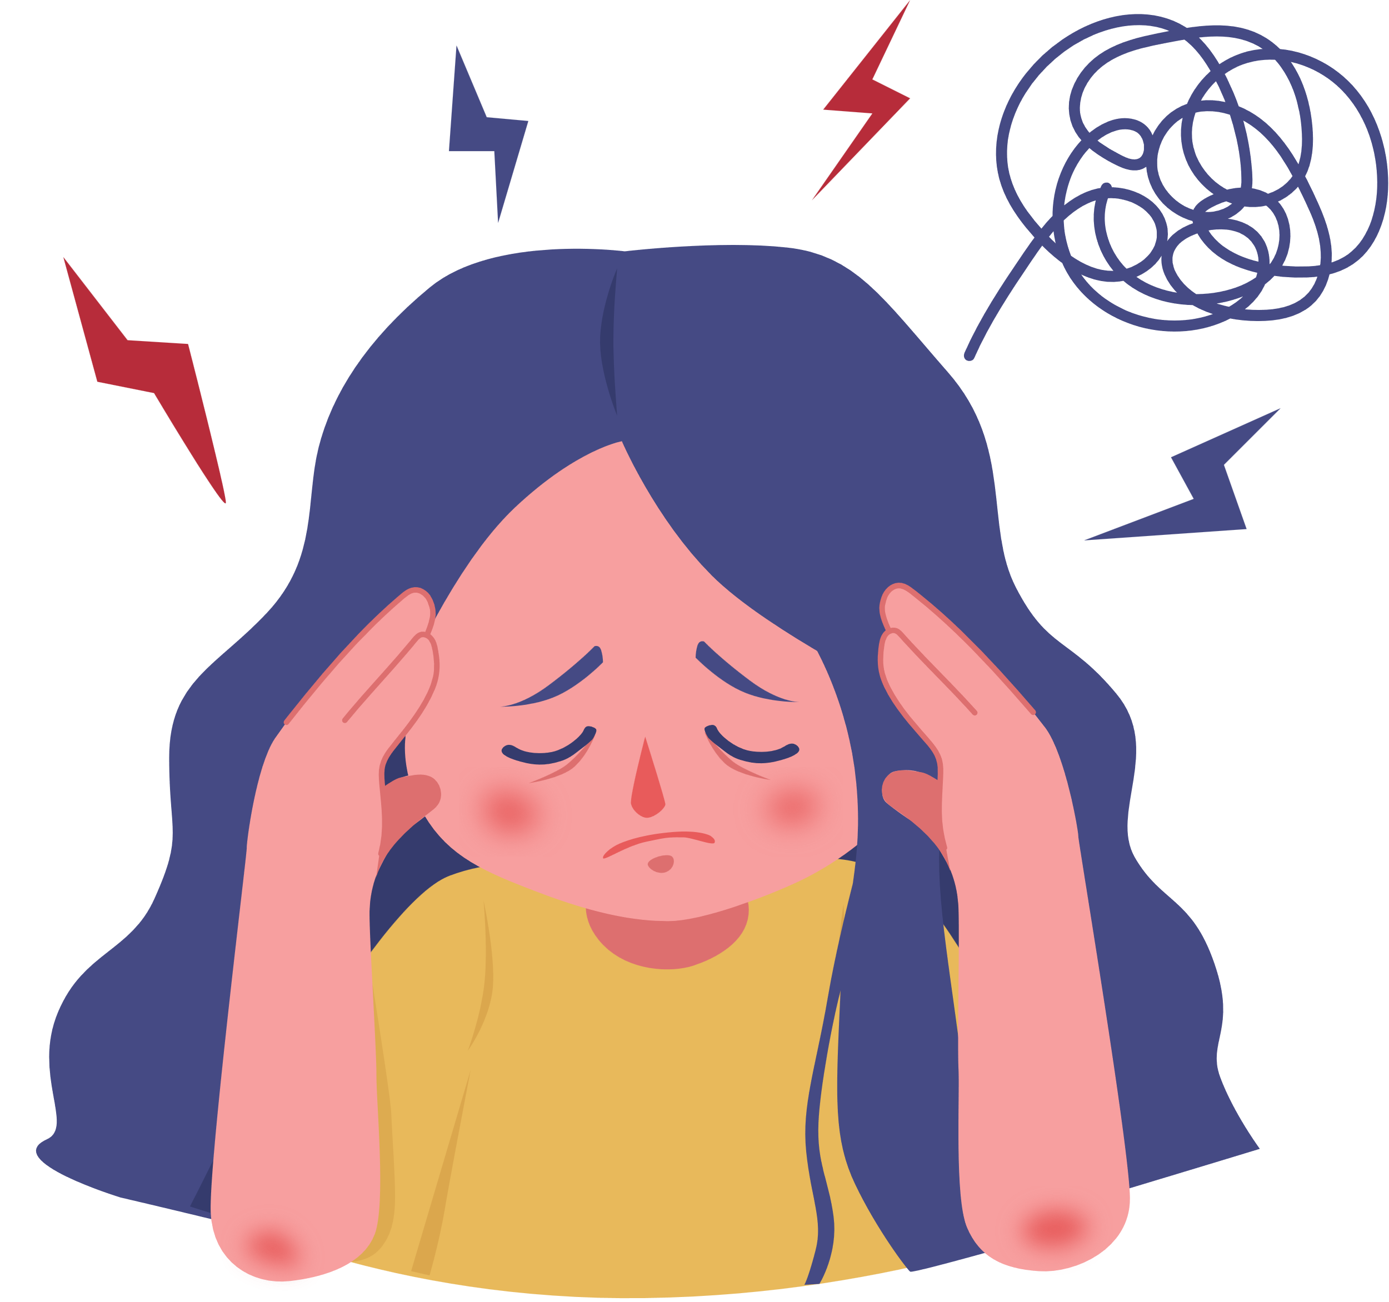

Supporting Young People’s Mental Health - Anxiety

Slide 2


Who are we?
Support for young people
Support for parents / carers
The Mental Health Support Team (MHST) within Solar provides Emotional Wellbeing and Mental Health Services to children, young people and families in Solihull.
Solar supports young people (0-19 years old with some aspects going up to 25 years old) who are struggling with their emotional wellbeing / mental health.
Workshops
Support for school staff
Advice, support and signposting
1:1 intervention support

Slide 3
Agenda
Strategies to support children with anxiety
What is anxiety
Understanding physiological symptoms
Signposting and further support
CBT cycle of anxiety

Slide 4
Anxiety disorders
In the 2023 Mental Health of Children and Young People in England survey, 1 in 5 children and young people aged 8 to 25 were found to have a probable mental health disorder.
Anxiety disorders tend to be the most common difficulty affecting children and adolescents.
Generalised Anxiety Disorder (GAD)
Panic Disorder (Panic Attacks)
Separation Anxiety
Obsessive Compulsive Disorder (OCD)
Social Anxiety (Social Phobia)
Selective mutism
Specific Phobias
Notes:
It is important for us to focus on understanding anxiety as it is the most common disorder in children and young people.
Generalized anxiety disorder includes persistent and excessive anxiety and worry about activities or events — even ordinary, routine issues. The worry is out of proportion to the actual circumstance, is difficult to control and affects how you feel physically. It often occurs along with other anxiety disorders or depression.
Panic disorder involves repeated episodes of sudden feelings of intense anxiety and fear or terror that reach a peak within minutes (panic attacks). You may have feelings of impending doom, shortness of breath, chest pain, or a rapid, fluttering or pounding heart (heart palpitations). These panic attacks may lead to worrying about them happening again or avoiding situations in which they've occurred.
Selective mutism is a consistent failure of children to speak in certain situations, such as school, even when they can speak in other situations, such as at home with close family members. This can interfere with school, work and social functioning.
Separation anxiety disorder is a childhood disorder characterized by anxiety that's excessive for the child's developmental level and related to separation from parents or others who have parental roles.
Social anxiety disorder (social phobia) involves high levels of anxiety, fear and avoidance of social situations due to feelings of embarrassment, self-consciousness and concern about being judged or viewed negatively by others.
Specific phobias are characterized by major anxiety when you're exposed to a specific object or situation and a desire to avoid it. Phobias provoke panic attacks in some people.

Slide 5

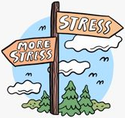
Risk factors – What can cause anxiety?
Biological factors
Genetics - Research has shown that anxiety disorders are more likely in children whose parents also have anxiety or other mental health problem.
Personality - We are all born with a particular genetic makeup and temperament / personality. Some of us are naturally more sensitive to anxiety or have a shy temperament and this can make us more vulnerable to experiencing problematic anxiety.
Traumatic / stressful events
Parental separation
Bereavement
Abuse or neglect
Bullying
Financial issues
Long term illness / accidents

Slide 6


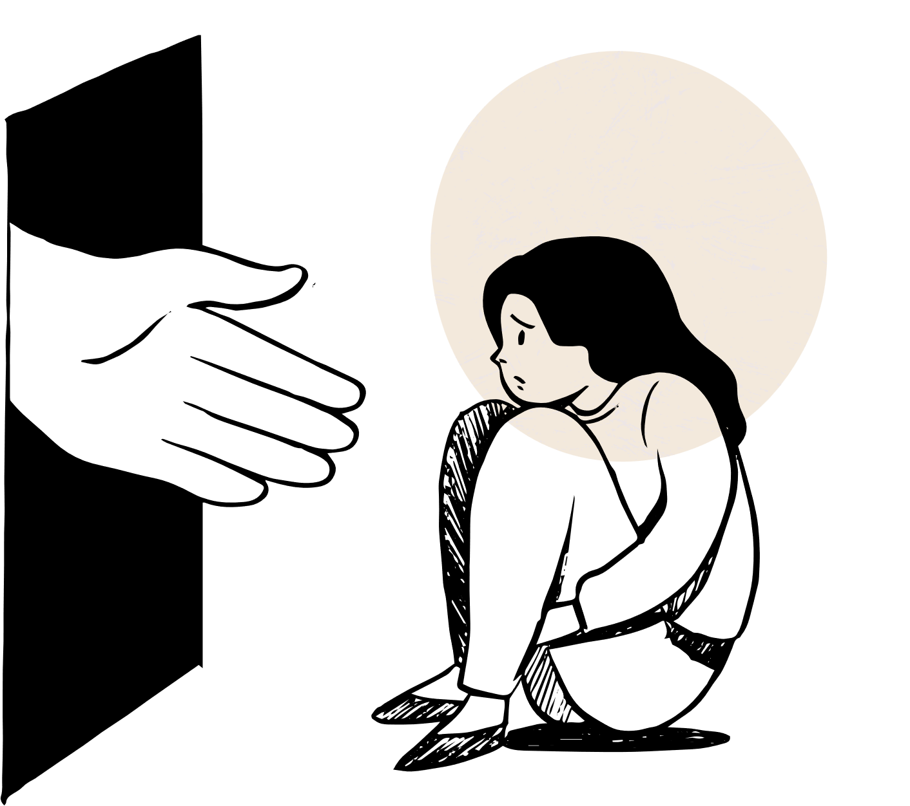
Signs that children may be struggling with anxiety...
Emotional dysregulation or distress e.g. crying or screaming
stomachache, sickness, headache or complaining of feeling ill
Low self esteem and/or lack of confidence
School refusal – impact on attendance
Display greater reliance upon family members e.g. separation anxiety
Struggling with peer relationships and/or social situations.
Avoidance of difficult or new situations
Seeming distracted or preoccupied
Difficulty concentrating, fidgeting, etc.
Constantly worrying or having negative thoughts
Seeking reassurance often
Notes:
DISCUSSION – What signs have you recognised in your classes that a child may be struggling with anxiety?

Slide 7

Supporting children and young people to recognise their anxiety, what it is and what is keeping it going
Notes:
The first step to supporting children and young people with anxiety is to help them in recognising what anxiety is, why we have it and what is keeping their own anxieties going.

Slide 8
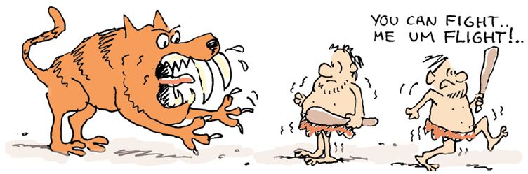
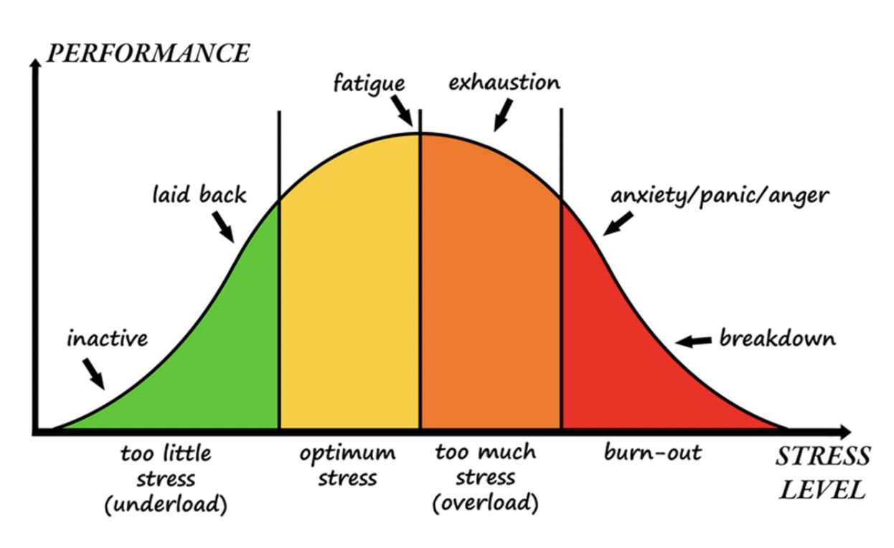

Psychoeducation of anxiety
Stress or anxiety is a natural response that has an evolutionary purpose linked to survival. This response, initiated by our brain, is called the Fight, flight or freeze response.
A little bit of anxiety is a good thing because it prepares our body for danger and helps us get things done (e.g., motivation to revise for an exam).
However, anxiety becomes a problem when it stops us from doing day to day things or concentrating as we are too busy worrying.
A good way to think of anxiety is like a faulty smoke alarm: it is overly sensitive and goes off all the time, even when there isn’t a real danger.
Notes:
We often explain to young people that our response to threats is an evolutionary advantage that was developed thousands of years ago when cavemen and cavewomen were in existence. This was a time when humans came into constant threat with large predators, putting their lives at risk on a regular basis. The body developed a natural response to this danger in order to maintain survival. We now refer to this response as ‘fight, flight or freeze’.
As human’s have evolved, we don’t face the same kind of life threatening situations as our ancestors, but our fight-flight-freeze response has remained.
Whilst some level of anxiety is a good thing as it prepares our body for danger and motivates us to do things (such as revising for an exam), it can become a problem when anxiety stops us from doing things and starts to impact our everyday life.
Subsequently, for some people , their fight-flight-freeze response is being activated inappropriately. This can be explained as a faulty smoke alarm that is overly sensitive, and goes off all the time, even when there isn't any real danger.

Slide 9
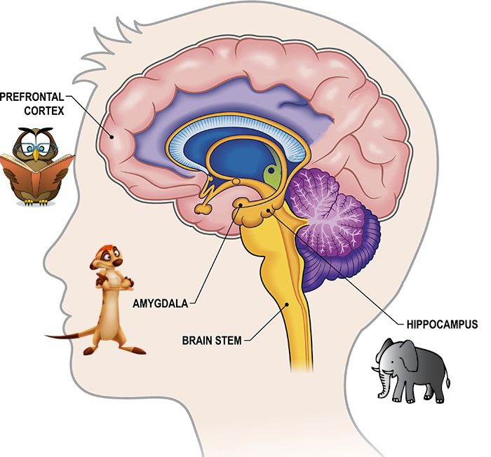
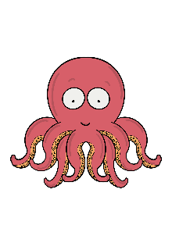
Brain Animals
When our meerkat takes over the owl flies away. We need to do something to calm down to bring our owl back
Helps us to think clearly, make good decisions and problem solve
Always on the lookout for danger, tells us how to feel and sometimes gets this wrong!
Stores memories
Tells the body what to do- be sick, breathe faster, pump more blood around the body
Notes:
The animal analogy of the brain can be a useful tool to help children understand the brain and emotions.
Supports with normalising difficulties.

Slide 10
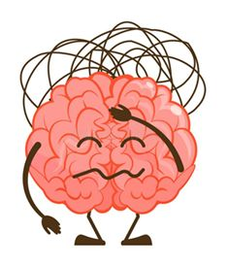
Identifying triggers
Crowded places
Taking a test or an exam
Friendship issues / arguments
Presenting something in front of people
Social situations
Meeting new people
Going to new places
Notes:
DISCUSSION – what are some common anxious triggers you have identified for children in your classes?
Some common anxious triggers include…
Important to me mindful of what may have triggered a child to feel anxious

Slide 11
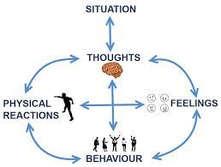
CBT cycle of anxiety
Identifying the link
Notes:
We can use a CBT informed model to understand how a situation can affect our thoughts, emotions, physical sensations and behaviours and how all of these areas interlink.
This is important to understand for anxiety, as we can get stuck in a negative cycle, so it can be helpful to notice when this happens and determine a plan of how we can change this cycle to be more positive.

Slide 12
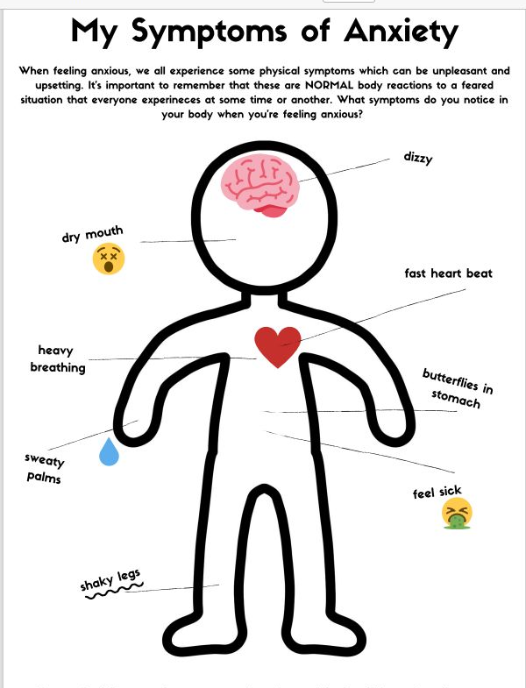
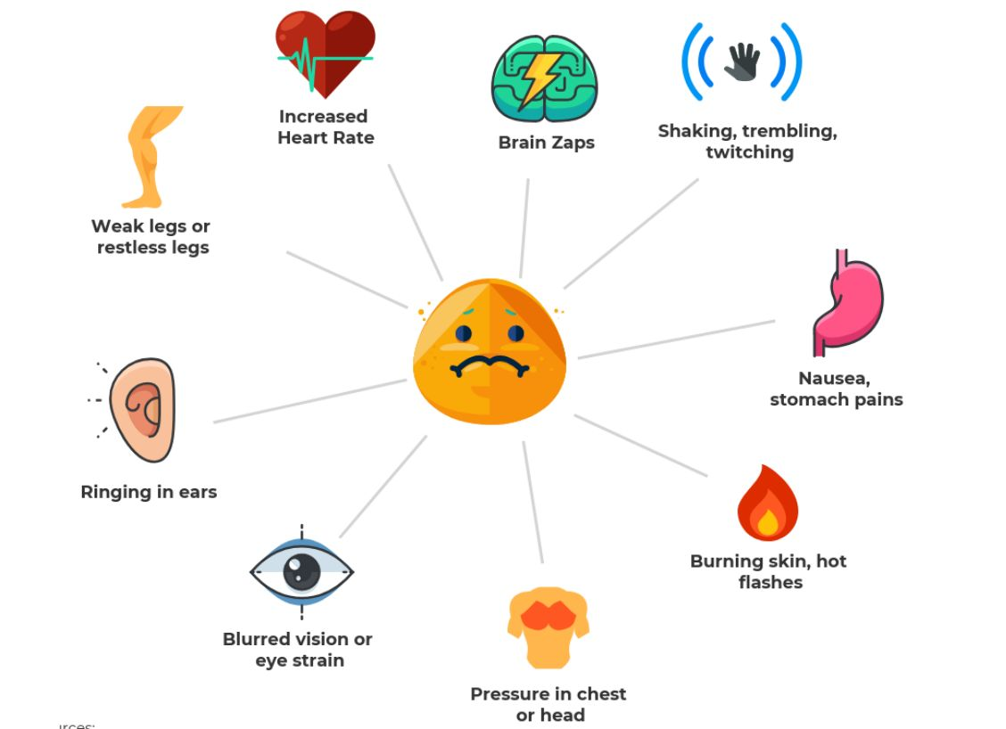
Physical Symptoms
Notes:
As the fight-flight-freeze response is a bodily response your brain will initiate to any perceived threat, whereby certain hormones like adrenalin and cortisol are released. This can causes physical reactions in your body including, which can explain why these physical sensations often accompany anxiety.

Slide 13

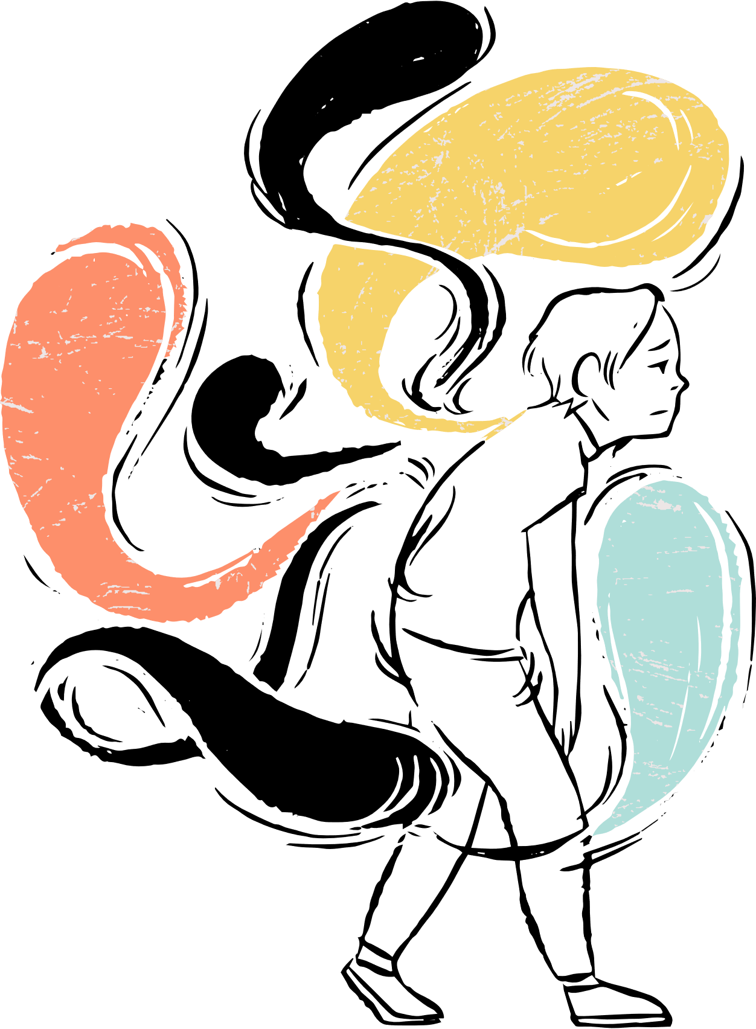
Anxious Thoughts
What if I am sick?
What if I fail my test?
Everyone hates me
People are judging me
What if people are talking about me
What if my friend doesn’t speak to me? What if I am alone at break and lunchtime.
There’s too much noise
I can’t cope
What if the teacher asks me to answer a question in class
Something bad is going to happen
I feel like I’m falling behind
Notes:
Anxiety can also be maintained by the thoughts we experience. Common anxious thoughts dependent upon the situation include:

Slide 14
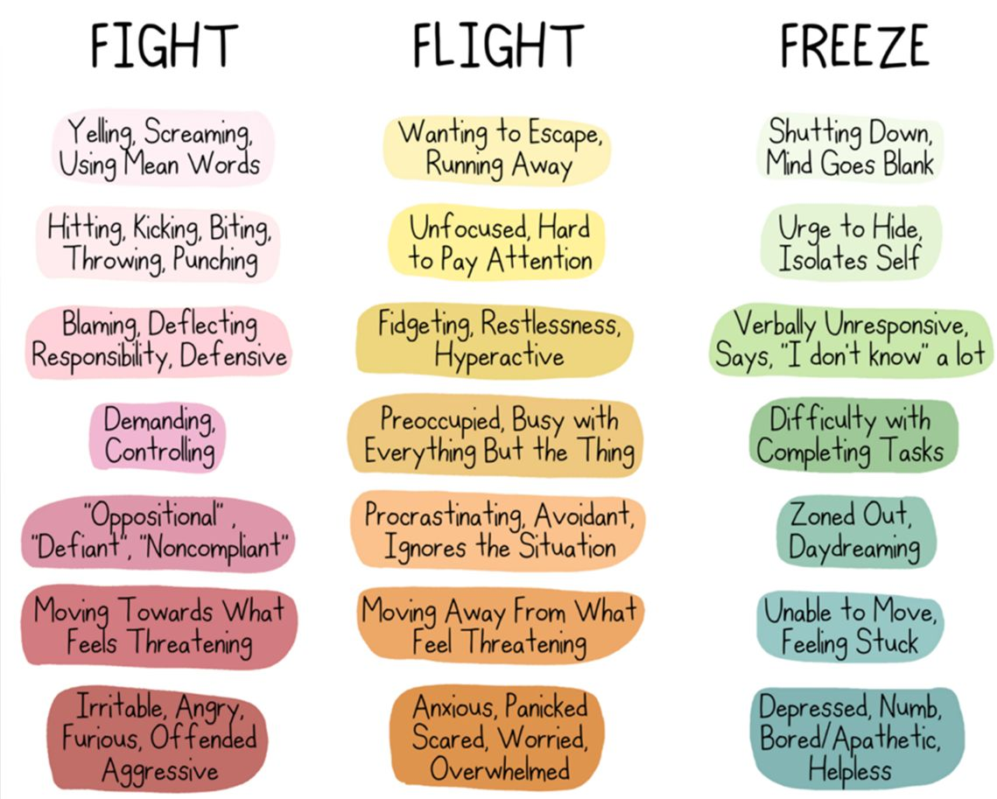
Anxious Behaviours

Slide 15
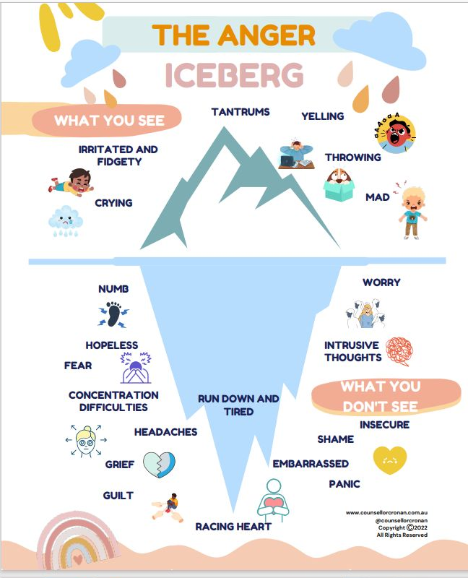
Anxiety can trigger anger and challenging behaviour (Fight response)
I can see / I have noticed that you have been shouting. What are you feeling inside?
Notes:
Also important to be considerate of underlying emotions – important to recognise and validate emotion not behaviour

Slide 16
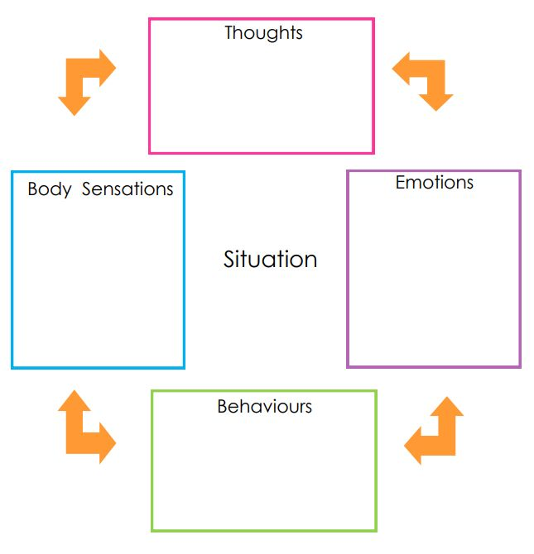
The cycle of Anxiety
What if people are mean to me?
What if the teacher picks on me to answer a question?
Stomach ache
Feel sick
Headache
Heart racing
Worried
Anxious
Scared
Angry
Going to school
May refuse to go to school
Crying
Notes:
We can use a CBT informed model to understand how a situation can affect our thoughts, emotions, physical sensations and behaviours and how all of these areas interlink.
This is important to understand for anxiety, as we can get stuck in a negative cycle, so it can be helpful to notice when this happens and determine a plan of how we can change this cycle to be more positive.

Slide 17
So how can we help break this cycle?

Slide 18
Validate and normalise difficulties
Questions | Validation | Normalising
How do you feel about that? | I think I might feel like that too if that happened to me | Being worried is really normal you know
What worries you about this? | It does sound worrying | Lots of children in our class would be worried about this
What would happen if you asked / cried / go? | I can see why you might think that would happen? | This happened to me when I….
Do you notice anything different in your tummy / heart? | It feels scary when breathing gets faster doesn’t it? | I get scared when my worries grow too.
Notes:
Empathise with the child, anxiety is not a nice feeling and can be really hard.
Normalise their experiences by sharing a time you’ve felt anxious.
Make suggestions if they’re unsure what’s making them anxious.
Check you’ve understood them by summarising

Slide 19
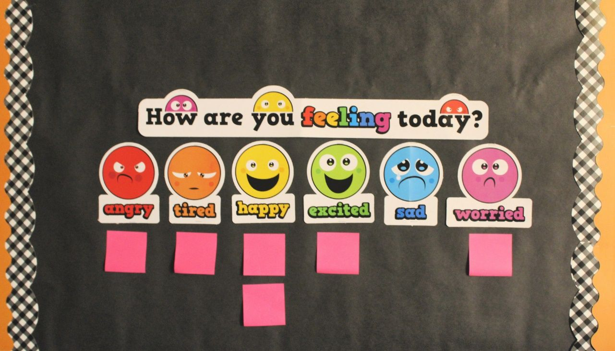

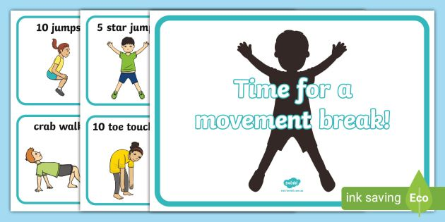
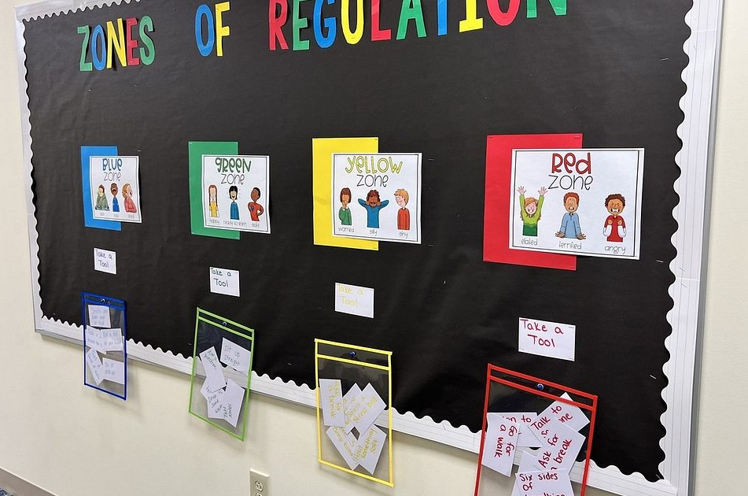
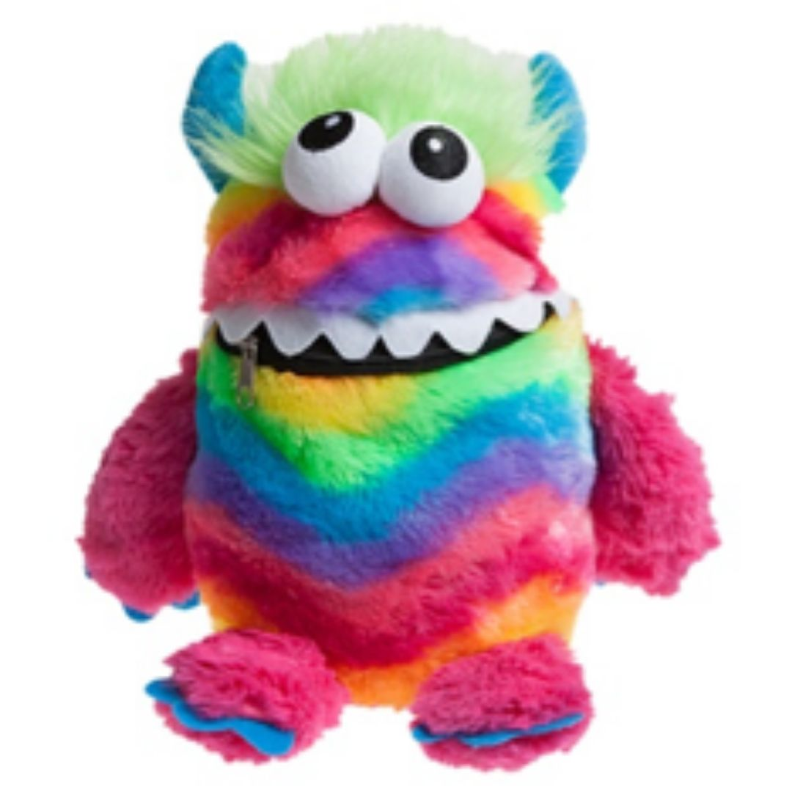
Classroom strategies
Notes:
Feeling boards – encourage children to place their name under the emotion they feel that day.
Zones of regulation – another way to check in on feelings – can have strategy / toolkit cards on how to support themselves to regulate dependent on how they are feeling
Worry boxes / worry monsters – support with recording worries and normalising difficulties
Allowing for movement or brain breaks

Slide 20
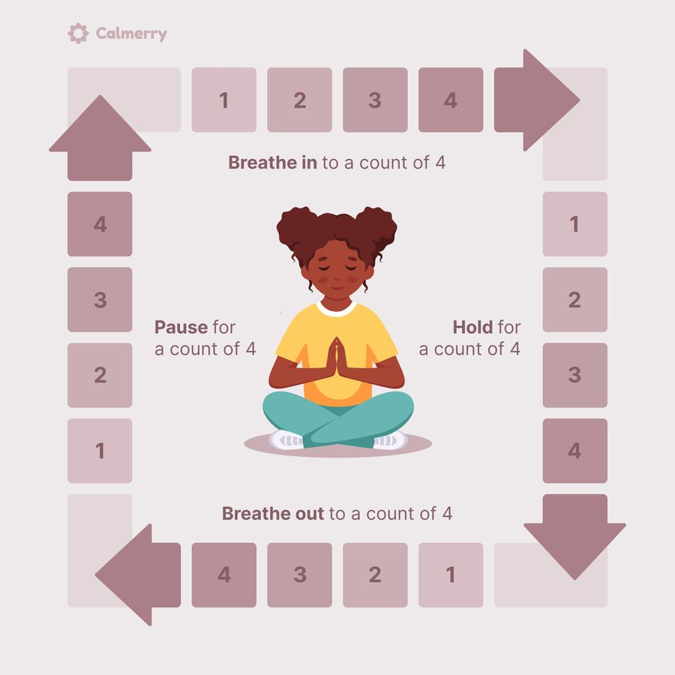
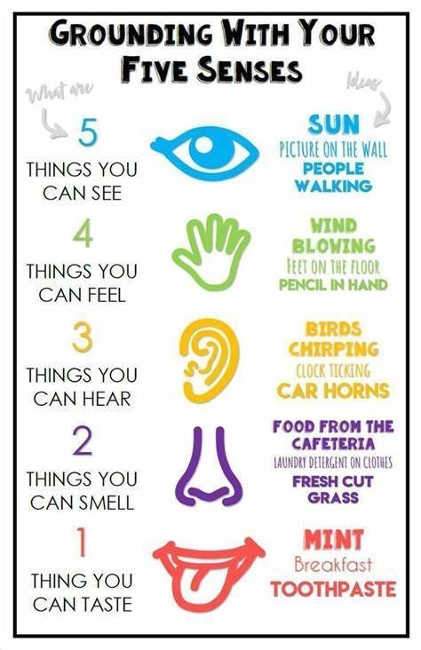
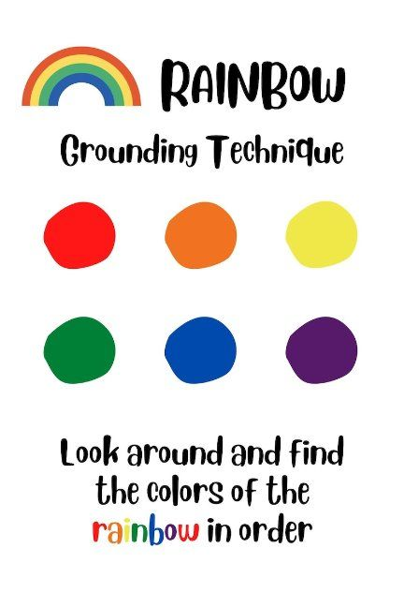
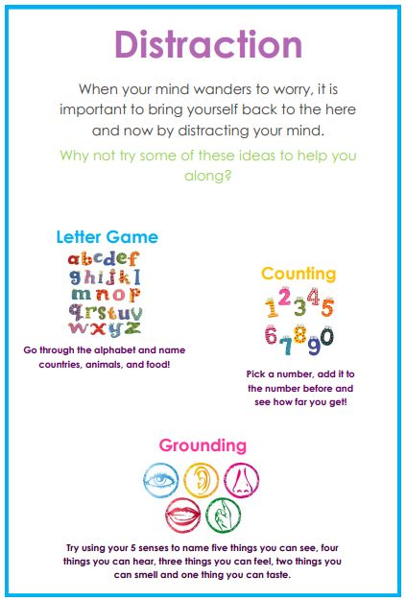
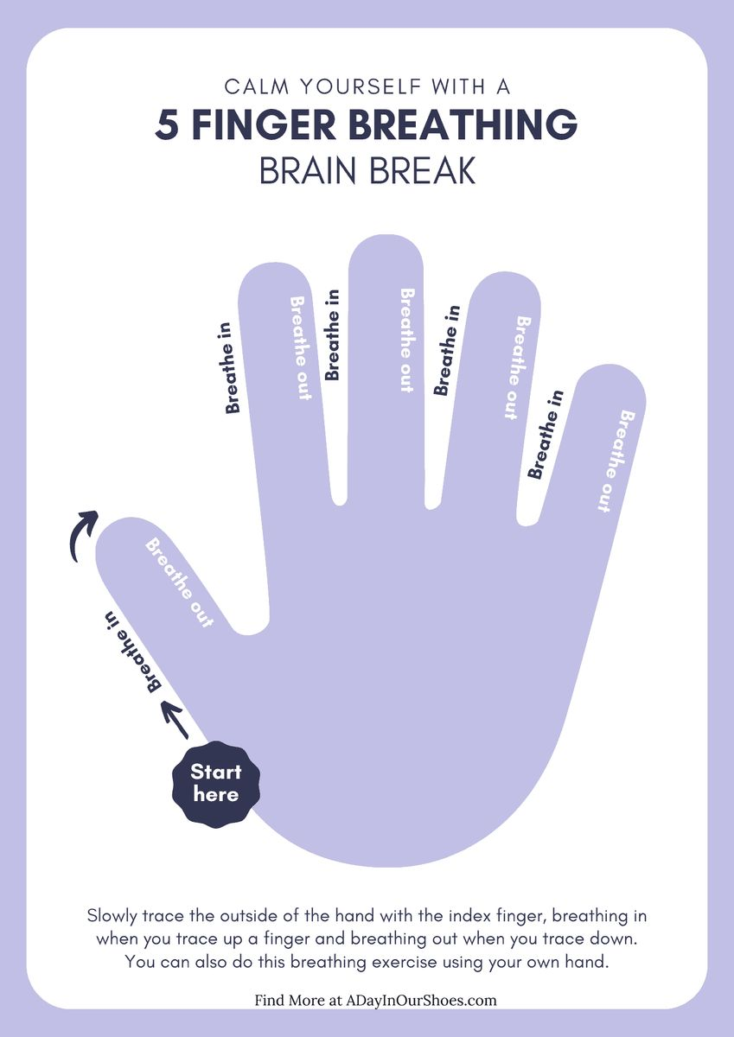
Breathing and Grounding Techniques
It can be useful to teach children that when fight or flight kicks in, our breathing speeds up, so to return to calm, we need to slow our breathing down or find ways to return to the present moment.
Notes:
Grounding can help us stay in the reality of the present moment, acting to take back control of how you are feeling and remind the brain that you
are safe. – (Brain analogy – octopus)
Here are some grounding activities you can practice. It is best to practice
these each day, when your child is already calm. You and your child can
practice these techniques together.

Slide 21
Individual adaptations
Early lunch pass (skip queue and crowds)
Transitional object
Soft starts
Fidget toys/wobble cushions
Having a safe space to regulate before lessons
Safe spaces (break/lunchtimes i.e., library, quiet room)
Key member of staff (check-ins)
Ensuring all staff are aware of difficulties/ adjustments
Timeout pass / Movement breaks
Changes to timetable (seating plans, classes)
Notes:
Some individuals may need specific reasonable adjustments to make them feel safe and less anxious in school.

Slide 22
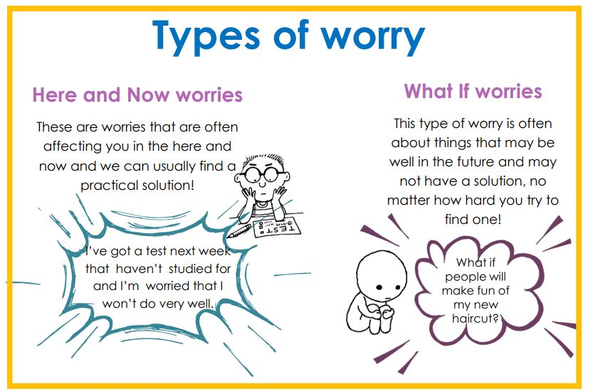
Intervention – Worry Management
Worry management is a technique to support young people with managing worry by identifying the two types of worries and limiting time spent worrying by setting a worry time.
Notes:
Intervention strategies – pastoral staff / communicate straetgies with parents for parents to implement at home
Worry management is a technique to support with managing worry by identifying the two types of worries and limiting time spent worrying by setting a worry time.
Here and now worries – practical worries
What if worries – hypothetical worries

Slide 23
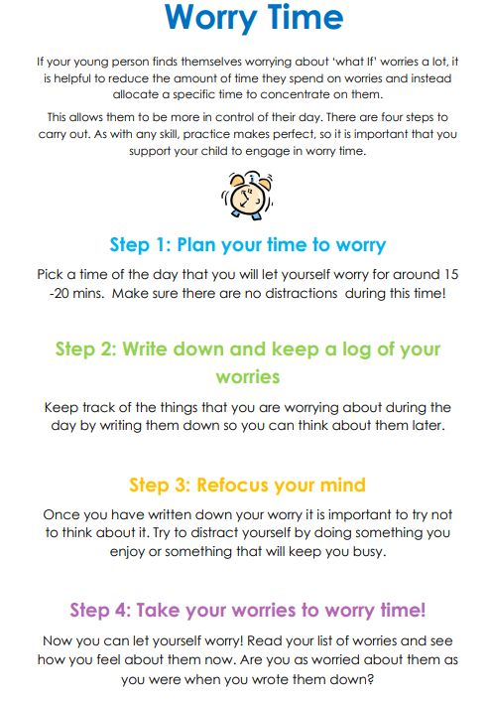
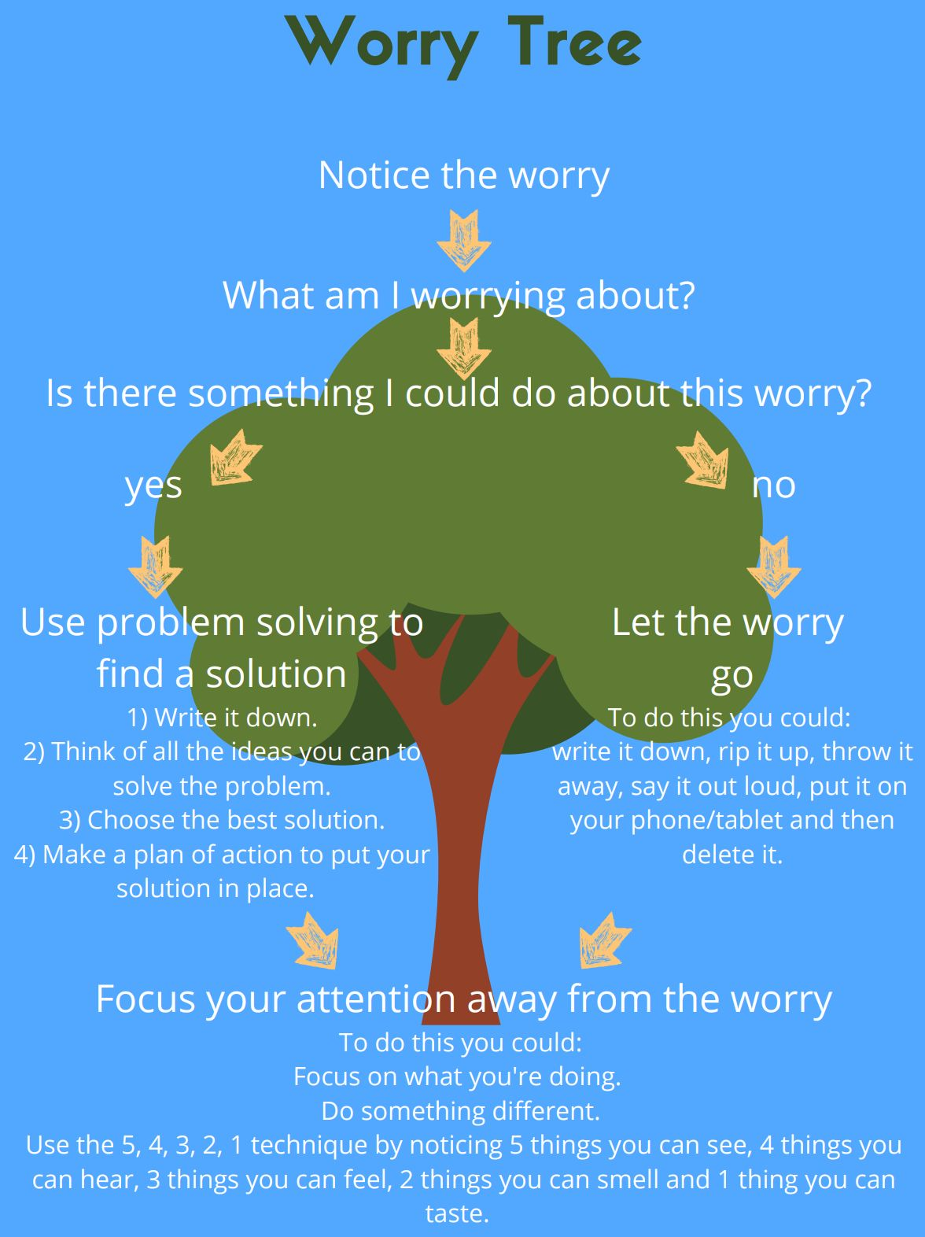

Notes:
To support with overcoming worry, it can be helpful to support a child with planning a worry time in order to limit the amount of time spent worrying. This involves creating a plan of how worries will be noted (i.e. phone, notebook, apps, worry monster, worry box). Young people should try to refocus their attention away from worries when it is not worry time. When it is the scheduled worry time, you can support a child to distinguish between hypothetical and practical worries.
During worry time, a worry tree can be a helpful visual tool to distinguish between hypothetical and practical worries, and determine a plan of how this worry will be managed.

Slide 24
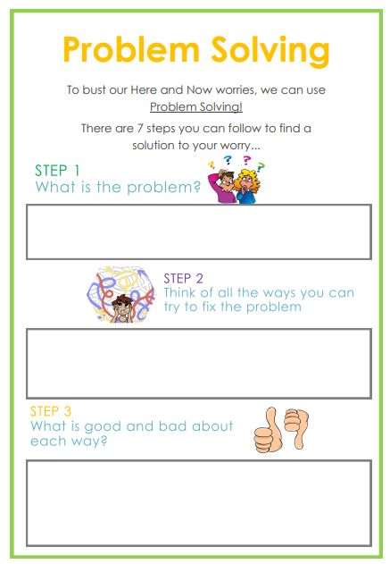
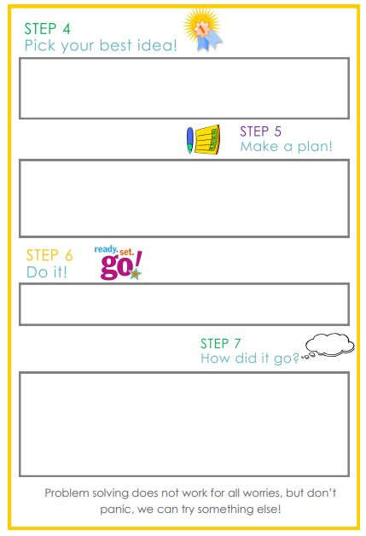

Slide 25
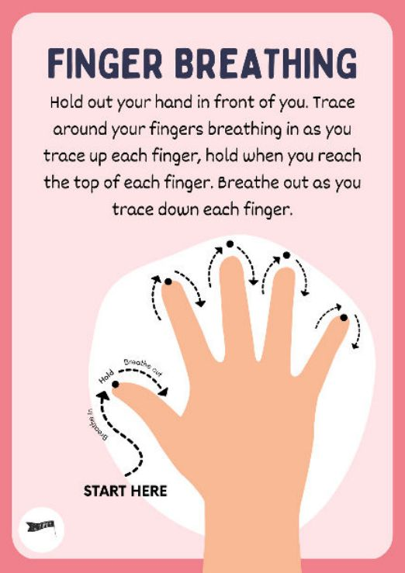
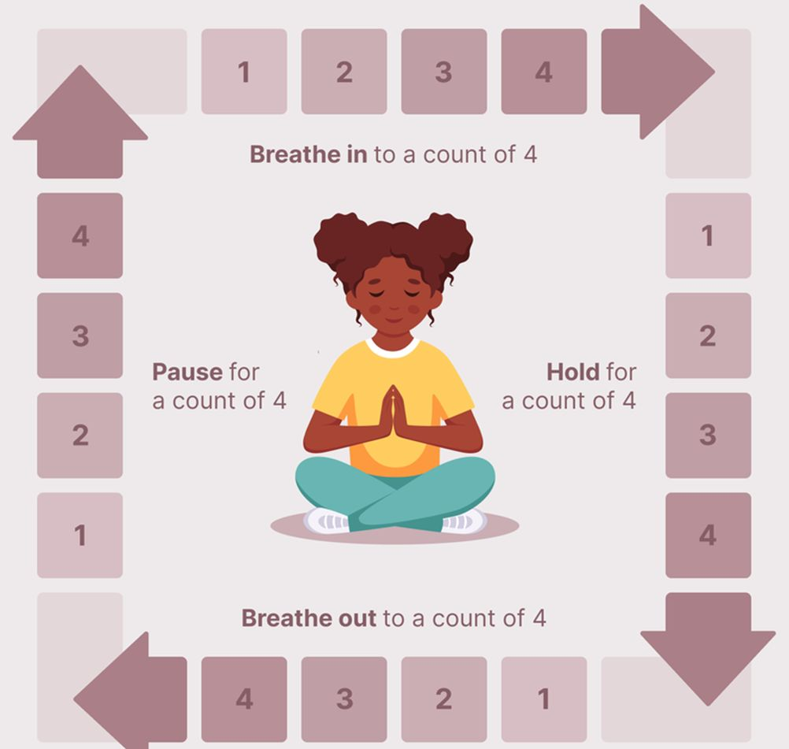
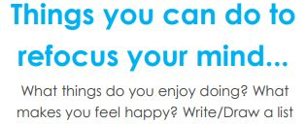

Notes:
Postponing thoughts for worry time (for example) or stopping thoughts at the end of worry time can be a real challenge. It is important that we have things lined up to help your child move on and get on with their day.
Grounding can help us stay in the reality of the present moment, acting to take back control of how you are feeling and remind the brain that you
are safe. Here are some grounding activities you can practice. It is best to practice
these each day, when your child is already calm. You and your child can practice these techniques together.
When fight or flight kicks in, our breathing speeds up, so to return to calm, we need to slow our breathing down. Here are some breathing exercises to try. It helps to practice them first, while you’re already calm. First read them slowly a couple of times, and then have a go at practicing.

Slide 26
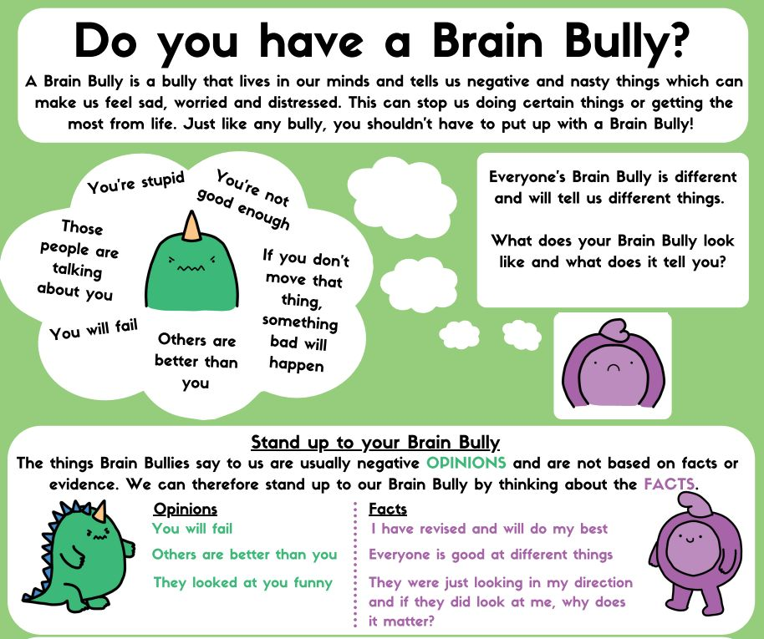
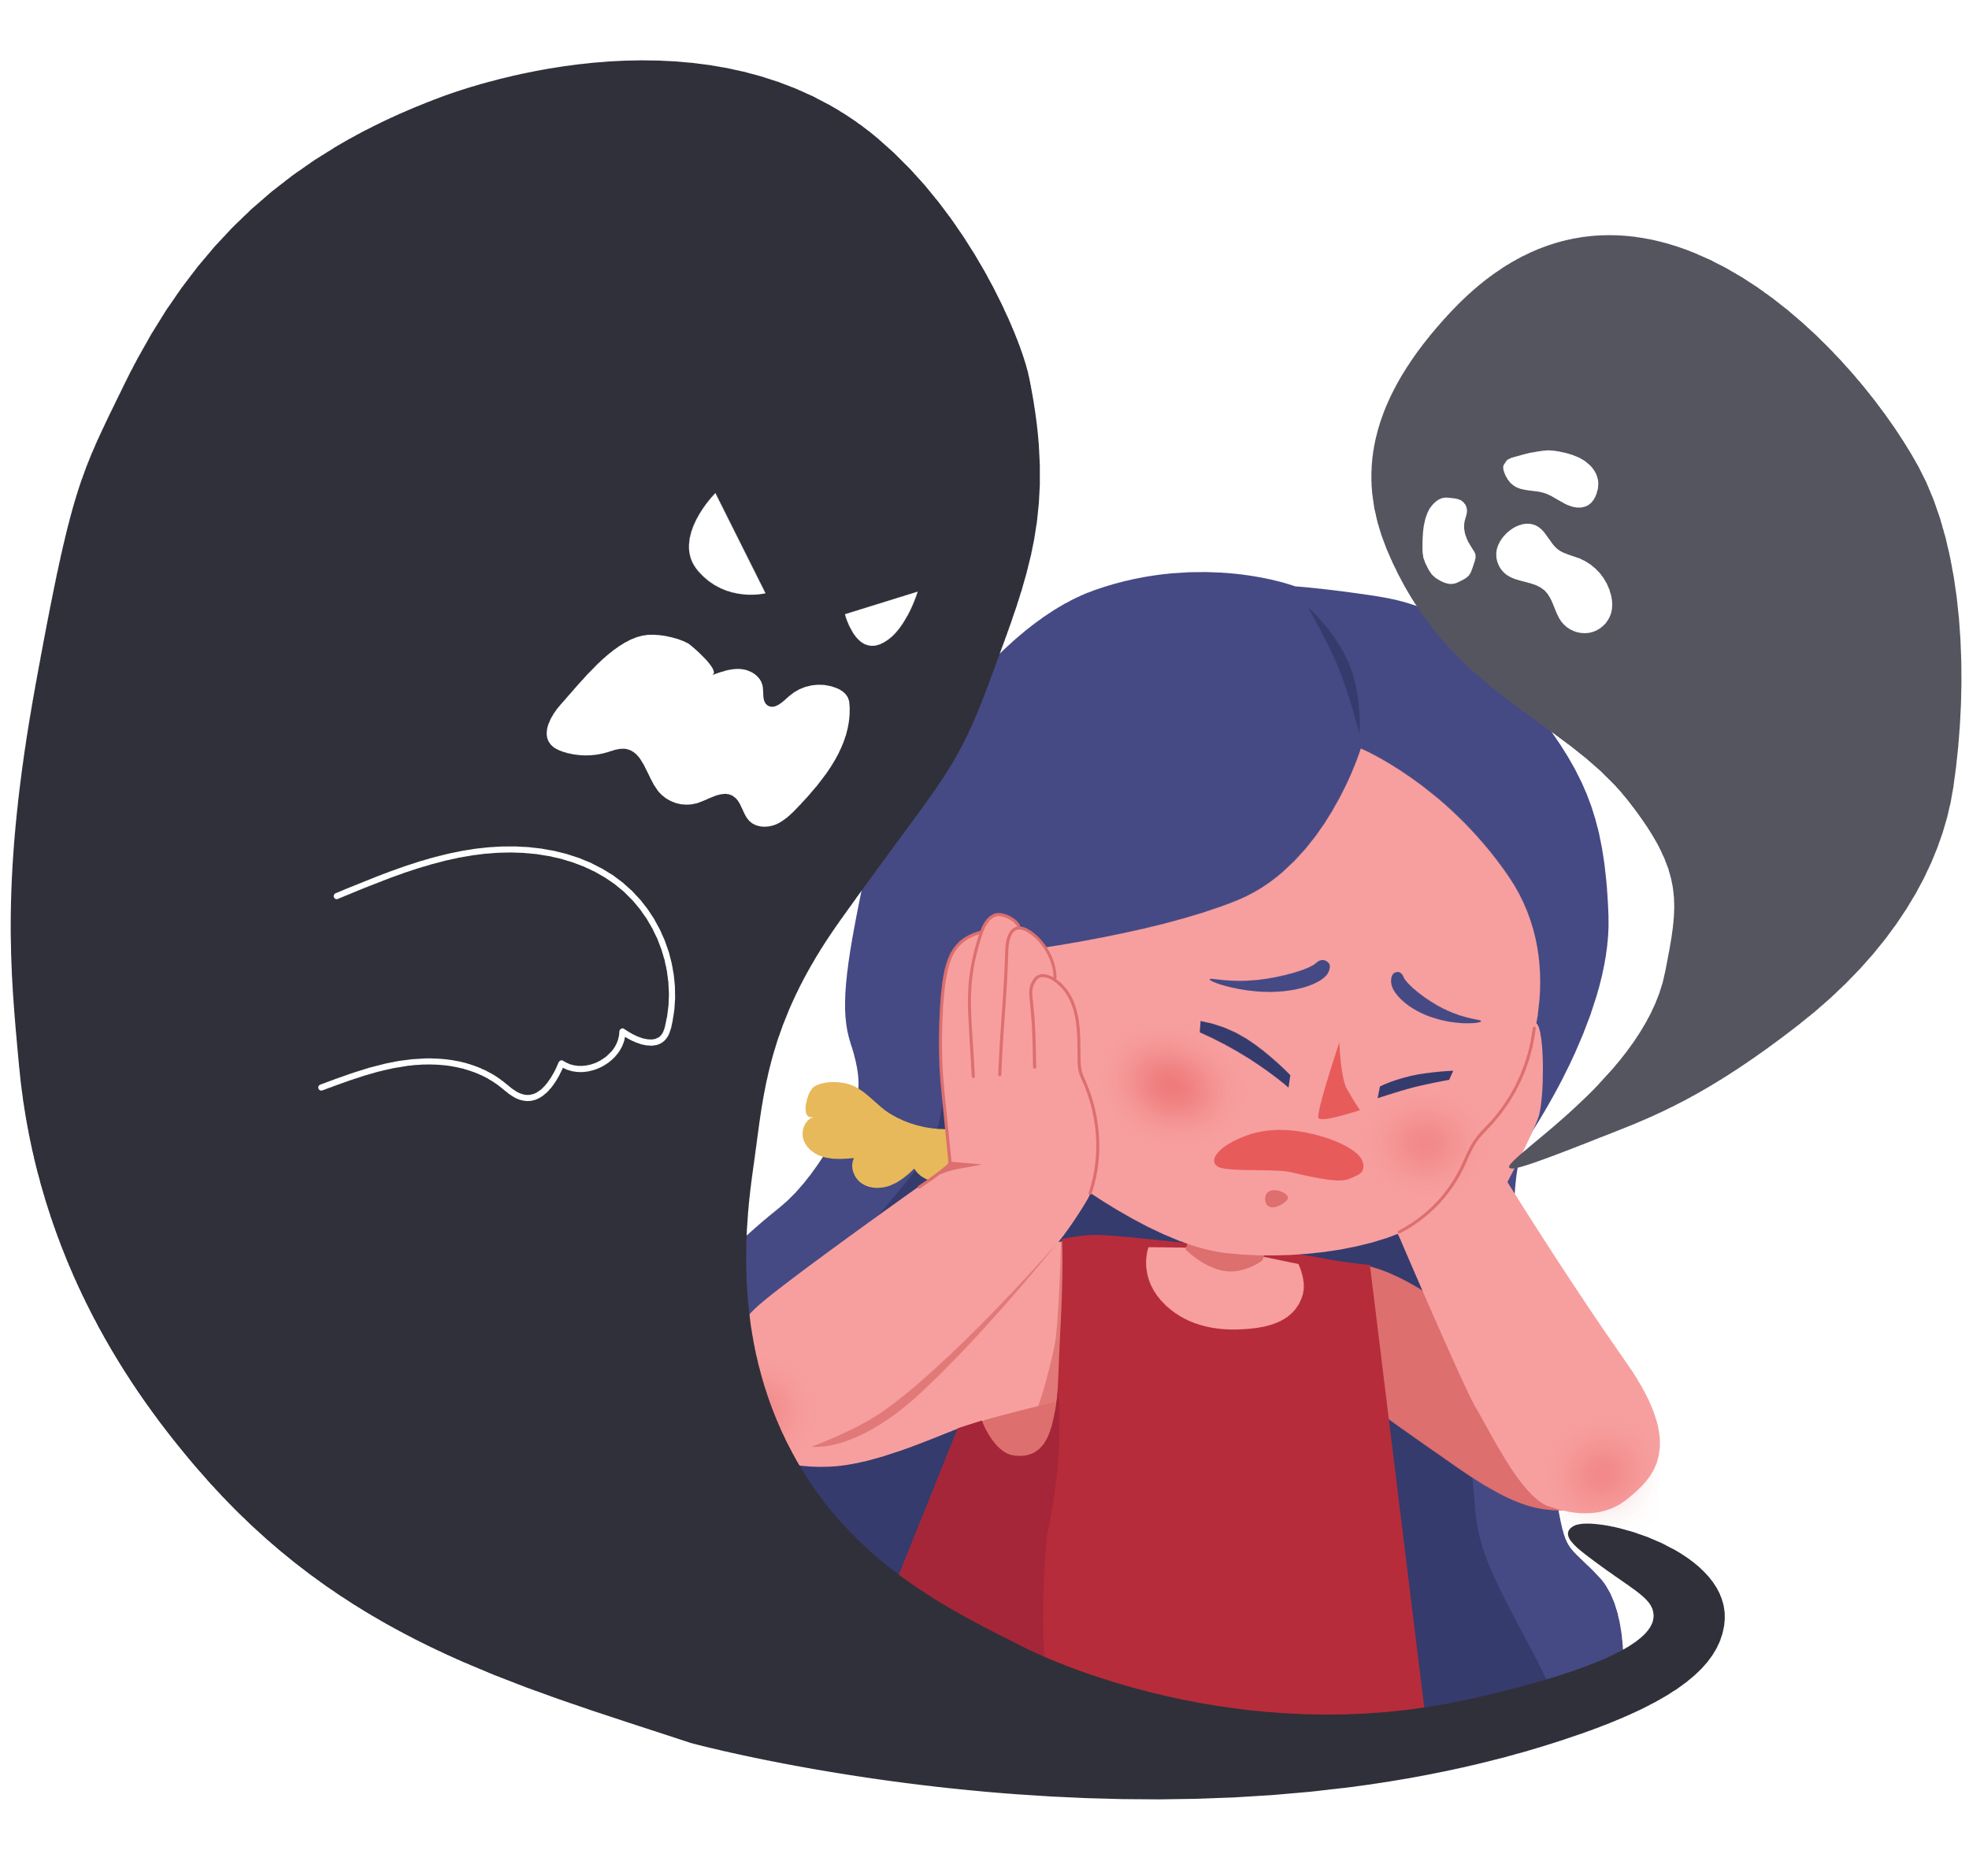
Intervention – Challenging unhelpful thoughts
Notes:
It can also be helpful to support children in identifying when they may be experiencing unhelpful thoughts. To support with recognising, it can be helpful to recognise as a ‘brain bully’. We can then share the importance of recognising the different between facts and opinions

Slide 27
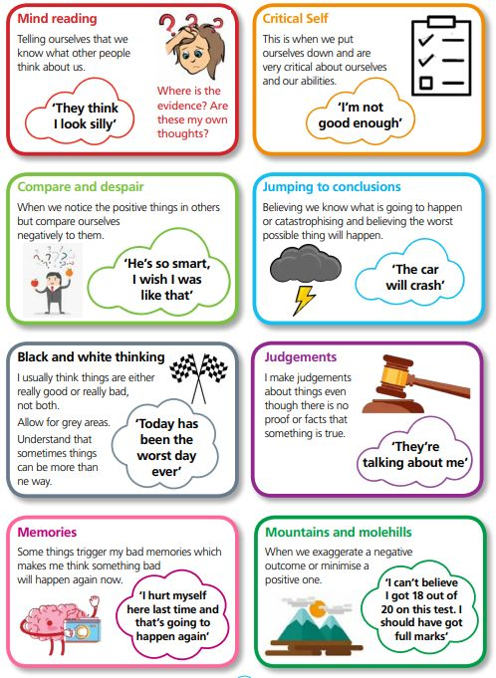
Role of negative thoughts in emotion
Unhelpful and negative thinking habits can lead to negative feelings without us even noticing.
The first step in changing negative thoughts to more positive ones is to become more aware of what we think.
Notes:
When considering the role negative thoughts can play in the cycle of negative emotion, you can support children to consider potential unhelpful thinking traps we can fall into, as our thoughts are not always true.
For some young people, identifying common thinking trap can be helpful in taking the blame away from them for thinking negatively and can see it as ‘falling into a trap’. Can have something to resonate / identify with.

Slide 28
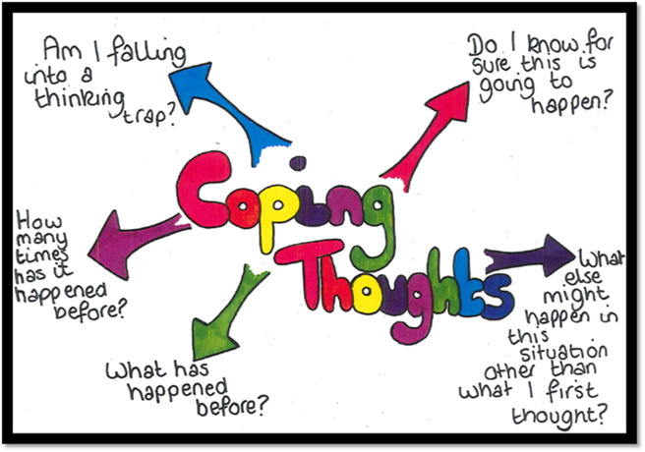
Challenging unhelpful thoughts
Notes:
You can support children to challenge unhelpful thoughts through questioning. Can help children to realise that our thoughts are not always true and can put things into perspective.

Slide 29


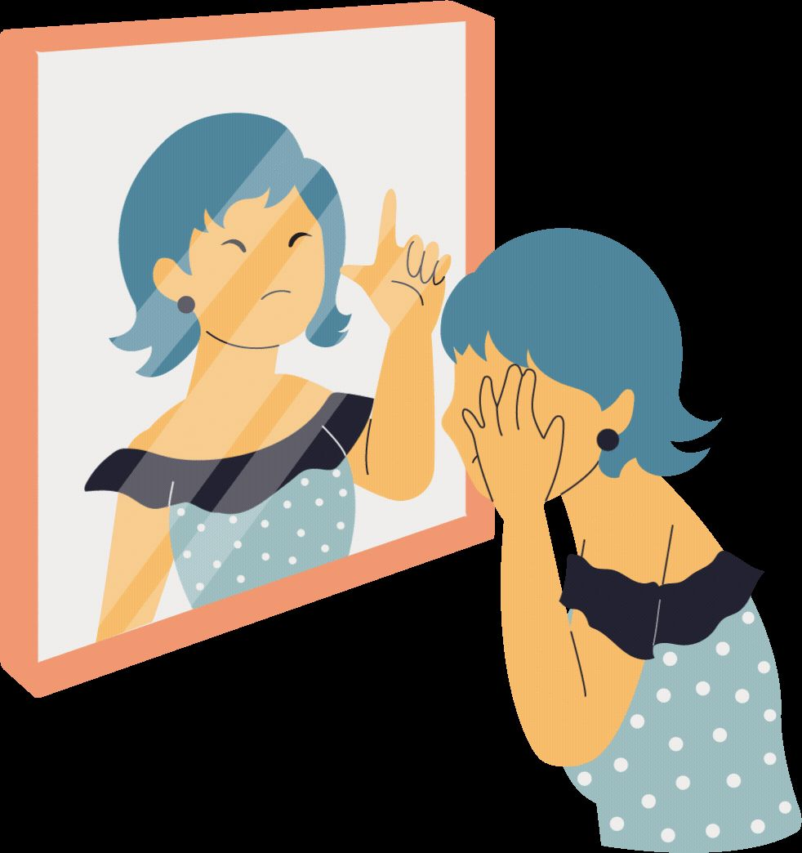
Positive Self-talk
We can often be our own worst enemy. We say things to ourselves that we would never say to anyone else and can really beat ourselves up and think the worst. If a child finds themselves being a bit unkind to themselves, or stuck with their worry thoughts, have them try saying some of these to themselves.
Notes:
Encouraging positive self-talk can be really important when considering our brains are wired to focus on the negatives.

Slide 30
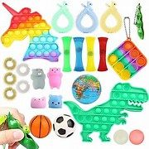
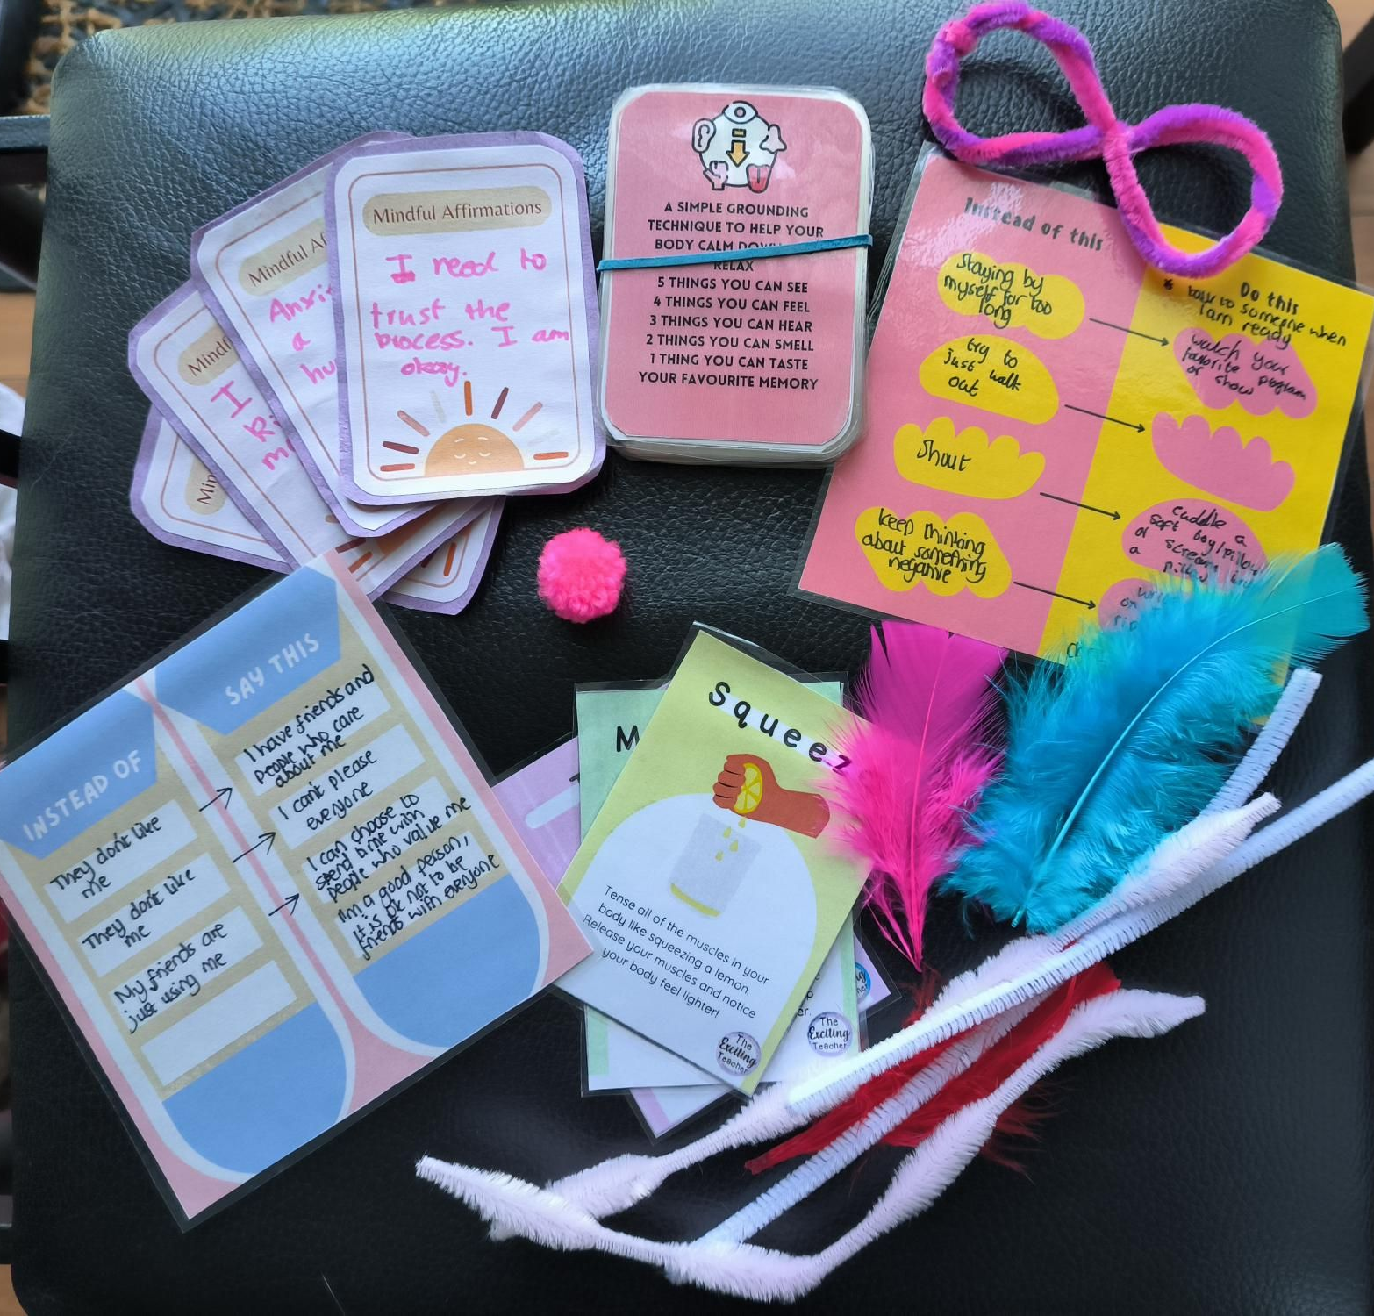
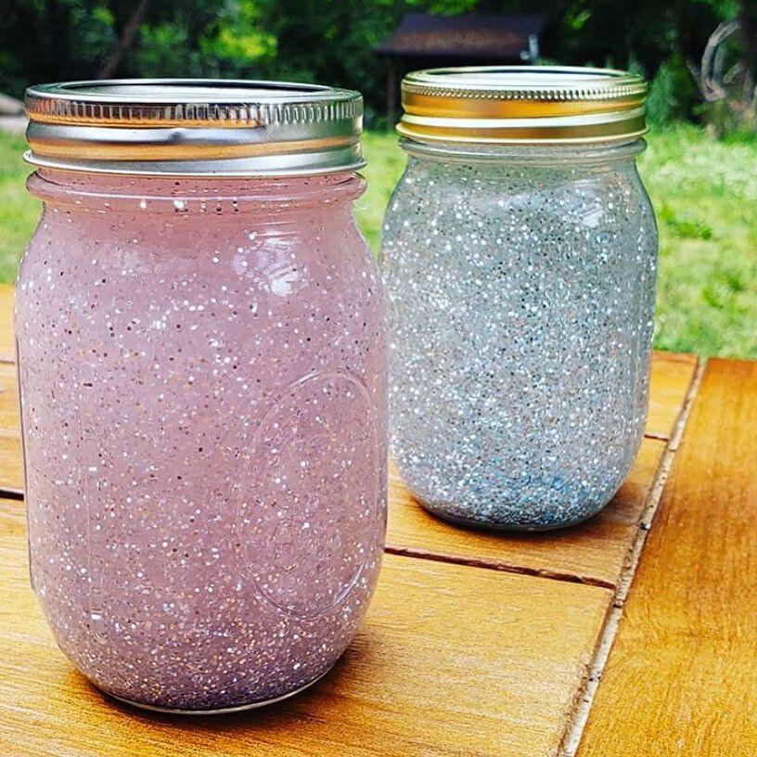
Self-soothe / calm down boxes
Notes:
Use of self-soothe / calm down boxes – specific to children

Slide 31
Key messages
Be mindful of risk factors for mental health difficulties in children and young people and common signs and symptoms of anxiety.
Validate and normalise difficulties
Support children in practicing breathing and grounding techniques
Work collaboratively with parents (presentation at home vs school may differ!)
Not all strategies will work for everybody – trial and error process

Slide 32
Signposting and further support
To make a referral to Solar, a referral form can be completed and found at: https://www.bsmhft.nhs.uk/our-services/solar-youth-services/professional/referrals/
Ordinary Magic - Ordinary Magic – Come Join the Fun
Practical resources / posters - https://weheartcbt.com/practitioner-resources
Managing Worries and Anxious feelings workbook for primary school children –
https://www.lpft.nhs.uk/young-people/online-workshops#
Ruby’s Worries - https://www.youtube.com/watch?v=lIS9Ang7cNg
The Huge Bag of Worries – Book
Fight-Flight-Freeze response: A guide to anxiety for kids - https://www.youtube.com/watch?v=FfSbWc3O_5M

Slide 33
Questions and Feedback

