Slide 1
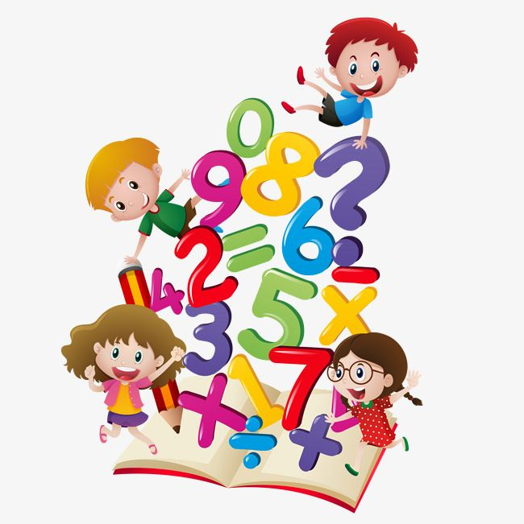

Mathematics at

Slide 2

Introduction
The maths team:
Miss Thornton
Mrs Nankivell (Maths mastery support)

Slide 3
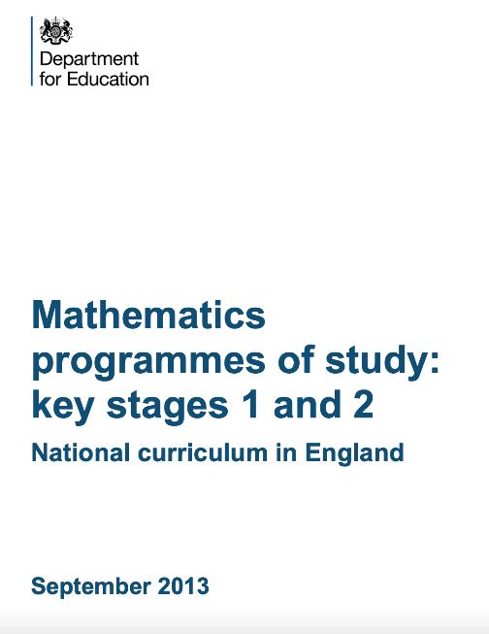
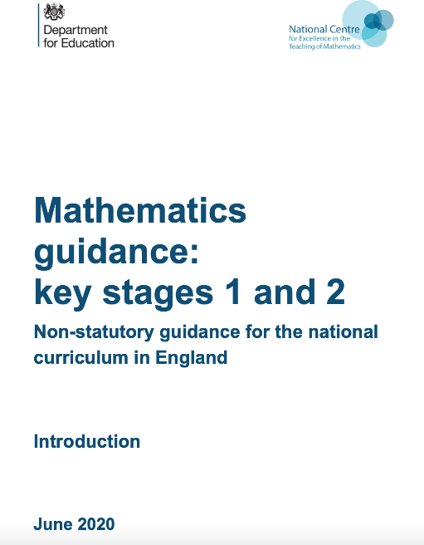

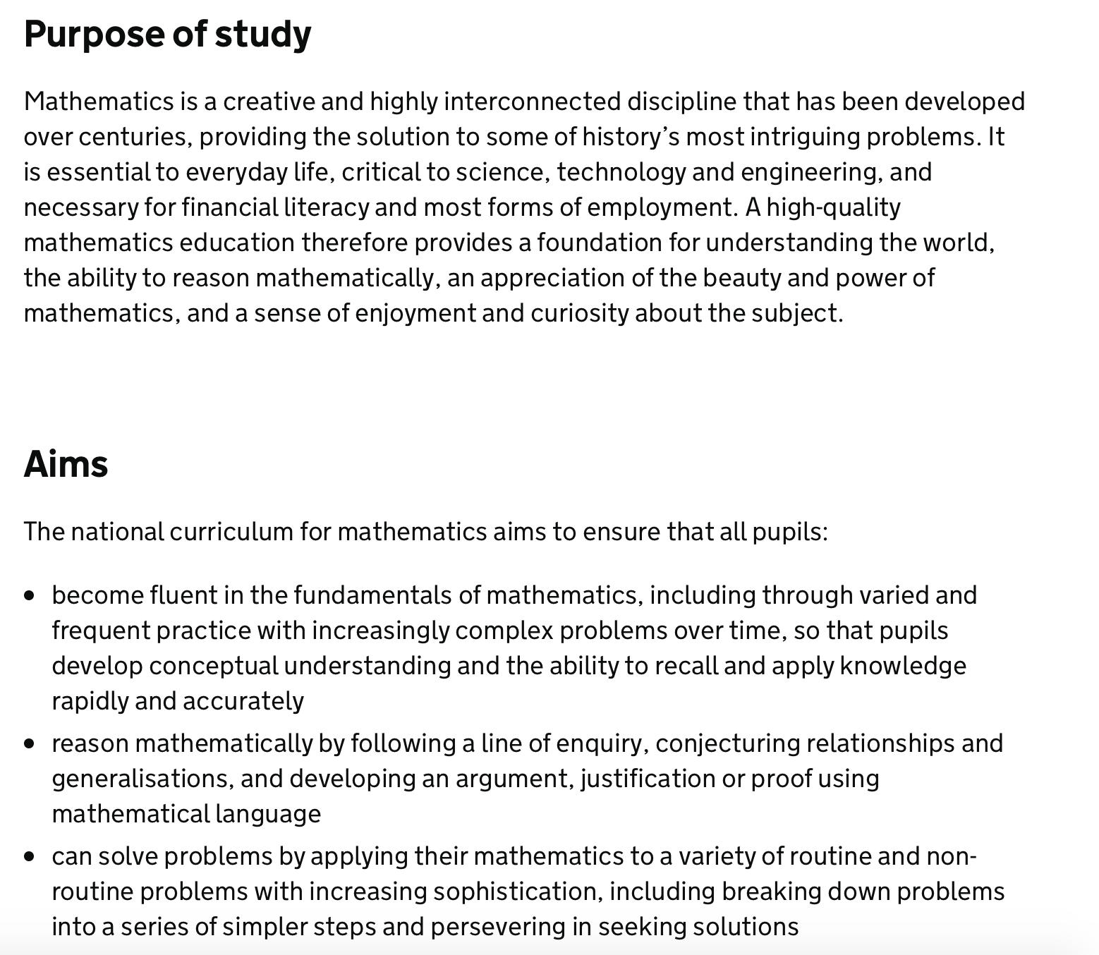
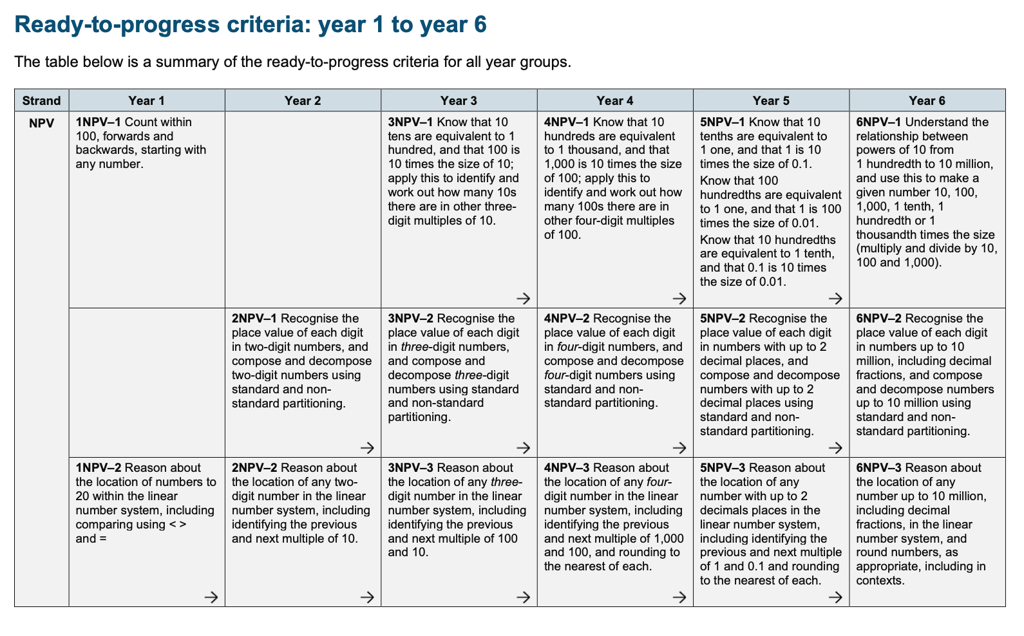
DFE Documents

Slide 4
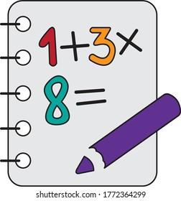

Maths Overview
Maths is taught daily, in line with the programme of study detailed in the National Curriculum for Mathematics; Maths lessons are carefully structured to move in small steps, and to include a variety of ways of presenting maths. The idea is to teach each concept in depth, before moving on too quickly.
Children are exposed to a wide range of mathematical structures and language from our lower years up, ensuring all children are able to become competent and confident mathematicians. All children are provided mathematical equipment and apparatus to assist their learning and ensure they have the tools to become able mathematicians.
Currently at Dorridge, we are on a progressive journey into becoming a mastery school. Miss Thornton and Mrs Nankivell are participants in the NCETM’s Teaching for Mastery work groups. Therefore, we are introducing routines and approaches which aim for all children to enjoy and learn in mathematics, by developing behaviours that engage learners and allow them to make mathematical connections no matter their ability.
National celebrations are acknowledged including NSPCC number day, which not only encourages the children’s love for maths, but also makes them aware of important charities within the UK.

Slide 5
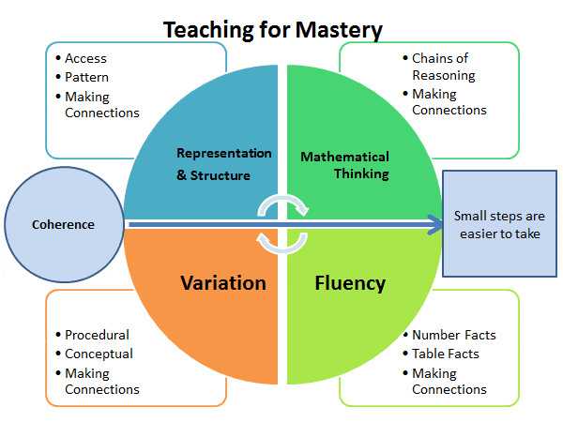
What is Teaching for Mastery?
Mastery of a mathematical concept means a child can use their knowledge of the concept to solve unfamiliar word problems, and undertake complex reasoning, using the appropriate mathematical vocabulary.

Slide 6
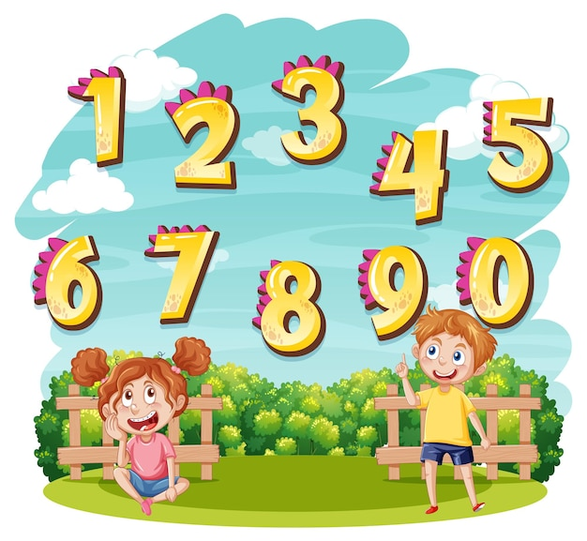
How is maths taught in EYFS?
Maths begins with our youngest children becoming familiar with number and recognising numbers and representations.
In the Early Years Foundation Stage (EYFS), teachers strive to ensure that children will develop a strong grounding in number, essential for gaining the platform to excel mathematically.
We intend for children to develop a deep conceptual understanding of the numbers to 10, the relationships between them and the patterns therein. By providing frequent, varied and engaging opportunities to build and apply this understanding, children will develop a secure base of knowledge from which
mathematical mastery is built.
In EYFS, we ensure that the children will:
Develop an understanding of number to 10, linking names of numbers, numerals,
their value, and their position in the counting order;
Subitise - to recognise quantities without counting - up to 5;
Automatically recall number bonds for numbers 0-5 and for 10, including
corresponding partitioning facts.
Automatically recall double facts up to 5+5;
Compare sets of objects up to 10 in different contexts, considering size and
difference;
Explore patterns of numbers within numbers up to 10, including evens and odds.

Slide 7

How maths is taught in KS1 and KS2?
R Time
R Time is used as a tool to allow children to recap and retain prior learning. Through short weekly sessions composed of a selection of questions generated by the class teacher, the children are supported to embed prior learning into their long term memory, and integrate new knowledge into larger ideas. In turn this keeps prior learning methods clear.
Recap: Last week; Rewind: Last Unit; Refresh: Last Year
Anchor tasks
Anchor tasks are used across KS1 and KS2 as a tool to recap and review prior learning, and introduce new learning. Teachers use these as a marking tool to assess current and new learning alongside the children.
Lesson structure
Our lessons follow a similar structure across the school. The children begin with either an
R Time or Anchor task, followed by the days learning. This may be consolidation of the
previous day if required, or progression onto the next step.
Assessment/interventions
At Dorridge, we use both formative and summative assessment tools. Our summative
assessment is carried out through the use of termly NTS tests. This works alongside the
White Rose Scheme of Learning, and only assesses the children on the learning and units of
work they should have completed at that point in the school year. Our formative
assessment is ongoing throughout lessons on a daily basis by both teachers and TLSA’s.

Slide 8
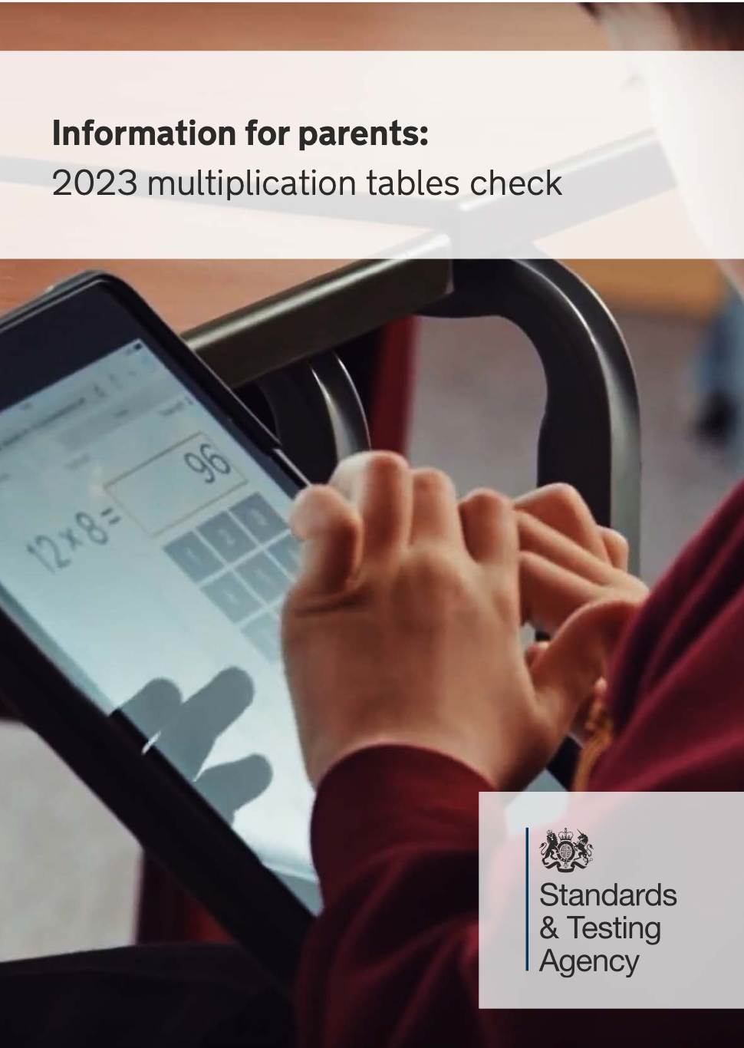
Multiplication tables check – Year 4
The MTC was introduced by the DFE to determine whether pupils can recall their times tables fluently. Over the duration of their mathematical education at Dorridge, from Year 1 to Year 4 every child will be expected to learning their multiplication tables. This is broken down into progressive, manageable steps for the children.
Each year group will focus on and embed different tables to ensure the children are given the best opportunity to learn their tables.
Year 1 – 2’s, 5’s and 10’s
Year 2 – 2’s, 5’s, 10’s and 3’s
Year 3 – 3’s, 4’s and 8’s
Year 4 – 6’s, 7’s, 9’s, 11’s and 12’s.
By the time the children reach year 4, they are able to use their previously learnt tables to assist them with their new tables.
This year, the MTC must be administered between:
Monday 5 June and Friday 16 June 2023
https://assets.publishing.service.gov.uk/government/uploads/system/uploads/attachment_data/file/1116420/2023_Information_for_parents_Multiplication_tables_check_Nov_22_PDFA.pdf

Slide 9


Maths homework
The children are set weekly mathematics homework through Mathletics. This will consolidate and work alongside their current unit of work. They will usually be set 2-3 tasks which they should be able to complete with little to no help. We encourage parents/carers to allow the children access to equipment, paper, pens to assist their homework completion, just as we would in school.
When the children are completing their Multiplication and Division units,(in years 2-6), the teachers may set the children a challenge on Times Table Rock Stars instead. We encourage all children to access TTRS regularly on top of their Mathletics tasks to aid their multiplication facts knowledge.

Slide 10


Thank you!

