Slide 1
Welcome to Year 4 at
Dorridge Primary School

Slide 2
The Year 4 Team
Miss Lloyd (4D) Year Leader and DPC Lead
Mrs Nankivell (4P) Maths Support and Music Lead
Miss Gee (4S)
Mrs Harden, TLSA
Notes:
GL

Slide 3


English
Taught in classes
Autumn Term:
The Promise by Nicola Davies
How to Train Your Dragon by Cressida Cowell
Dare to care: Pet Dragon by M. P. Robertson and Sally Symes
The Jabberwocky by Lewis Carroll
Homework- Deadline for this is a Friday.
Spellings every week, Monday to Thursday, Spelling test on Friday
Alternating comprehension/grammar homework.
Spellings tailored to child’s abilities, but still exposed to Year 4 spellings for vocabulary
Notes:
GL

Slide 4
Reading
In school:
Reading Time, whole class shared reading, discussing and reading the texts over a term.
Example texts
The Lion, The Witch and The Wardrobe, Charlotte’s Webb and Varjak Paw.
At home:
Daily reading at home, please discuss their reading with your child. Record and sign in the Home School Organiser
Half termly Reading Assembly
Teachers will check this weekly, record, and a message sent home if reading is not done or recorded.
Children will be rewarded with dojos and raffle tickets
Children should have a reading stage book and a library book. Teachers will move children to the next stage when appropriate and at their discretion.
Notes:
GL

Slide 5
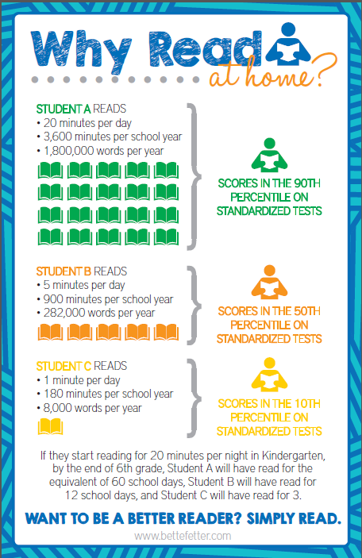
Notes:
GL

Slide 6
Maths
Following White Rose mastery planning,.
Homework:
Given out on Tuesday
Mathletics which results and completion will be monitored
TT Rock Stars
Children have their passwords in HSO’s.
Notes:
MG

Slide 7
Multiplication Tables Check
- Tests children’s multiplication knowledge and fluency.
- 25 questions, 6 seconds to answer each question.
https://www.timestables.co.uk - Pupils can access different games and tests for all times tables. This website also has a replica of the MTC, which can be found on the menu.
https://www.theschoolrun.com/maths/times-tables - This website has lots of free resources for supporting times tables recall.
https://www.topmarks.co.uk/maths-games/7-11-years/times-tables
Times Tables songs are available on YouTube or the BBC Super Movers songs which your child will have used in class.
https://youtu.be/GhAJMJUsAac
Notes:
MG

Slide 8
DPC UNITS
Autumn
Brainwaves
Footprints from the Past
Spring
Active Planet
(Earthquakes, volcanoes and tsunamis)
Summer
The Great, The Bold and The Brave
(Romans, Celts, Anglo Saxons and Vikings)
Notes:
SB

Slide 9
Trips and Events
Autumn Term
- Oxford History Museum
- Visit from Teach Rex
- Pantomime
Christmas Production
Guitar Lessons
Spring and Summer trips to be arranged and confirmed.
Notes:
SB

Slide 10
PE
Wednesday PM for all classes
Children should come into school in their PE kits
Hair should be tied back for boys and girls
Earrings should be removed or covered if they are newly pierced.
Notes:
GL

Slide 11

Home School Organiser
We promote Organisation, Independence and Communication
Please remind your child to bring it home each night and back to school the following day
Please check and sign reading daily. Comments are welcome too.
Monitoring carried out by the teacher once a week.
If your child is being collected by another parent/adult, please let the teacher know or write any messages to teachers in the HSO.
Notes:
GL

Slide 12
Equipment
Simple pencil case: pencil, rubber, sharpener, ruler, glue stick, Pencil crayons, felt pens.
This year, all children will be using pens during the Autumn term. We request that children come to school equipped with either a blue Friction pen or a blue Berol Handwriting.
Notes:
MG

Slide 13
Sanctions
REWARDS
Dojos
Caught being Kind
Weekly Endeavour Certificate
Celebration Assembly
Postcards
Head Teacher awards
Outstanding Work
Thinking time – reflecting on the incident. Chill Out Zone
Behaviour logs - not making the right choices on the playground or in assembly
Notes:
SB

Slide 15


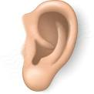



Slide 17
at Dorridge Primary School

